Slide 1

Supporting Early Career Educators: Teacher Induction Professionalism Series
Michele Stephens
Chief Human Resources Officer
Rockdale county public schools
eHCLE Capstone project

Slide 2
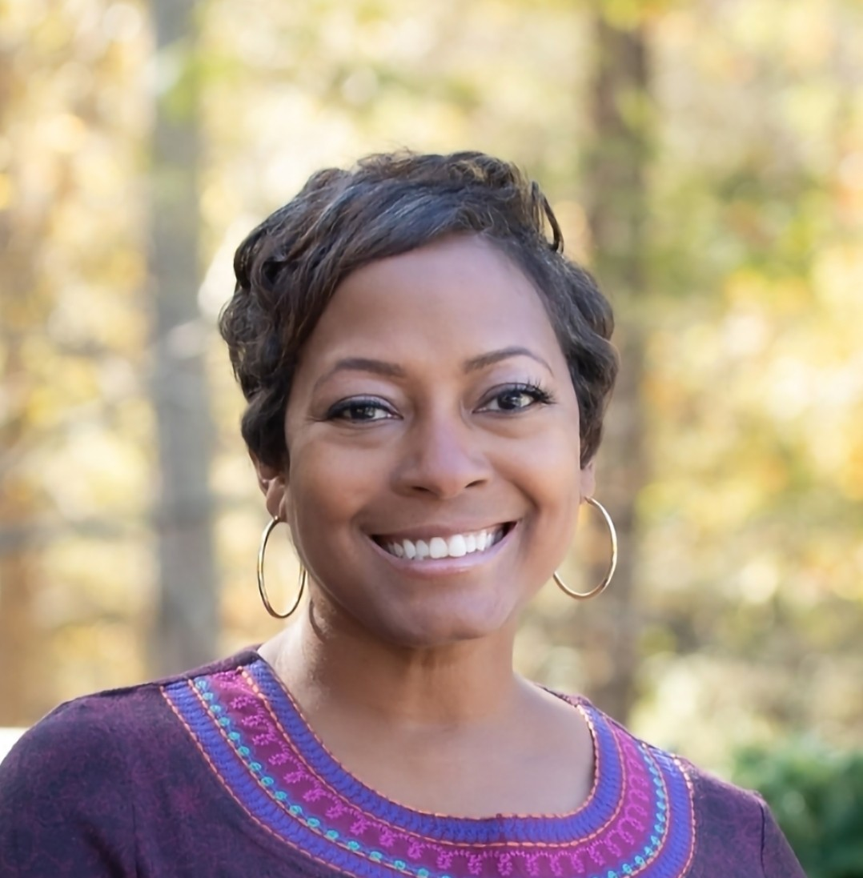
Presenter
Michele Stephens
Chief Human Resources Officer, Rockdale County Public Schools
Notes:
Background info re: counseling, special education and HR.

Slide 3



About RCPS
Located in Metro Atlanta
Enrollment of approximately 15, 000 students
3 traditional High Schools, 4 middle schools and 11 elementary schools
Rockdale Career Academy, Rockdale Magnet School and EPIC Center

Slide 4

Who are you guys? ☺ Where are you from?
Notes:
Wait time… show the results

Slide 5
Organizational Needs
Anecdotal data from principals and HR investigations show new Special Education teachers struggle with:
Classroom management
Instructional delivery
Professional conduct
Notes:
The original focus was on all new teachers, but that was a bit daunting from an HR standpoint. This comprehensive professional development series is specifically designed to equip first-year Special Education teachers with the foundational knowledge and practical strategies necessary for a successful and impactful career. Recognizing the unique challenges faced by new educators in this critical field, the series aims to foster confidence, enhance pedagogical skills, and ensure effective support for students with diverse learning needs. Participants will engage in targeted learning experiences that address common areas of difficulty, promoting a proactive approach to classroom leadership and instructional excellence.
Recent observations and internal data highlight a pressing need for specialized support for first-year Special Education teachers. Anecdotal evidence, corroborated by discussions with Building Principals and district Special Education Administration, indicates that many new teachers struggle with key aspects of their role, including **effective classroom management**, **differentiated instruction**, and **appropriate behavioral redirection strategies**. Furthermore, insights gleaned from Human Resources investigations reveal that a significant number of disciplinary actions against teachers stem from initial missteps in these very areas. This series directly addresses these identified gaps, providing timely intervention and robust training to mitigate potential challenges and cultivate a highly effective teaching workforce from the outset. By investing in our new Special Education teachers, we aim to reduce turnover, improve student outcomes, and uphold the highest standards of professional conduct and instructional quality.

Slide 6
Why?
If we provide targeted support to new Special Education teachers,
Then they will be more successful and more likely to be retained.
Target Group: 30-40 first/second year Special Education teachers (SY25-26)
Notes:
Theory of action statement

Slide 7
Special Education New Hires
For the 25-26SY, we hired 50 new (to the district) special education teachers.
22/50 were not certified at the time of hire.
15/50 were first-year teachers.
Only three of the 15 first-year teachers were certified at the time of hire.

Slide 8
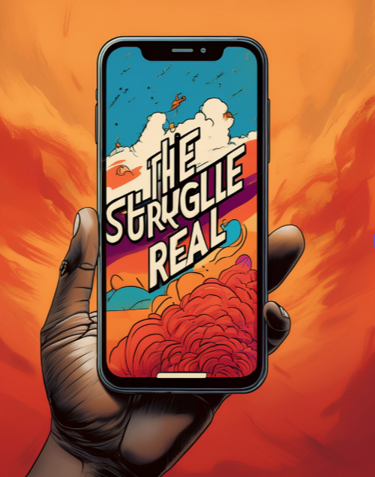
Act 1: Adventures in Struggling Teacherland
Notes:
Day after day, it's the same old thing. Teachers making poor judgment calls that land them in the hot seat. Sometimes that's a meeting with HR, sometimes that's looking for a new job altogether. It's gotten so bad that people don't even want to teach. "It's not worth it!" "These kids are terrible!" "I didn't like school the first time around." What are we to do? How are we going to serve our children? When we find teachers, how can we keep them? We have got to come up with a plan to support our new and struggling teachers!

Slide 9
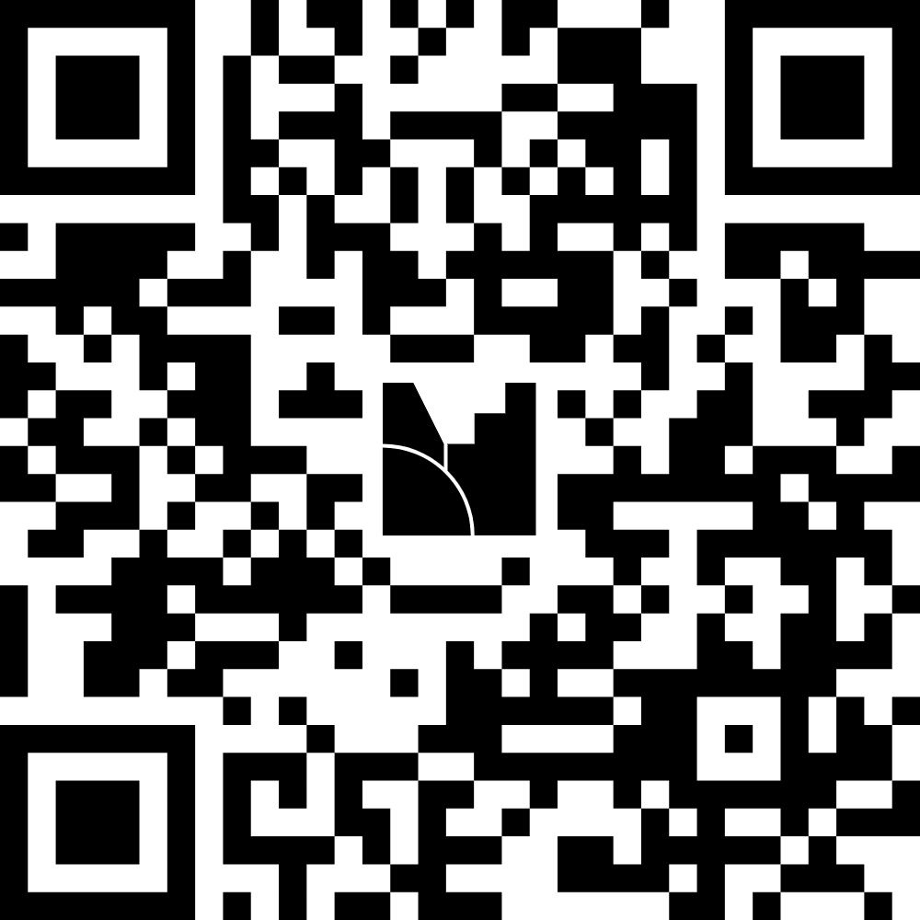
Who feels my pain?
Notes:
Wait time… show the results

Slide 10
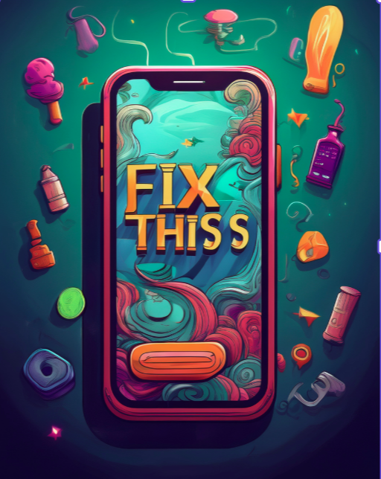
Act 2: What’s the Plan?
Notes:
Chat

Slide 11
Goal 1: Professional Development
Conduct at least 3 PL sessions
Principal support and marketing
80% attendance rate (formative)

Slide 12
Professional Learning Topics
Professionalism (ongoing)
Organizational Structure
IEP Best Practices (ongoing)
Classroom Management (ongoing)
Certification Plans
School Calendar Events
Notes:
EX: appropriate apparel, adhering to the schedule; LTECs, Coordinators, Directors- school based staff

Slide 13
Goal 2: Increase Teacher Effectiveness
Increase certification rate from 20% to 40% by the end of the school year. (Baseline SY25 19% to 28%)
Monitor enrollment and progress in certification programs
Notes:
We hire provisionally certified teachers.

Slide 14
Strategic Alignment
Supports district mission to improve teacher effectiveness and retention.
Aligns with strategic goals for professional development and certification.
Notes:
How does this align with our strategic plan?

Slide 15

Collaboration and Support: What did that look like?
Collaboration amongst the following groups
Human Resources leadership
Department of Exceptional Children leadership
Department of Professional Learning leadership
Community Partners
Notes:
Georgia United Credit Union, University Partners

Slide 16
Timeline of Key Activities
Apr. 2025
Planning with Principals
May 2025
Planning with Exceptional Children and Teacher Induction
July 2025
Pre-planning PL Session
Aug. 2025
Teacher Workday PL Session
Oct. 2025
Virtual PL Session
Jan. 2026
In-person PL Session
Mar. 2026
Virtual PL Session
May 2026
End-of-Year Celebration
Notes:
Dr. Tyra Simon

Slide 17


New Teacher Induction Cohort (NTIC)
Session 1
August 11, 2025
Notes:
Dr. Tyra Simon, Director of Exceptional Children

Slide 18
Agenda
8:30 AM – 8:45 AM | Welcome & Introductions | Opening remarks by Chief Michele Stephens & Dr. Tyra M. Simon Overview of the Cohort’s purpose and goals
8:45 AM – 9:15 AM | Icebreaker Activity | Building community among cohort members
9:15 AM – 12:30 PM | Chapter One: “Welcome to Your Professional World” | From the Survival Guide for New Special Education Teachers Understanding the role of a Special Education Professional Setting expectations for professional growth Key skills for success in the first year aligning with the 5 Priorities: A. B. C. D & E
12:30 PM – 1:30 PM | Lunch (On Your Own)
1:30 PM – 3:00 PM | Human Resources & School Safety and Security | HR Overview – Chief Michele Stephens School Safety and Security Overview – Director Darren Greene
3:00 PM – 3:30 PM | Closing & Next Steps | Reflection on today’s learning Overview of upcoming cohort sessions and topics Q&A
Notes:
Director Simon created this with her team.

Slide 19

Resources Utilized:
Notes:
Dr. Simon, Director, reviewed this text. It was purchased by PL using Title II-A resources. Guiding the work of this cohort.

Slide 20
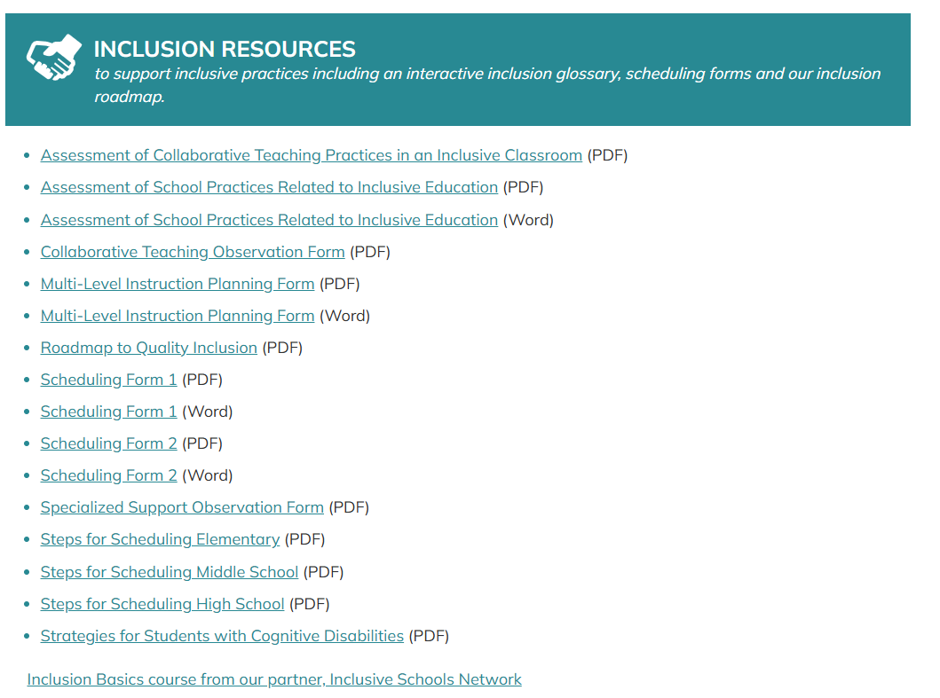
Stetson & Associates, Inc.
Notes:
Free resource for teachers, but request permission. Inclusion resources, Diff instruction resources, collaborative teaching resources, and Paraeducator resources.

Slide 21

The Georgia Code of Ethics for Educators
Standard 1: Legal Compliance
Standard 2: Conduct with Students
Standard 3: Alcohol or Drugs
Standard 4: Honesty
Standard 5: Public Funds and Property
Standard 6: Remunerative Conduct
Standard 7: Confidential Information
Standard 8: Required Reports
Standard 9: Professional Conduct
Standard 10: Testing
Notes:
Georgia Professional Standards Commission (GaPSC)

Slide 22
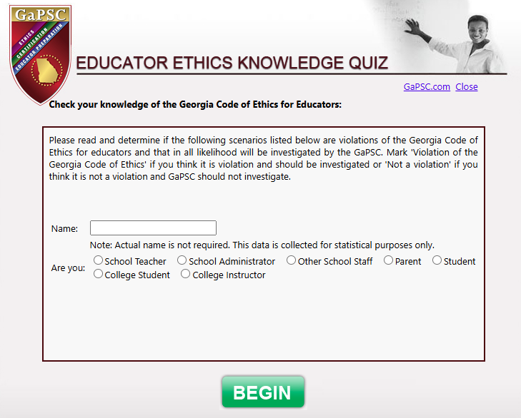

Educator Ethics Knowledge Quiz
Violation or NOT???
Notes:
Ethics Questions courtesy of the Georgia Professional Standards Commission

Slide 23
Best Practices in the Classroom
Practice emotional balance
Collaborate on challenging situations
Refrain from unnecessary physical contact
Recognize when it’s time to take a break
Avoid punitive responses
Focus on de-escalation rather than escalation
Ensure compliance with fidelity
Use positive verbal and non-verbal communication
Don’t hesitate to ask for help
Rely on your training when times get tough.
Notes:
Jamal Buster, HR Investigator

Slide 24
HR Investigations (through November)
2024-2025 SY
2025-2026 SY
15 teacher investigations
13 substantiated allegations
Special Education teachers- 2 substantiated
15 teacher investigations (Date 11/11)
10 substantiated allegations
Special Education teachers- 4 substantiated including one from the cohort
Notes:
Professional Conduct. Comparison of investigative reports from last year to this year? Through November

Slide 25

Certification Plan paired with Professional Learning Plans
The certification plan should be uploaded along with the Professional Learning Plan (PLP).
Who needs a PLP?
Induction level teacher or administrator
Educator returning to the profession after an absence of one or more years
Educator who is new to Georgia
Educator who is working in a field that requires a non-renewable certificate
Educator who is working in a certification field in which the educator has not worked before or has not worked in Georgia for a long period of time even though the educator is certified in this field
Educator whose summative evaluation rating is Level I or II (out of four)
Notes:
Certification plans are

Slide 26

Certification Plan Process
You will meet with your Principal, or Assistant Principal, to create plan to that addresses:
GACE Testing requirements (i.e. Registration, score reports)
University program enrollment, transcripts
Completion of a University program or Georgia Teacher Academy for Preparation and Pedagogy(GaTAPP) acceptance/completion
These meetings will occur 3-4 times a year to monitor your progress prior to the issuance of a teacher contract.
Notes:
Progress needed to achieve second contract

Slide 27

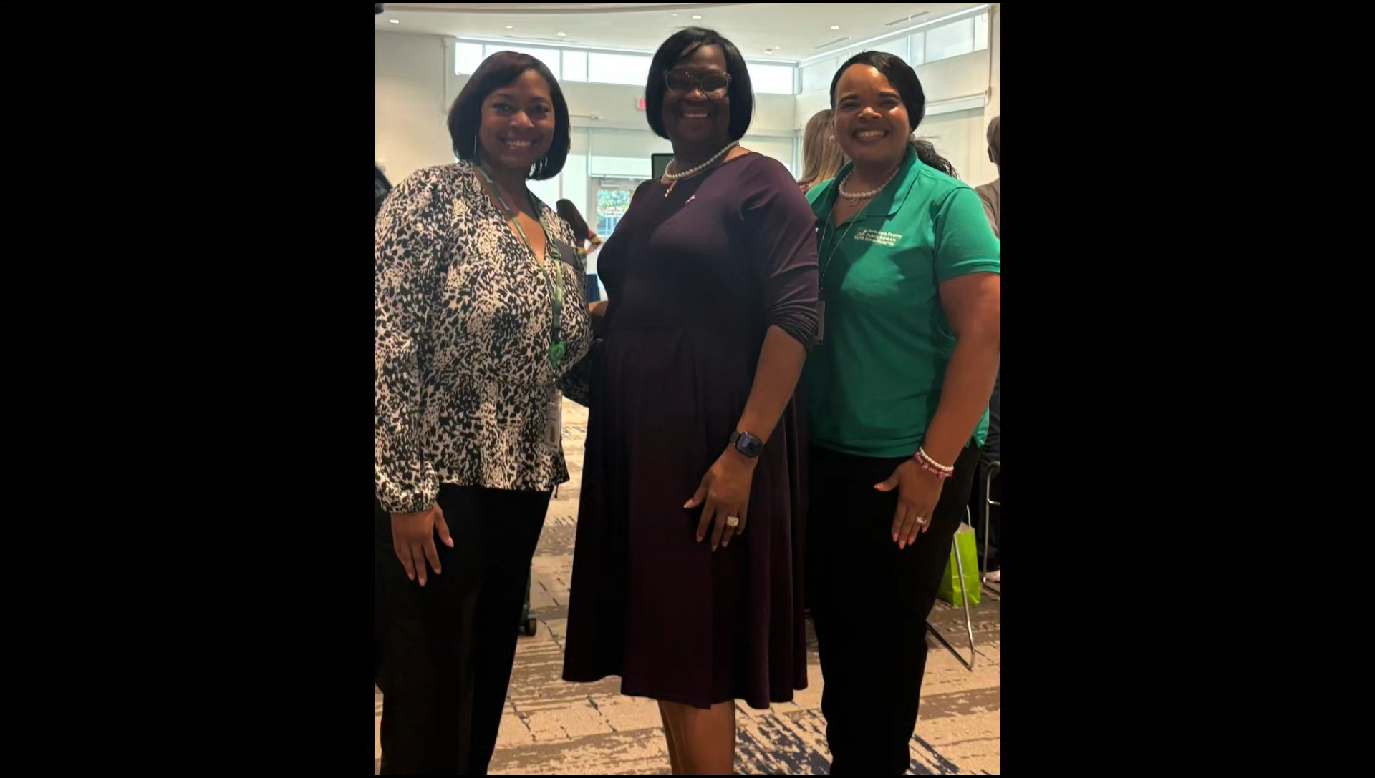
Connecting our Educators to Universities
Notes:
University Partner Fair

Slide 28
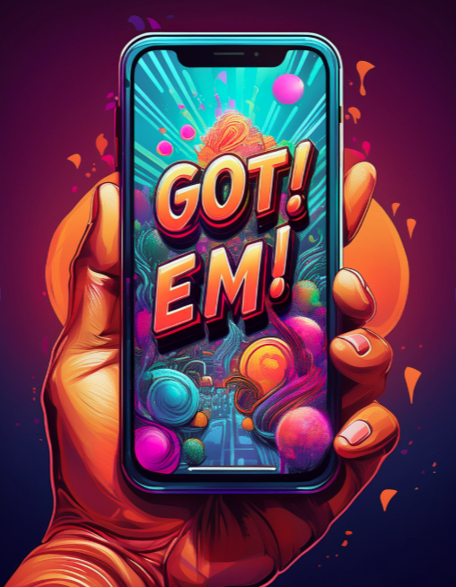
Act 3: Shiny, Happy Teachers Holding Hands … Hopefully
Notes:
Hopefully…. https://youtube.com/clip/UgkxM5N1iLRTtkflVj6153pUl6m5KUIpcY4-?si=tI09zssqZdBkbtgy
We are only halfway thorugh/.

Slide 29
What’s the cost involved?
School day subs- one day at a cost of$5,600
Books- Set of 50 to support the Educators
The training was primarily provided from in-house personnel: Special Education Directors and Coordinators, Instructional Coaches, HR Leadership and the HR Personnel Investigator.
Notes:
Planned primarily on days where students were out, no subs ; 40 subs at approx. $140 each
Books cost $29 each via the Council for Exceptional Children, but bulk pricing is available

Slide 30

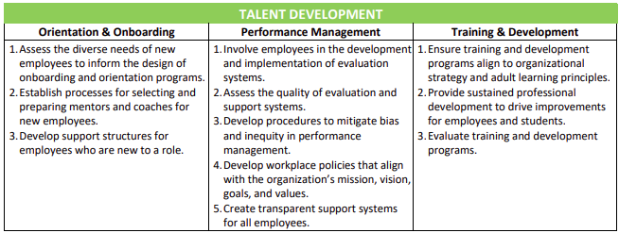
Alignment with eHCLE Standards
Notes:
Training and Development--- surveys that we intend to

Slide 31
Data Collection and Analysis
Sources:
Retention data
Evaluations
Certification progress
Principal input
Analysis:
Mid-year and end-of-year surveys
Certification tracking
Teacher surveys analyzed after each session to inform planning

Slide 32
Questions?
Michele Stephens
mstephens@rockdale.k12.ga.us

Slide 33
Note of Appreciation
Thank you to the American Association of School Personnel Administartors (AASPA) and the Experience Management Community.
A special thank you to my coach Dr. Naima Khandaker and my groupmates, Dr. Charles Ogdan and Lydia Gaddis ,for all of your advice and the thoughtful feedback this year!

