Slide 1
pHCLE Study Group
Talent Management & Development
Instructor: Danette Meyer
May 12, 2021

Slide 2
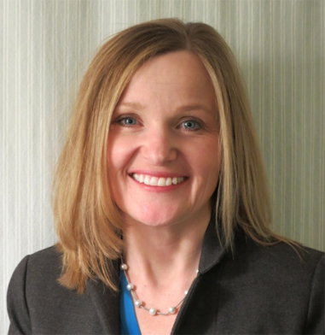
      Danette Meyer, pHCLE
      Assistant Superintendent for Human Resources
      Shaumburg SD54
      DanetteMeyer@sd54.k12.il.us
      847-357-5096
      Twitter: @DanetteMeyer54
© 2021, American Association of School Personnel Administrators. All Rights Reserved.

Slide 3
Tell us what you think!
In the chat please share...
What was your favorite part of last week’s study session?

Slide 4
      Study Session Outline:
      Introductions
      Preparing for the exam
      How I prepared…
      Checking for baseline understanding: Kahoot!
      Reviewing each quadrant:
        pHCLE Standards
        Instructor Examples
        Q&A
      Final Practice Questions
      Overall Q&A
      Study Session Purpose:
      Gain strategies to prepare for your exam
      Briefly review four areas of the standards
      Learn from instructor examples
      Check your understanding with practice test questions
      Answer your questions about the exam
© 2021, American Association of School Personnel Administrators. All Rights Reserved.
Notes:
Invite others to share their examples.

Slide 5

Preparing for your Exam
Reading Reference Guide
The pHCLE Reading Reference Guide is resource to help you engage in a self-study program for the certification exam. The guide defines key terms and provides links to suggested readings to help you further your learning. Topics are organized by the Human Capital Leaders in Education Professional Standards.
AASPA Recorded Webinars
AASPA offers recorded webinars as an additional resource for our members. Webinar topics are researched, created, and delivered by AASPA members. All webinars align with HCLE standards and some are eligible for HRCI or SHRM re-certification credit.
Study Sessions
These sessions will be recorded and accessible to review after the they are completed.
Other Professional Development Activities
Other growth and development activities such as reading HR books and articles, attending an HR conference, taking classes, etc. will help prepare individuals for the pHCLE exam.
© 2021, American Association of School Personnel Administrators. All Rights Reserved.

Slide 6
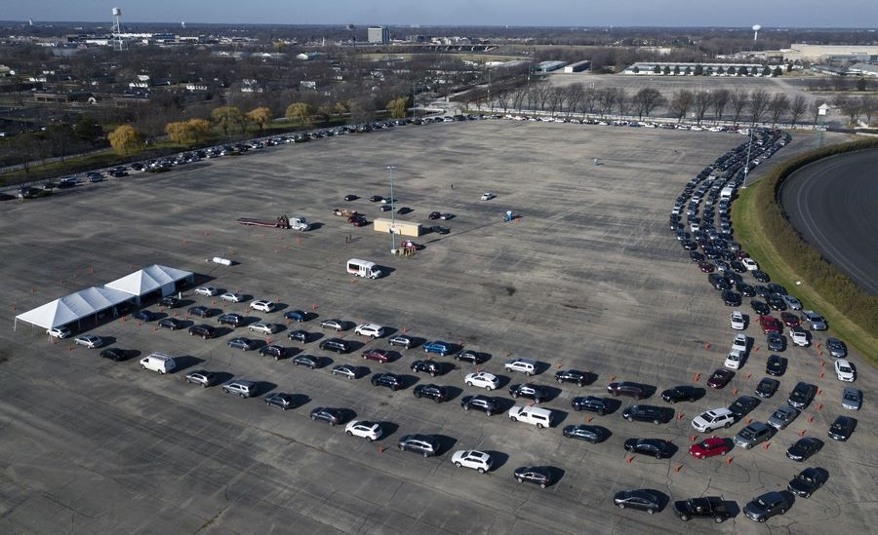
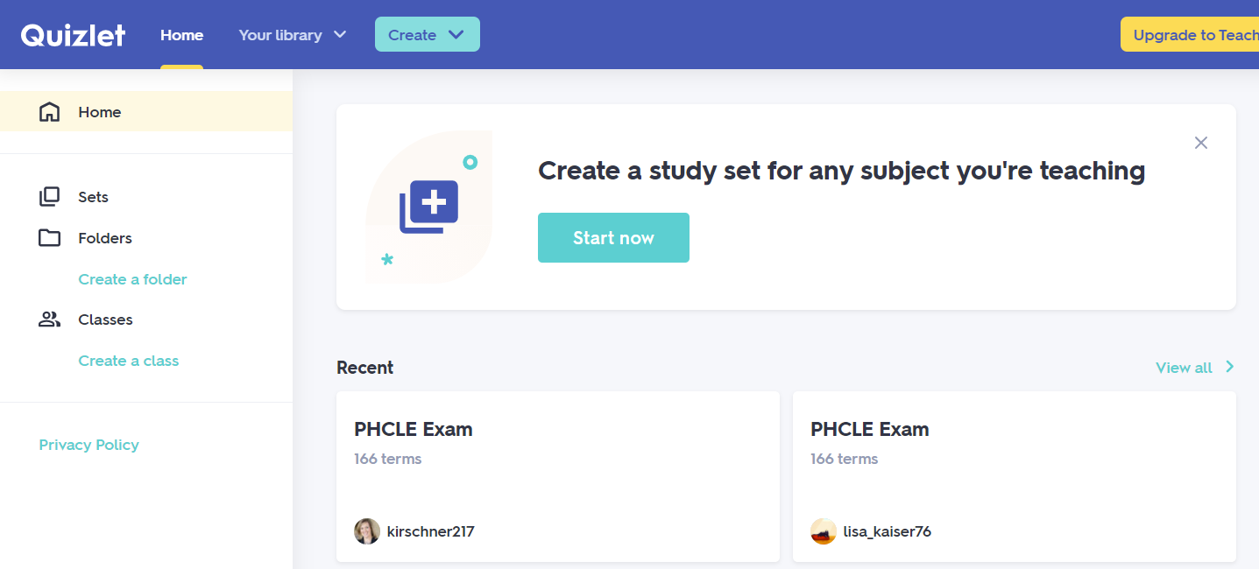
      Danette Meyer Study Plan
      Read all the online course content and participated in the learning sessions.
      Studied the terms by using the 2 pHCLE decks on Quizlet.
      Made my own examples to
      practice the formulas.
© 2021, American Association of School Personnel Administrators. All Rights Reserved.

Slide 7

Talent Management & Development
Onboarding
Training & Development
Performance Management
Career Ladders & Succession
pHCLE Exam Weight:
20%
Planning

Slide 8


Check Your Understanding: Talent Management & Development

Slide 9

Onboarding
Process of helping new employees adjust to the performance and cultural aspects of their new roles over an extended period of time

Slide 10
Onboarding
HCLE Standard | Content Outline | Terms & Definitions
T.ON.1 Orient new employees to the organization. | Orientation How employee handbooks and other communication channels can be used to communicate workplace policies and protocols. Types of information (i.e., organizational, job-specific, community) included in a comprehensive orientation experience. | Employee Handbook: Document used to communicate important workplace policies and expectations to employees. Onboarding: Process of helping new employees adjust to the performance and cultural aspects of their new roles over an extended period of time (often 6 months or more) Orientation: Process that focuses on paperwork and other compliance activities for new hires. Typically is a one-time event held before an employee begins their new job. Types of Information: Comprehensive orientation and onboarding programs introduce new employees to their role and work team and help them learn about the organization and the community it supports. Organization information: e.g., District overview, Vision, mission, and goals, Facilities, Organizational policies and rules, Benefits and employee support services Job-specific: e.g., Job duties and expectations, Department or team goals, Introduction to manager and colleagues Community: e.g., Relocation information, Local businesses, Banking, Transportation
T.ON.2 Onboard new employees. | Purpose and core components of a job description Job analysis | Coaching: Relationship between two individuals that tends to be short-term and focused on improving performance. Mentoring: Relationship between two individuals focused on long-term development toward career goals and objectives.
© 2021, American Association of School Personnel Administrators. All Rights Reserved.

Slide 11
T.ON.1 Orient new employees to the organization.
Orientation
Onboarding
Orientation
Helps new employees acclimate to their job and your organization
Involves a series of events and ongoing support
Longer duration
(6 mths or longer)
Onboarding
Tends to emphasizes transactional activities (e.g. benefits enrollment, paperwork, key policies) ​
One-time event typically held before employee’s first day​
Shorter duration
© 2021, American Association of School Personnel Administrators. All Rights Reserved.
Notes:
Walk through image
Share an example of how YOUR district approaches this process

Slide 12
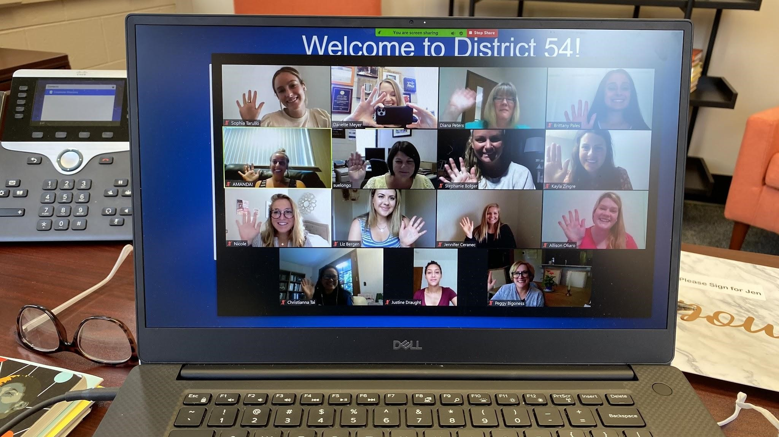
Orientation: Maximizing Opportunity

Slide 13
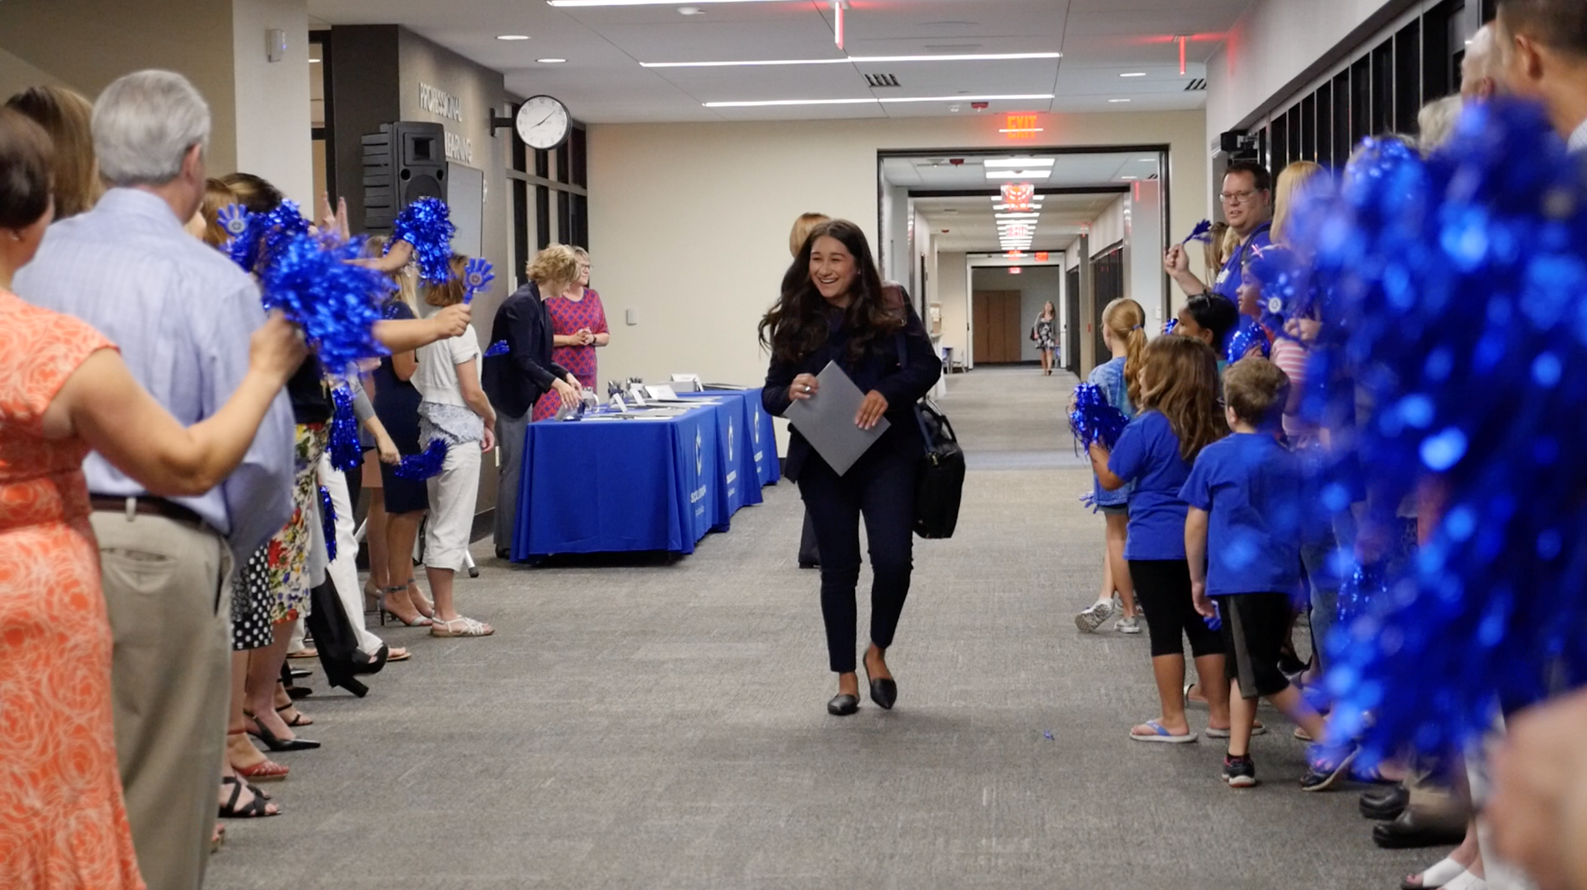
Induction Week: Day 1 Peak Moment

Slide 14
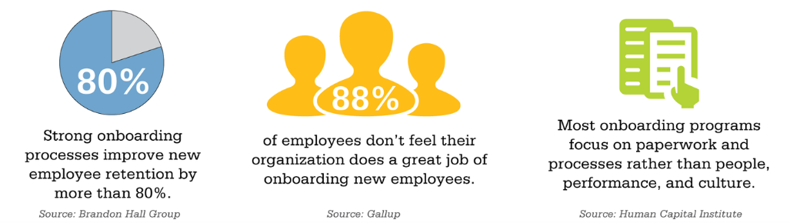
T.ON.2 Onboard new employees.

Slide 15



T.ON.2 Onboard new employees.
Coach
Mentor
Focus: Improving performance in current job
Task-oriented
Short-term relationship
Focus: Personal growth & long-term career development
Relationship-oriented
Long-term relationship
Notes:
As
k this:

Slide 16
Onboarding
HCLE Standard | Content Outline | Terms & Definitions
T.ON.1 Orient new employees to the organization. | Orientation How employee handbooks and other communication channels can be used to communicate workplace policies and protocols. Types of information (i.e., organizational, job-specific, community) included in a comprehensive orientation experience. | Employee Handbook: Document used to communicate important workplace policies and expectations to employees. Onboarding: Process of helping new employees adjust to the performance and cultural aspects of their new roles over an extended period of time (often 6 months or more) Orientation: Process that focuses on paperwork and other compliance activities for new hires. Typically is a one-time event held before an employee begins their new job. Types of Information: Comprehensive orientation and onboarding programs introduce new employees to their role and work team and help them learn about the organization and the community it supports. Organization information: e.g., District overview, Vision, mission, and goals, Facilities, Organizational policies and rules, Benefits and employee support services Job-specific: e.g., Job duties and expectations, Department or team goals, Introduction to manager and colleagues Community: e.g., Relocation information, Local businesses, Banking, Transportation
T.ON.2 Onboard new employees. | Purpose and core components of a job description Job analysis | Coaching: Relationship between two individuals that tends to be short-term and focused on improving performance. Mentoring: Relationship between two individuals focused on long-term development toward career goals and objectives.
© 2021, American Association of School Personnel Administrators. All Rights Reserved.

Slide 17

Training & Development
Learning activities that support the acquisition of skills, knowledge, and abilities

Slide 18
Training & Development
HCLE Standard | Content Outline | Terms & Definitions
T.TD.1 Coordinate training and professional development programs. | Two types of adult development (i.e., horizontal, vertical), and how to support both through training and development. Implications of zones of safety (i.e., risk zone, danger zone) for learning. Principles of adult learning (i.e., self-directed, transferrable, connected, experiential, goal-oriented), and implications for professional development. | Adult Learning Principles: Self-directed- Provides choice and opportunities to prioritize activities. Transferrable: Has real-life use in their current role. Connected: Builds on what learners know and do well while extending their thinking. Experiential: Provides opportunities for processing, hands-on application, and reflection. Andragogy: The method and practices of teaching adult learners. Horizontal Development: Acquiring new knowledge, skills, and competencies. Professional Development: Learning activities that expand skills, knowledge, and abilities to support personal growth and career advancement; also referred to as professional learning. Training: A learning activity focused on the acquisition of knowledge and skills required for a particular job or task. Vertical Development: Advancing the capability to think in more complex, systemic, and interdependent ways. Learning Zone Model: Model that can be used for designing learning experiences. Divides the experience of learning into three zones. Comfort Zone- Limited opportunity for learning. Often involves routine tasks that don’t require individuals to acquire new knowledge or skills. Can provide a safe space for individuals to reflect and make sense of their experiences. Risk Zone- Optimal space for learning. Requires individuals to stretch beyond their current capabilities. Danger/Panic Zone: Learning is blocked by fear and anxiety. Individuals feel overwhelmed by expectations.
© 2021, American Association of School Personnel Administrators. All Rights Reserved.

Slide 19
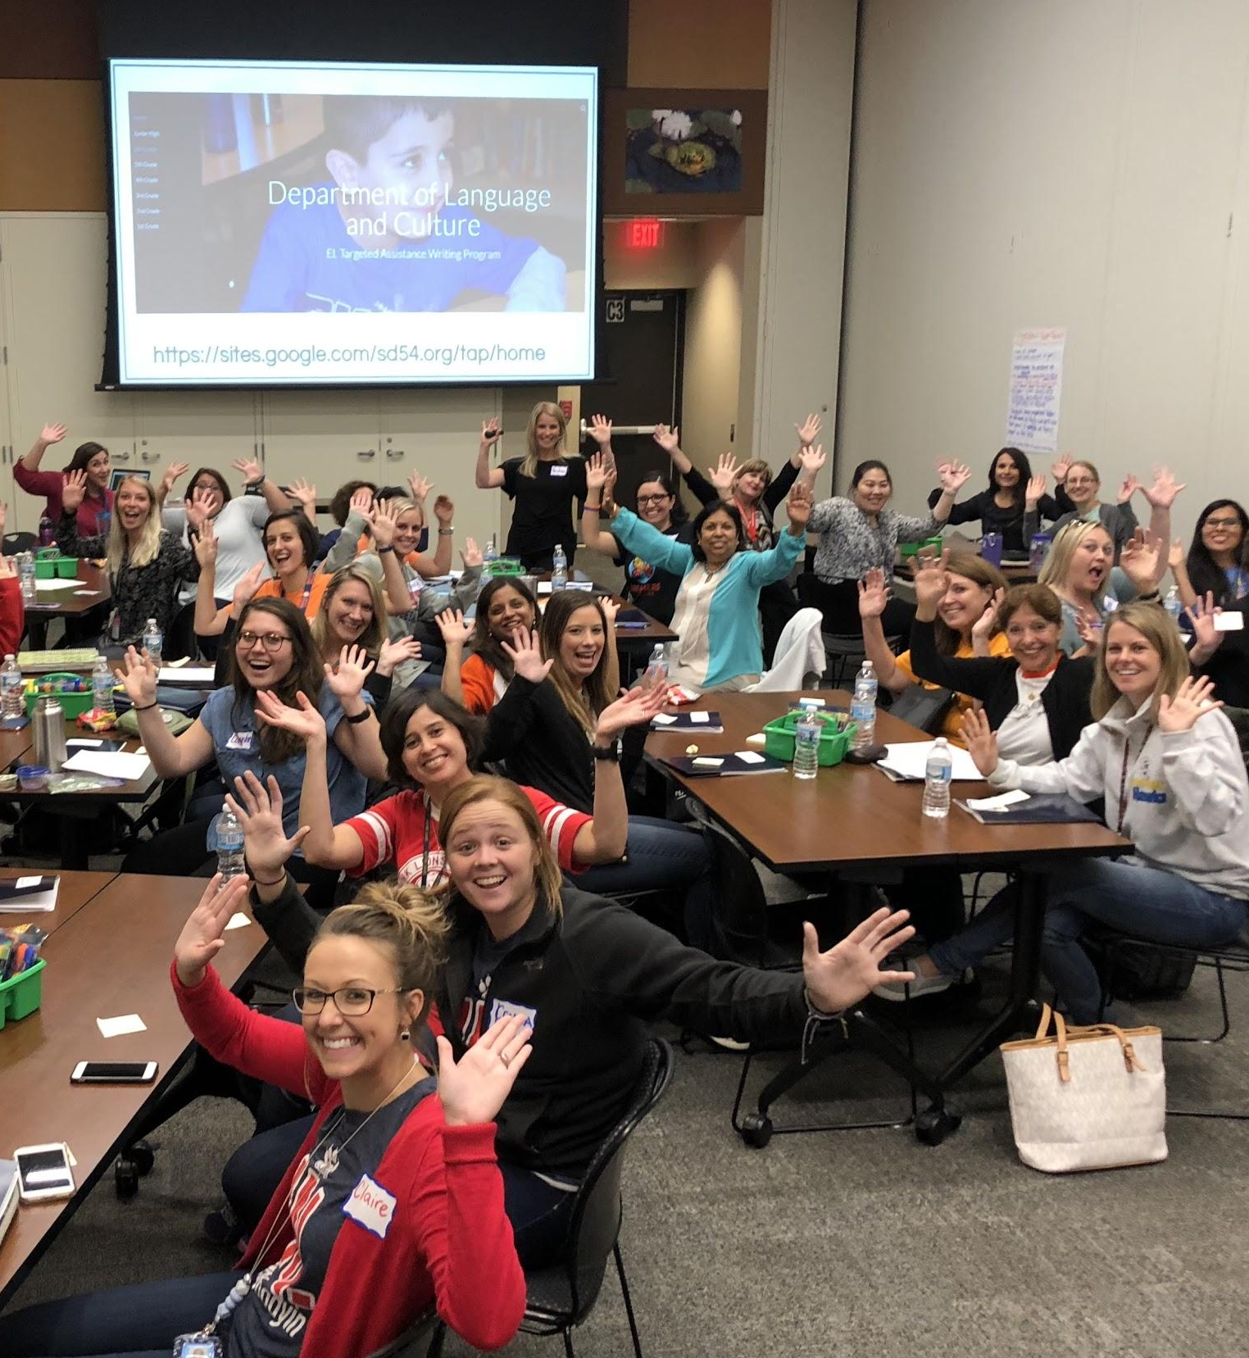
Development
Induction Week
Building-Based and Full-time Release Instructional Mentors
Building and District-Based Instructional Coaches
District sponsored Professional Development Courses
Summer PD Offerings
Collaborative Teaming
Aspiring Administrators Academy
(98% of Admin are hired from within)

Slide 20

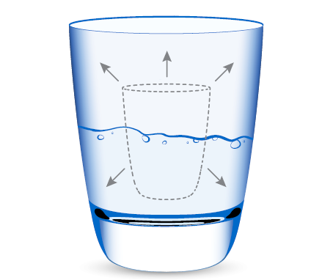
T.TD.1 Coordinate training and professional development programs.
Vertical Development
Ability to think in more complex, systemic, and interdependent ways
Horizontal development
Adding new knowledge and skills
Notes:
Walk through image
Share an example of how YOUR district approaches this process

Slide 21
T.TD.1 Coordinate training and professional development programs.
Implications for training & development
Competence
Capacity
Horizontal
Development
Vertical
Development
Increase technical competencies and content knowledge
What you know
Skills training
Increase ability to handle complexity and uncertainty
How you think
Transformational learning experiences
Notes:
Walk through image
Share an example of how YOUR district approaches this process

Slide 22

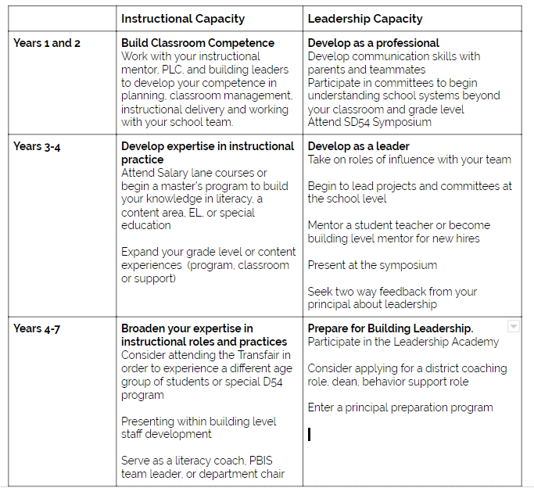
Leadership Development
How are you building experience from day 1 for next level leadership?

Slide 23
T.TD.1 Coordinate training and professional development programs.
Conditions for Vertical Development
1. The What. Initiates.
Reveals that our current way of making sense of the world is inadequate.
1. Heat Experiences
3. Elevated Sensemaking
2. Colliding Perspectives
The sweet spot for vertical development
3. The How. Integrates.
Uses process or coach to integrate and make sense of perspectives and experiences
2. The Who. Enables.
Exposure to people with different worldviews, opinions, backgrounds, and training.

Slide 24
T.TD.1 Coordinate training and professional development programs.
Self-directed
Adults need choice and opportunities to prioritize the work.
Transferrable
Adults need learning that has real life, immediate use and is useful for their unique circumstances.
Adult Learning Principles
Connected
Adults need learning that connects to what they know and do well and extends their thinking.
Experiential
Adults need learning that is hands-on, engaging, or gives them an opportunity for reflection or processing.

Slide 25
Training & Development
HCLE Standard | Content Outline | Terms & Definitions
T.TD.1 Coordinate training and professional development programs. | Two types of adult development (i.e., horizontal, vertical), and how to support both through training and development. Implications of zones of safety (i.e., risk zone, danger zone) for learning. Principles of adult learning (i.e., self-directed, transferrable, connected, experiential, goal-oriented), and implications for professional development. | Adult Learning Principles: Self-directed- Provides choice and opportunities to prioritize activities. Transferrable: Has real-life use in their current role. Connected: Builds on what learners know and do well while extending their thinking. Experiential: Provides opportunities for processing, hands-on application, and reflection. Andragogy: The method and practices of teaching adult learners. Horizontal Development: Acquiring new knowledge, skills, and competencies. Professional Development: Learning activities that expand skills, knowledge, and abilities to support personal growth and career advancement; also referred to as professional learning. Training: A learning activity focused on the acquisition of knowledge and skills required for a particular job or task. Vertical Development: Advancing the capability to think in more complex, systemic, and interdependent ways. Learning Zone Model: Model that can be used for designing learning experiences. Divides the experience of learning into three zones. Comfort Zone- Limited opportunity for learning. Often involves routine tasks that don’t require individuals to acquire new knowledge or skills. Can provide a safe space for individuals to reflect and make sense of their experiences. Risk Zone- Optimal space for learning. Requires individuals to stretch beyond their current capabilities. Danger/Panic Zone: Learning is blocked by fear and anxiety. Individuals feel overwhelmed by expectations.
© 2021, American Association of School Personnel Administrators. All Rights Reserved.

Slide 26

Performance Management
Process of maintaining or improving job performance through ongoing communication between a supervisor and an employee in support of accomplishing the strategic goals of the organization.

Slide 27
Performance Management
HCLE Standard | Content Outline | Terms & Definitions
T.PM.1 Implement a comprehensive evaluation system. | Components of a comprehensive evaluation system Strategies for improving validity and reliability in evaluation systems. | Comprehensive Evaluation: The ongoing process of using multiple measures to assess individual or group performance relative to clearly defined standards and provide opportunities for reflection, feedback, and support. Performance Management: Process of maintaining or improving job performance through ongoing communication between a supervisor and an employee in support of accomplishing the strategic goals of the organization.
T.PM.2 Address employee discipline and ensure due process. | Seven tests for just cause, as part of due process. How to respond to discipline issues. | Due Process: Requirement to respect the legal rights afforded to individuals Seven Tests for Just Cause
T.PM.3 Manage employee transitions. | Difference between voluntary and involuntary employee exit Difference between stay interviews and exit interviews Federal legislation and guidelines that have implications for performance mgt | Exit Interview: A conversation held with an employee to learn about their motivations for leaving the organization. Involuntary Turnover: Occurs when the decision to end employment is made by the organization. Common reasons include layoffs or reductions in force and performance issues. Stay Interview: A regular, informal conversation between a supervisor and an employee about the employee's level of job satisfaction and specific ways the supervisor can maintain or improve it. Voluntary Turnover: Occurs when the decision to end employment is made by the employee such as a resignation or retirement.
© 2021, American Association of School Personnel Administrators. All Rights Reserved.

Slide 28
T.PM.1 Implement a comprehensive evaluation system.
Assessment
Performance Standards
Reflection, Feedback, & Support
Components of a comprehensive evaluation system
© 2021, American Association of School Personnel Administrators. All Rights Reserved.
Notes:
Who: Create personas/profiles of your ideal candidate to support sourcing/recruiting efforts.
Walk through image
Share an example of how YOUR district approaches this process

Slide 29



T.PM.1 Implement a comprehensive evaluation system.
Performance Standards | Assessment & Feedback | Monitor
Establish clear expectations | Collect multiple measures of performance | Training to calibrate evaluators
Develop common understanding | Establish standards for documenting performance
Improving the reliability & validity of evaluations
Performance Standards | Assessment & Feedback | Monitor
Communicate expectations | Provide factual evidence | Monitor for adverse impact (4/5ths rule)
Apply standards consistently | Conduct bias training
Avoiding discrimination in evaluations
Linking HCLE Standards:
See also P.CI.3 Improve the HCMS

Slide 30







T.PM.2 Address employee discipline and ensure due process.
7 Tests of Just Cause
Reasonable Policy
Evidence
Proof of misconduct or policy violation
Related to orderly, efficient, and safe operations
Adequate warning
Objectivity
Reasonable Discipline
Employee informed of the policy AND consequences for violating.
Fair and objective investigation
Discipline appropriate for the situation.
Sufficient Investigation
Uniformity
Investigation conducted before deciding on disciplinary action
Have rules been applied equally, without discrimination?

Slide 31
Performance Management
HCLE Standard | Content Outline | Terms & Definitions
T.PM.1 Implement a comprehensive evaluation system. | Components of a comprehensive evaluation system Strategies for improving validity and reliability in evaluation systems. | Comprehensive Evaluation: The ongoing process of using multiple measures to assess individual or group performance relative to clearly defined standards and provide opportunities for reflection, feedback, and support. Performance Management: Process of maintaining or improving job performance through ongoing communication between a supervisor and an employee in support of accomplishing the strategic goals of the organization.
T.PM.2 Address employee discipline and ensure due process. | Seven tests for just cause, as part of due process. How to respond to discipline issues. | Due Process: Requirement to respect the legal rights afforded to individuals Seven Tests for Just Cause
T.PM.3 Manage employee transitions. | Difference between voluntary and involuntary employee exit Difference between stay interviews and exit interviews Federal legislation and guidelines that have implications for performance mgt | Exit Interview: A conversation held with an employee to learn about their motivations for leaving the organization. Involuntary Turnover: Occurs when the decision to end employment is made by the organization. Common reasons include layoffs or reductions in force and performance issues. Stay Interview: A regular, informal conversation between a supervisor and an employee about the employee's level of job satisfaction and specific ways the supervisor can maintain or improve it. Voluntary Turnover: Occurs when the decision to end employment is made by the employee such as a resignation or retirement.
© 2021, American Association of School Personnel Administrators. All Rights Reserved.

Slide 32

Career Ladders & Succession Planning
Professional pathways through which individuals can more broadly impact and expand their role in the organization.
Process for identifying and developing high-performing internal staff to assume critical positions within an organization

Slide 33
Career Ladders & Succession Planning
HCLE Standard | Content Outline | Terms & Definitions
T.CL.1 Support high-performing employees in increasing their organizational impact. | Goals of career ladders History of career ladders in education. Difference between career ladder and career lattice. | Career Ladders: Professional pathways through which individuals can more broadly impact and expand their role in the organization. Also referred to as career pathways, career lattices, and career tracks.
T.CL.2 Plan for the succession of employees. | Goals of succession planning. Types of positions that are well suited for succession planning. Succession planning processes and tools (e.g., candidate slate, nine-cell chart). Knowledge transfer strategies to support succession planning and ensure smooth transitions as employees change roles or leave the organization. | Succession Planning: Process for identifying and developing high-performing internal staff to assume critical positions within an organization. Candidate Slate: This simple organizational tool helps identity future candidates for identified roles in an organization, as part of the succession planning process. Nine-Cell Chart: This succession planning tool uses two parameters to assess employees’ readiness to assume new positions in the organization. It involves a three-step process: 1) Use evaluations and other data to plot employees based on (a) their performance and (b) extent to which their actions/behaviors align with organizational values; 2) Have managers review and suggest adjustments; and 3) Finalize charts and use for further development and decision-making.
© 2021, American Association of School Personnel Administrators. All Rights Reserved.

Slide 34
T.CL.1 Support high-performing employees in increasing their organizational impact.
Career Ladders
Provide opportunities for employees to expand their impact and role.
Characteristics of
Career Ladders
NOT Career Ladders
Involved vertical movement between jobs (career advancement)
May allow for horizontal movement (breadth of skills)
May provide expanded roles outside traditional supervisory or managerial responsibilities.
Payment for additional duties
(e.g., lunch duty)
Attending district leadership or department meetings
Participating in training or leadership development programs
Rotating or temporary assignments
© 2021, American Association of School Personnel Administrators. All Rights Reserved.
Notes:
Funneling definition: A hiring process that quickly sorts through applicants using low-cost, low-effort methods in the preliminary stages to help preserve resources for use in screening and hiring the most promising candidates for a position
Walk through image
Share an example of how YOUR district approaches this process

Slide 35
T.CL.2 Plan for the succession of employees.
Succession Planning Process
01
02
03
04
05
Identify critical positions for succession planning
Assess leadership potential of possible candidates
Develop and retain talent pool
Transfer knowledge from incumbent to successor(s)
Monitor and evaluate success

Slide 36






T.CL.2 Plan for the succession of employees.
Succession Planning: Examples of critical positions
Single
incumbent
Risk of
attrition
Difficult to
replace
Specialized knowledge & experience
Risk of
retirement
Difficult to
retain

Slide 37

Achieves Outcomes
Support
Adult SEL
Future Leaders
Positive Collaborator and Trust Builder
Negative Leader or Passively Neutral
Support Instructional Capacity
Hold
Accountable
Low Outcomes

Slide 38
Career Ladders & Succession Planning
HCLE Standard | Content Outline | Terms & Definitions
T.CL.1 Support high-performing employees in increasing their organizational impact. | Goals of career ladders History of career ladders in education. Difference between career ladder and career lattice. | Career Ladders: Professional pathways through which individuals can more broadly impact and expand their role in the organization. Also referred to as career pathways, career lattices, and career tracks.
T.CL.2 Plan for the succession of employees. | Goals of succession planning. Types of positions that are well suited for succession planning. Succession planning processes and tools (e.g., candidate slate, nine-cell chart). Knowledge transfer strategies to support succession planning and ensure smooth transitions as employees change roles or leave the organization. | Succession Planning: Process for identifying and developing high-performing internal staff to assume critical positions within an organization. Candidate Slate: This simple organizational tool helps identity future candidates for identified roles in an organization, as part of the succession planning process. Nine-Cell Chart: This succession planning tool uses two parameters to assess employees’ readiness to assume new positions in the organization. It involves a three-step process: 1) Use evaluations and other data to plot employees based on (a) their performance and (b) extent to which their actions/behaviors align with organizational values; 2) Have managers review and suggest adjustments; and 3) Finalize charts and use for further development and decision-making.
© 2021, American Association of School Personnel Administrators. All Rights Reserved.

Slide 39
Talent Management & Development
Onboarding
Training & Development
Performance Management
Career Ladders & Succession
pHCLE Exam Weight:
20%
Planning

