Slide 1
pHCLE Study Group
Strategic Staffing
Instructor: Liz Young
August 4, 2021

Slide 2


      Liz Young, pHCLE
      Coordinator of Talent Management/Recruiting
      Fulton County Schools
      younge1@fultonschools.org
      470-254-4951
      Twitter: @lizdyoung
© 2021, American Association of School Personnel Administrators. All Rights Reserved.

Slide 3
Getting to Know You!
In the chat please share...
Name
Job Title
Organization Name – City, State
Student Count

Slide 4
      Study Session Outline:
      Introductions
      Preparing for the exam
      How I prepared…
      Reviewing each quadrant:
        Checking for baseline understanding: Kahoot!
        Reviewing Standards
        Instructor Examples
        Q&A
      Overall Q&A
      Study Session Purpose:
      Gain strategies to prepare for your exam
      Briefly review four areas of the standards
      Learn from instructor examples
      Check your understanding with practice test questions
      Answer your questions about the exam
© 2021, American Association of School Personnel Administrators. All Rights Reserved.
Notes:
Invite others to share their examples.

Slide 5
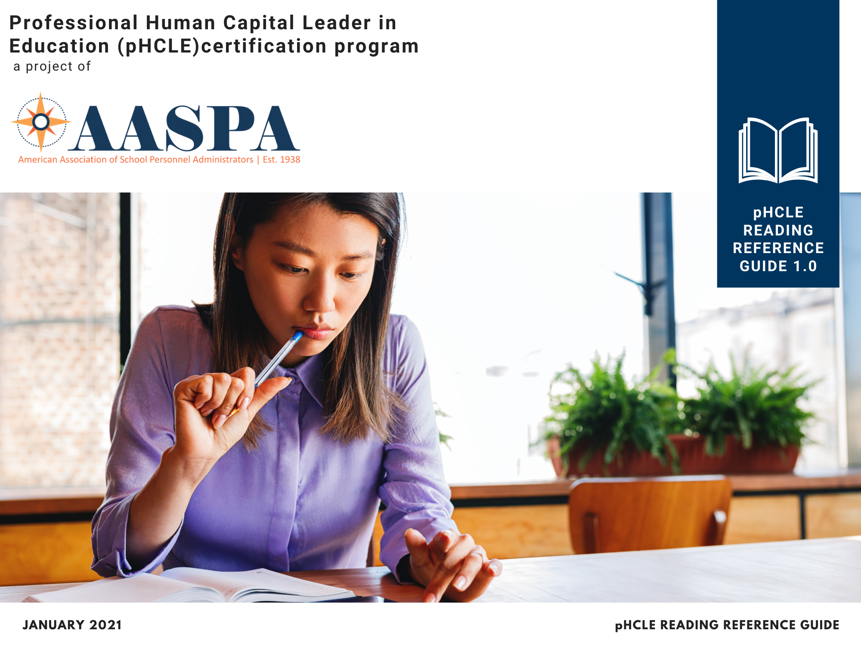
Preparing for your Exam
Reading Reference Guide
The pHCLE Reading Reference Guide is resource to help you engage in a self-study program for the certification exam. The guide defines key terms and provides links to suggested readings to help you further your learning. Topics are organized by the Human Capital Leaders in Education Professional Standards.
AASPA Recorded Webinars
AASPA offers recorded webinars as an additional resource for our members. Webinar topics are researched, created, and delivered by AASPA members. All webinars align with HCLE standards and some are eligible for HRCI or SHRM re-certification credit.
Study Sessions
These sessions will be recorded and accessible to review after the they are completed.
Other Professional Development Activities
Other growth and development activities such as reading HR books and articles, attending an HR conference, taking classes, etc. will help prepare individuals for the pHCLE exam.
© 2021, American Association of School Personnel Administrators. All Rights Reserved.

Slide 6

      Liz’s Study Plan
      How did I prepare for the exam?
      Reviewed terms and definitions
        Quizlet (app)
      Reread assigned readings and study guide (notes)
      Team approach
        Reviewed practice questions
        Understand the application of terms and definitions to scenarios
© 2021, American Association of School Personnel Administrators. All Rights Reserved.

Slide 7

Strategic Staffing
Workforce Planning
HR Branding
Sourcing & Recruiting
Selection & Placement
pHCLE Exam Weight:
25 %

Slide 8


Check Your Understanding: Strategic Staffing

Slide 9

Workforce Planning
Process to align the workforce with the needs and priorities of the organization.

Slide 10
Workforce Planning
HCLE Standard | Content Outline | Terms & Definitions
S.WP.1 Analyze staffing requirements to meet strategic goals. | Workforce planning process: Involves three steps: 1) supply analysis, 2) demand analysis, and 3) gap analysis. | Demand Analysis: An evaluation of future needs of the organization including desired staffing levels; desired knowledge, skills, and abilities; and projected personnel expenses. Gap Analysis: The process of comparing supply and demand to identify areas of misalignment. Supply Analysis: An evaluation of current resources including staffing levels; staff knowledge, skills, and abilities; and projected funding. Workforce Analysis: Process of examining data to uncover gaps between supply and demand. It is the first phase of workforce planning and serves as the foundation of a workforce plan. Workforce Plan: Report that identifies targeted strategies to ensure that the organization’s workforce is operating within budget and addresses the existing and anticipated needs of all learners. Workforce Planning: Process to align the workforce with the needs and priorities of the organization and the students it serves.
S.WP.2 Create job descriptions that reflect position requirements. | Purpose and core components of a job description Job analysis | Job Analysis: Systemic study of jobs to determine what activities (tasks) and responsibilities they include, personal qualifications necessary for performance, conditions under which work is performed, and reporting structure. Job Description: Written summary of the qualifications required to perform a job, including duties, responsibilities, physical requirements, and necessary qualifications. (Job descriptions are a foundational part of many HR processes.)
© 2021, American Association of School Personnel Administrators. All Rights Reserved.

Slide 11
S.WP.1 Analyze staffing requirements to meet strategic goals.
STAFFING STRATEGIES
Hire
Retain
Forecast Staffing Demands
Forecast Staffing Supply
Complete Gap Analysis
Train/Retrain
New Staffing Levels
RIF
Incent Retirements
Incent Retire Rehires
Q: What do we need?
Example Information:
Forecasted enrollment
Forecasted staffing retirements
Projected personnel budget
Q: What do we have?
Example Information:
Current staffing information
Job descriptions
Allocated positions
Design Flexible Arrangements
Transition Roles
Grow Your Own
Change Job Requirements
Workforce Analysis
Workforce Plan
© 2021, American Association of School Personnel Administrators. All Rights Reserved.
Notes:
Walk through image
Share an example of how YOUR district approaches this process

Slide 12
S.WP.2 Create job descriptions that reflect position requirements.
Job Analysis
DATA SOURCES
Employees
Supervisor
Job analyst
Job/Process Information
Job Description
Job Title
COLLECTED JOB INFORMATION
Tasks
Required knowledge, skills, and abilities
Education, Licensure, Certifications, Certificates, & Other Training
Job Experience
Equipment used
Work Environment & Hazards
Physical Demands
Supervisory Responsibilities
Reports To
Pay Band
Job Summary
DATA COLLECTION PRACTICES
Shadowing
Interviews
Questionnaire
O*Net
Process Records
Job Duties
Education Requirements
Knowledge, Skills, & Abilities (KSAs)
Physical Demands
© 2021, American Association of School Personnel Administrators. All Rights Reserved.
Notes:
Analyze the JOB not the person in the job.
Walk through image
Share an example of how YOUR district approaches this process

Slide 13
S.WP.2 Create job descriptions that reflect position requirements.
Remember…
Job analysis is a study of the job NOT the person in the job.
Ask This
What level of education is required to perform the essential job tasks?
Not That
What degrees or certifications does the incumbent have?
Notes:
As
k this:

Slide 14
Workforce Planning
HCLE Standard | Content Outline | Terms & Definitions
S.WP.1 Analyze staffing requirements to meet strategic goals. | Workforce planning process: Involves three steps: 1) supply analysis, 2) demand analysis, and 3) gap analysis. | Demand Analysis: An evaluation of future needs (or demands) of the organization including desired staffing levels; desired knowledge, skills, and abilities; and projected personnel expenses. Gap Analysis: The process of comparing supply and demand to identify areas of misalignment. Supply Analysis: An evaluation of current resources (or supply) including staffing levels; staff knowledge, skills, and abilities; and projected funding. Workforce Analysis: Process of examining data to uncover gaps between supply and demand. It is the first phase of workforce planning and serves as the foundation of a workforce plan. Workforce Plan: Report that identifies targeted strategies to ensure that the organization’s workforce is operating within budget and addresses the existing and anticipated needs of all learners. Workforce Planning: Process to align the workforce with the needs and priorities of the organization and the students it serves.
S.WP.2 Create job descriptions that reflect position requirements. | Purpose and core components of a job description Job analysis | Job Analysis: Systemic study of jobs to determine what activities (tasks) and responsibilities they include, personal qualifications necessary for performance, conditions under which work is performed, and reporting structure. Job Description: Written summary of the qualifications required to perform a job, including duties, responsibilities, physical requirements, and necessary qualifications. (Jobs descriptions are a foundational part of many HR processes.)
© 2021, American Association of School Personnel Administrators. All Rights Reserved.

Slide 15

HR Branding
Process of managing and influencing your reputation as an employer with current and prospective employees and stakeholders.

Slide 16
Human Resources Branding
HCLE Standard | Content Outline | Terms & Definitions
S.BR.1 Present a consistent organizational brand. | Assessing your HR brand: Role of actual candidates, ideal candidates, and incumbents Communicating your brand | Actual Candidates: People who have applied for a position in your organization. Help you determine how well an HR brand intervention worked. Employee Value Proposition: A statement that communicates the essence of an organization—how it is unique, what it stands for, and why people would want to be part of it. Human Resources (HR) Branding: Process of managing and influencing your reputation as an employer with current and prospective employees and stakeholders. Ideal Candidates: Person(s) who would best meet your needs in a position. Help you hypothesize what the future-state HR brand should be. Incumbents: Person(s) who are currently in a specific position within the organization. Help you analyze your current HR brand. Also see definitions and references under P.CO.1 Use communications to ensure effective implementation of the HCMS.
© 2021, American Association of School Personnel Administrators. All Rights Reserved.

Slide 17


S.BR.1 Present a consistent organizational brand.
Employee Value Proposition (EVP) Communication Channels and Messages
Communicate your EVP throughout the employee journey!
Awareness
(passive candidates)
Consideration
(active candidates)
Apply/Interview
(applicants)
Offer
(ideal candidate)
Hire
(incumbent)
Social Media
Website
Billboard
Newspaper Ad
Events
Website
Job Posting
Career Fairs
College/University Presentations
Website
Applicant Tracking System
Virtual Interview
Offer letter
Personal Email
Phone Call
Employee records system
Intranet
Work Email
Channel
We are a great place to work!
Our community is amazing!
We have open jobs!
Our employees love us! We love our employees!
Opportunities await!
We value you and your time!
We want you on our team!
There are many perks to working here!
Welcome to the family!
Message
Notes:
Walk through image
Share an example of how YOUR district approaches this process

Slide 18
Human Resources Branding
HCLE Standard | Content Outline | Terms & Definitions
S.BR.1 Present a consistent organizational brand. | Assessing your HR brand: Role of actual candidates, ideal candidates, and incumbents Communicating your brand | Actual Candidates: People who have applied for a position in your organization. Help you determine how well an HR brand intervention worked. Employee Value Proposition: A statement that communicates the essence of an organization—how it is unique, what it stands for, and why people would want to be part of it. Human Resources (HR) Branding: Process of managing and influencing your reputation as an employer with current and prospective employees and stakeholders. Ideal Candidates: Person(s) who would best meet your needs in a position. Help you hypothesize what the future-state HR brand should be. Incumbents: Person(s) who are currently in a specific position within the organization. Help you analyze your current HR brand. Also see definitions and references under P.CO.1 Use communications to ensure effective implementation of the HCMS.
© 2021, American Association of School Personnel Administrators. All Rights Reserved.

Slide 19

Sourcing & Recruiting
Process of uncovering sources of high-potential candidates by reviewing information on current successful employees and identifying targeted strategies to locate qualified candidates and convince them to apply to your organization

Slide 20
Sourcing & Recruiting
HCLE Standard | Content Outline | Terms & Definitions
S.SR.1 Identify sources of high-quality candidates. | Sourcing practices | Sourcing: Uncovering sources of high-potential candidates by reviewing information on current successful employees.
S.SR.2 Develop a recruitment strategy. | Building a talent pipeline: e.g., Grow-your-own programs, Alternative certification programs, Community partnerships | Talent Pipeline: Pool of potential candidates who are qualified and prepared to fill key roles in your organization when there are openings. Talent Pipeline Management: Actively building and maintaining a sustainable pool of talent for your organization. Recruiting: Targeted strategies to identify qualified candidates and convince them to apply to your organization. Active candidates: Individuals who are currently searching for a new job. Passive candidates: Individuals who possess desired skills and/or qualifications, but who are not actively searching for a new job.
S.SR.3 Implement the recruitment strategy. | Internal & External recruitment: Advantages and disadvantages | External Recruitment: Looking outside the organization to fill an open position. Internal Recruitment: Looking at employees within the organization to fill an open position. Targeted Recruitment: Active process of identifying individuals who meet specific criteria. Often used when hiring for high-level positions or positions that require a specialized skillset.
© 2021, American Association of School Personnel Administrators. All Rights Reserved.

Slide 21


S.SR.1 Identify sources of high-quality candidates.
Who is your ideal candidate?
Bio/
Background
Frustrations/ Motivations
Goals
© 2021, American Association of School Personnel Administrators. All Rights Reserved.
Notes:
Who: Create personas/profiles of your ideal candidate to support sourcing/recruiting efforts.
Walk through image
Share an example of how YOUR district approaches this process

Slide 22

S.SR.1 Identify sources of high-quality candidates.
Using SWOT Analysis to Develop a Strategy to Improve Sourcing
STRENGTHS
What do you currently do well with regards to sourcing?
WEAKNESSES
What could you improve with regards to sourcing?
Internal Factors (People, resources, processes, past experiences)
OPPORTUNITIES
What opportunities are open to you?
THREATS
What threats could cause setbacks?
External Factors (Trends, legislation, demographics, current events)
Linking HCLE Standards:
See also P.SA.1 Develop an organizational strategy.
© 2021, American Association of School Personnel Administrators. All Rights Reserved.
Notes:
SWOT analysis can help you refine/update your sourcing and recruiting strategies.
Where: The source… where are you most likely to find/encounter your ideal candidate.
Walk through image
Share an example of how YOUR district approaches this process

Slide 23
S.SR.2 Develop a recruitment strategy.
How will you connect with potential candidates?
Who
Ideal candidate profiles/personas
Job description/position requirements
Where
Sources of ideal candidates
How
Communications channels
Messaging aligned to goals/frustrations/motivations
© 2021, American Association of School Personnel Administrators. All Rights Reserved.
Notes:
Which communications channels are most likely to reach your ideal candidate?
How do you appeal to their needs and desires in your job advertisements/postings?
Walk through image
Share an example of how YOUR district approaches this process

Slide 24
S.SR.3 Implement the recruitment strategy.
Internal vs. External Recruiting
INTERNAL
EXTERNAL
Understands the mission, vision, culture Invested in the organization Provides growth opportunities/ rewards performance | Can hire for needed expertise or experience New perspective/ideas Can help facilitate a change in direction
Can be time consuming to develop skills and abilities Creates another position opening Jealousy/ office politics | Limited information about performance history Higher cost Morale of internal candidates who weren’t selected
ADVANTAGES
DISADVANTAGES
© 2021, American Association of School Personnel Administrators. All Rights Reserved.
Notes:
Walk through image
Share an example of how YOUR district approaches this process

Slide 25
Sourcing & Recruiting
HCLE Standard | Content Outline | Terms & Definitions
S.SR.1 Identify sources of high-quality candidates. | Sourcing practices | Sourcing: Uncovering sources of high-potential candidates by reviewing information on current successful employees.
S.SR.2 Develop a recruitment strategy. | Building a talent pipeline: e.g., Grow-your-own programs, Alternative certification programs, Community partnerships | Talent Pipeline: Pool of potential candidates who are qualified and prepared to fill key roles in your organization when there are openings. Talent Pipeline Management: Actively building and maintaining a sustainable pool of talent for your organization. Recruiting: Targeted strategies to identify qualified candidates and convince them to apply to your organization. Active candidates: Individuals who are currently searching for a new job. Passive candidates: Individuals who possess desired skills and/or qualifications, but who are not actively searching for a new job.
S.SR.3 Implement the recruitment strategy. | Internal & External recruitment: Advantages and disadvantages | External Recruitment: Looking outside the organization to fill an open position. Internal Recruitment: Looking at employees within the organization to fill an open position. Targeted Recruitment: Active process of identifying individuals who meet specific criteria. Often used when hiring for high-level positions or positions that require a specialized skillset.
© 2021, American Association of School Personnel Administrators. All Rights Reserved.

Slide 26

Selection & Placement
Process to identify the most suitable candidate for an open position based on the competencies required to perform the job and then assign staff to departments, buildings, and/or groups of students.

Slide 27
Selection & Placement
HCLE Standard | Content Outline | Terms & Definitions
S.SP.1 Develop a selection process. | Types of staffing strategies (i.e., centralized, de-centralized/site-based, hybrid). Strategies for maximizing reliability, validity, and efficiency in the selection process (e.g., funneling). Types of interviews and questions (structured, unstructured, behavior-based, situational, knowledge-based). Goals of realistic job previews. | Select List – See Reading Reference Guide for full list of Terms Cost per Hire: The costs associated with hiring a new employee, which may include recruiting, screening, and training expenses. Calculated by dividing total costs by the number of people hired. Funneling: A hiring process that quickly sorts through applicants using low-cost, low-effort methods in the preliminary stages to help preserve resources for use in screening and hiring the most promising candidates for a position.
S.SP.2 Select and hire staff. | Federal laws and guidelines relevant to employee hiring and selection. | Select List – See Reading Reference Guide for full list of Terms Adverse Impact: A significantly different rate of selection in hiring, promotion, or other employment decisions that negatively and disproportionately impacts members of a specific race, gender, or ethnic group. Disparate Treatment: An employment decision, practice, policy, or tool that intentionally discriminates against a protected class based on race, color, religion, sex, or national origin.
S.SP.3 Determine placements for new and existing staff. | Placement strategies for dealing with students’ inequitable access to effective instruction. Implications of state equity plans for human capital leaders in education. | Centralized Staffing Function: Staffing processes are standardized and directly controlled by the central office management team. Decentralized Staffing Function: Staffing is managed locally, with strategies and processes that are tailored to local circumstances. Equity gap: The difference between the rate students from low-income families or students of color are educated by excellent educators and the rate at which other students are educated by excellent educators. Placement: The process by which staff are assigned to buildings and/or groups of students.
© 2021, American Association of School Personnel Administrators. All Rights Reserved.

Slide 28
S.SP.1 Develop a selection process.
Funneling Example: TPS Teacher Selection Process
Minimum requirements screen
Interview
Final verification
Reference check &
Pre-screener
Lower cost & effort steps
Goals:
Use resources more efficiently
Improve reliability & validity of the process by using multiple measures/ data points.
Higher cost & effort steps
© 2021, American Association of School Personnel Administrators. All Rights Reserved.
Notes:
Funneling definition: A hiring process that quickly sorts through applicants using low-cost, low-effort methods in the preliminary stages to help preserve resources for use in screening and hiring the most promising candidates for a position
Walk through image
Share an example of how YOUR district approaches this process

Slide 29
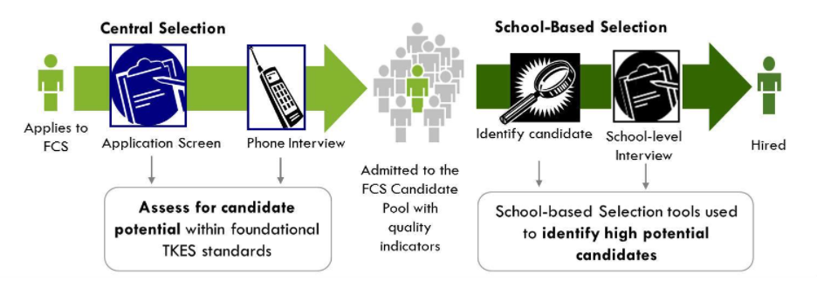
S.SP.1 Develop a selection process.
Fulton County Schools (Georgia) Teacher Selection Model
High performing teachers (Teacher Selectors) screen teacher applicants. Growth & Opportunity.

Slide 30
S.SP.1 Develop a selection process.
(Internal Recruiting Costs + External Recruiting Costs)
Total number of hires
Cost per hire =
Internal recruiting costs: Organizational costs to carry out recruiting activities
  Examples: Salaries and benefits for recruiting and staffing employees, Employee travel to job fairs, Referral bonuses
External recruiting costs: Fees paid to outside organizations
  Examples: Job board postings, Applicant tracking system, Printing expenses for recruitment materials
© 2021, American Association of School Personnel Administrators. All Rights Reserved.
Notes:
Walk through image
Share an example of how YOUR district approaches this process
https://resources.workable.com/tutorial/faq-recruitment-budget-metrics

Slide 31
S.SP.1 Develop a selection process.
Cost per Hire Practice Question
Expense Type | Expense Details | Total Cost
HR Recruiting & Staffing Personnel | 734 hours, $35/hour burdened labor rate | ?
Transportation Manager | 70 hours, $68/hour burdened labor rate | ?
Employee Referral Bonus | $100 bonus for each referral that results in hire. Nine (9) new bus drivers were referred. | ?
Applicant Tracking System | $2050 | ?
Advertising/Job Boards | $625 | ?
Printing | $150 | ?
 |  | ?
What is the cost per hire for bus drivers? During the school year 42 new bus drivers were hired.
Total Cost per Hire = ?

Slide 32
S.SP.1 Develop a selection process.
Cost per Hire Practice Question
Expense Type | Expense Details | Total cost
HR Recruiting & Staffing Personnel | 734 hours, $35/hour burdened labor rate | $25,690
Transportation Manager | 70 hours, $68/hour burdened labor rate | $4,760
Employee Referral Bonus | $100 bonus for each referral that results in hire. Nine (9) new bus drivers were referred. | $900
Applicant Tracking System | $2050 | $2050
Advertising/Job Boards | $625 | $625
Printing | $150 | $150
 |  | $34,175
What is the cost per hire for bus drivers? During the school year 42 new bus drivers were hired.
Total Cost per Hire:
$34,175/42 = $813.69

Slide 33
S.SP.1 Develop a selection process.
Monitoring Selection Processes for Adverse Impact
How do you know if your hiring process unintentionally discriminates against a group of employees?
The Uniform Guidelines on Employee Selection Procedures establishes federal guidance to help organizations develop selection procedures that comply with EEO laws.
The uniform guidelines recommend using the four-fifths (or 80 percent) rule to uncover evidence of adverse impact in selection processes. This approach can be used to examine any employment decision (e.g., termination, promotion, compensation).
1. Selection rates
2. Identify largest
3. Impact ratios
4. Adverse impact?
  Calculate percentage selected for each group (e.g., gender, race/ethnicity)
  Which group has the highest selection rate?
  Impact ratio= (selection rate of remaining groups)/ (highest selection rate)
  Are any impact ratios less than 4/5 (80%)? If yes → evidence of adverse impact.
Linking HCLE Standards:
See also P.SR.1 Apply relevant law and regulations to education organizations.
© 2021, American Association of School Personnel Administrators. All Rights Reserved.

Slide 34
S.SP.1 Develop a selection process.
Adverse Impact Practice Question
Is there evidence of adverse impact in the following hiring process?
1.
Group | # Candidates | # Hired | Selection Rate | Impact Ratio
Males | 21 | 5 | 5/21 = 0.238
Females | 48 | 14 | 14/48=0.292

Slide 35
S.SP.1 Develop a selection process.
Adverse Impact Practice Question
Is there evidence of adverse impact in the following hiring process?
1.
Group | # Candidates | # Hired | Selection Rate | Impact Ratio
Males | 21 | 5 | 5/21 = 0.238
Females | 48 | 14 | 14/48=0.292
2.
Which group has the highest selection rate? Females

Slide 36
S.SP.1 Develop a selection process.
Adverse Impact Practice Question
Is there evidence of adverse impact in the following hiring process?
1.
3.
Group | # Candidates | # Hired | Selection Rate | Impact Ratio
Males | 21 | 5 | 5/21 = 0.238
Females | 48 | 14 | 14/48=0.292 | 0.238/0.292=0.815
2.
Which group has the highest selection rate? Females

Slide 37
S.SP.1 Develop a selection process.
Adverse Impact Practice Question
Is there evidence of adverse impact in the following hiring process?
1.
3.
Group | # Candidates | # Hired | Selection Rate | Impact Ratio
Males | 21 | 5 | 5/21 = 0.238
Females | 48 | 14 | 14/48=0.292 | 0.238/0.292=0.815
2.
Which group has the highest selection rate? Females
4.
Is there evidence of adverse impact? No. 0.815 > 0.80

Slide 38
Selection & Placement
HCLE Standard | Content Outline | Terms & Definitions
S.SP.1 Develop a selection process. | Types of staffing strategies (i.e., centralized, de-centralized/site-based, hybrid). Strategies for maximizing reliability, validity, and efficiency in the selection process (e.g., funneling). Types of interviews and questions (structured, unstructured, behavior-based, situational, knowledge-based). Goals of realistic job previews. | Select List – See Reading Reference Guide for full list of Terms Cost per Hire: The costs associated with hiring a new employee, which may include recruiting, screening, and training expenses. Calculated by dividing total costs by the number of people hired. Funneling: A hiring process that quickly sorts through applicants using low-cost, low-effort methods in the preliminary stages to help preserve resources for use in screening and hiring the most promising candidates for a position.
S.SP.2 Select and hire staff. | Federal laws and guidelines relevant to employee hiring and selection. | Select List – See Reading Reference Guide for full list of Terms Adverse Impact: A significantly different rate of selection in hiring, promotion, or other employment decisions that negatively and disproportionately impacts members of a specific race, gender, or ethnic group. Disparate Treatment: An employment decision, practice, policy, or tool that intentionally discriminates against a protected class based on race, color, religion, sex, or national origin.
S.SP.3 Determine placements for new and existing staff. | Placement strategies for dealing with students’ inequitable access to effective instruction. Implications of state equity plans for human capital leaders in education. | Centralized Staffing Function: Staffing processes are standardized and directly controlled by the central office management team. Decentralized Staffing Function: Staffing is managed locally, with strategies and processes that are tailored to local circumstances. Equity gap: The difference between the rate students from low-income families or students of color are educated by excellent educators and the rate at which other students are educated by excellent educators. Placement: The process by which staff are assigned to buildings and/or groups of students.
© 2021, American Association of School Personnel Administrators. All Rights Reserved.

Slide 39
Strategic Staffing
Workforce Planning
HR Branding
Sourcing & Recruiting
Selection & Placement
pHCLE Exam Weight:
25 %

