Slide 1
Member-Get-A-Member
Campaign Materials
2025

Slide 2
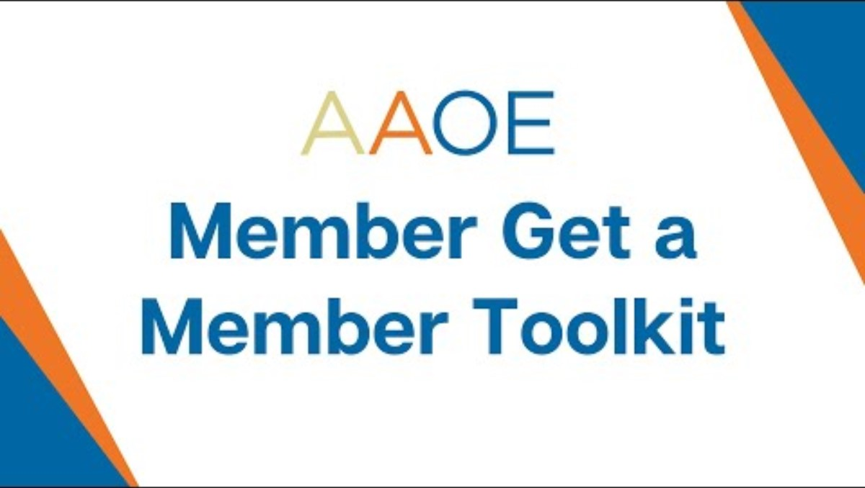
Video Instructions for Using this Kit
This video provides detailed information about how to use this kit.
There are also written instructions in this presentation if you prefer.

Slide 3
Contents
How to use this kit
Why reach out to your network?
Tracking your impact
Who can join AAOE?
How much does it cost to join?
What’s in it for them?
Short email messages
Video testimonials
Customizable social media templates
Sample social media posts
Hashtags to use
Tagging AAOE

Slide 4
How to Use This Kit
This kit is designed for AAOE members to reach out to their networks – in their practices/departments and outside of their own workplace to get more orthopedic practice professionals to join AAOE.
There are sample templates for social media and email to choose from. We recommend doing both – sending emails (or calling/visiting) as well as posting to social media. This will increase the impact of our efforts!
Reach out to Nicole La Vigne (nlavigne@aaoe.net) or Cathy Lada (clada@aaoe.net) with any questions!
Reach out to Cathy or Nicole to get your 15% off membership coupon code!

Slide 5
Why Reach Out to Your Network?
Growing AAOE’s membership creates impact—bringing in new members strengthens networking, advocacy, and resources for everyone.
We’ve made it easy for you with customizable email messages, social posts, and social images, along with testimonials that are all plug-and-play.
You’ll get rewarded! (See the next page to lock in your rewards)
  Earn $20 for each new member in an existing practice once approved and paid.
  $50 for the first person in a new practice, plus $20 per additional person that joins at the same time.
The new practice saves 15% on their first-year membership dues!
And, if you’re at all competitive, we will have a public leaderboard on the AAOE website tracking who brings in new memberships weekly!

Slide 6
Tracking Your Impact
Reach out to Nicole La Vigne (nlavigne@aaoe.net), Marketing & Membership Manager, to get a personal discount code you can send to your network.
Ask your outreach contacts to put your personal 15% off discount code on their membership applications when they join.
Check out the online leaderboard of results
(Not sure if they're a member? Check our membership directory - this is a members' only resource.)

Slide 7
Who Can Join AAOE?
Must work in the U.S.
Cannot be a vendor
Consultants can join if they are working for a practice
Individuals with interest in orthopedic or musculoskeletal practice management (but not employed by a vendor*)
Employees of orthopedic or musculoskeletal practice practices/departments interested in a leadership role
Orthopedic surgeons or physicians

Slide 8
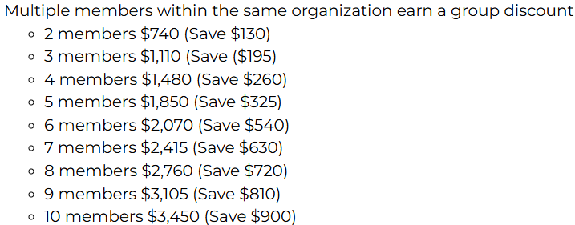
How Much Does it Cost to Join?
Individual dues start at $435 (and with your code for 15% off first-year dues, that drops to $369.75)
Students: $30
See the dues page for 10+ member rates

Slide 9
What’s in it for Them? (The people you ask to join)
If they join between April 15 and September 30, they will get a 15% reduction in first-year membership dues. They will need to use a personalized code from you (reach out to Nicole to get your code) when they apply.
All the benefits you enjoy – professional development, networking, benchmarking, advocacy, a robust online community, a top-tier Annual Conference, and more. Be sure to share how you have personally benefitted from your AAOE membership when you reach out to your network!
  All of these resources were designed to help orthopedic professionals grow and learn, improving the way their practices/departments are run and thereby improving patient care.

Slide 10
Outreach Assets

Slide 11
Collateral & Links You Can Include in Your Emails
Instructions: Right-click on the item below, click link options, click copy link to insert them into your emails.
Membership benefits
Flyer about the Collaborate community
Membership dues schedule

Slide 12
Convince Your Boss To Include All Managers And Higher In AAOE Membership
Here is language you can use as a starter/opener with your boss to discuss adding your work colleagues to AAOE membership:
I've found my AAOE membership incredibly valuable, and I believe our colleagues would benefit just as much. AAOE offers orthopedic-specific business education and resources that help address the real-world challenges we face every day—things that aren't always covered in clinical or administrative training. The webinars, benchmarking data, and access to a nationwide peer network have helped me improve operations and stay ahead of industry trends. Expanding membership to our team could elevate how we tackle issues together and create a stronger, more informed leadership pipeline within our practice.
I’ve gotten so much out of my AAOE membership—resources, education, and ideas that actually apply to what we deal with every day in the practice. It’s helped me make better decisions and connect with others in similar roles. I really think more of our team would benefit from being part of this—it could make us even stronger as a group.
AAOE has been a game-changer for me—it's given me practical tools, peer support, and education that actually helps me solve problems in our day-to-day operations. If more of our team had access to this, I know we could work even smarter and more strategically. I’d love to talk about getting a few others signed up so we can really take advantage of what AAOE has to offer as a team.
Add to all:
Specific examples of how you've benefitted/what you've learned/helpful connections you've made
For the next several weeks, we can use my 15% off discount code to take 15% off of the first-year dues for anyone who signs up.

Slide 13
Convincing Your Co-workers To Join
Here is language you can use as a starter/opener with your colleagues to discuss joining AAOE:
AAOE has been a game-changer for me—it's given me practical tools, peer support, and education that actually helps me solve problems in our day-to-day operations. If more of our team had access to this, I know we could work even smarter and more strategically. Here is a list of the benefits you'd get - Membership Information - American Alliance of Orthopaedic Executives. Can I give you my discount code for you to join AAOE?
I’ve gotten so much out of my AAOE membership—resources, education, and ideas that actually apply to what we deal with every day in the practice. It’s helped me make better decisions and connect with others in similar roles. I really think you would benefit from being part of this—it could make us even stronger as a group. Here is a list of the benefits you'd get - Membership Information - American Alliance of Orthopaedic Executives. Can I give you my discount code for you to join AAOE?
Add to all:
Specific examples of how you've benefitted/what you've learned/helpful connections you've made

Slide 14
Short Email Message For Recruiting From Your Non-work Network:
Healthcare Environment Focus
SUBJECT: Why I’m a Member of AAOE, and You Should be, Too
Hi [Name],
Healthcare is constantly changing—and managing an orthopedic practice gets more complex every year. That’s why I rely on the American Association of Orthopaedic Executives (AAOE).
Through AAOE, I’ve gained access to valuable tools like the benchmarking survey, the physician fee schedule, and the guide to using athletic trainers in a physician practice. Their education offerings—like webinars, online courses, and the annual conference—keep me informed and prepared for what’s ahead. Plus, the member community is an incredible place to exchange ideas and solutions.
If you're not already a member, I highly recommend checking it out: https://www.aaoe.net/membership-information For the next several weeks, you can use my code – XX – to take 15% off first-year membership dues!
Let me know if you have any questions—I’m happy to share more about how AAOE has helped me. I’d love for you to see the value and join AAOE!
Best,
[Your Name]

Slide 15
Short Email Message:
Career Focus
Subject: Want to Take Your Career to the Next Level?
Hi [Name],
If you're looking to grow professionally in orthopedic practice management, I highly recommend joining the American Alliance of Orthopaedic Executives (AAOE).
AAOE has helped me level up through strategic management education, leadership development resources, and tools like benchmarking data, MIPS support, and operational templates. But more than that, it's connected me with a network of peers who support and challenge each other to grow.
It’s made a huge difference in my career—and it can for yours too. If you're not already a member, I highly recommend checking it out: https://www.aaoe.net/membership-information For the next several weeks, you can use my code – XX – to take 15% off first-year membership dues!
Let me know if you want to talk more about it—I’m happy to share how AAOE has impacted my journey.
Best,
[Your Name]

Slide 16
Sample Email –
Sign Up a Whole Team
Subject: Why We Signed Up Our Whole Team for AAOE
Hi [Name],
AAOE has been a game-changer for our practice. From business education and benchmarking to real-time peer insights, it’s helped us improve operations and strengthen team collaboration.
Dr. Michael Behr of OrthoAtlanta put it best:
"AAOE fills the business education gap and helps us stay competitive in a rapidly evolving healthcare environment.“
If you're not already a member, now’s a great time to join—and sign up your whole team. Bulk membership discounts are available!
🔗 Explore AAOE Membership
Let me know if you'd like to hear more about our experience. For the next several weeks, you can use my code – XX – to take 15% off first-year membership dues!
Best,
[Your Name]

Slide 17
Video Testimonials
Feel free to send links to your network and your colleagues:
Upgrade your membership – add more management and “growing” management staff: Membership Testimonial | Andrea Vitalich
Strong community on collaborate, excellent resources: AAOE Collaborate | Matt Penrose – Testimonial
AAOE colleagues helped her every step of her career: Start Networking with AAOE | Carol Ittig
Transitioned from a clinic role to leadership role with help of AAOE members: Membership Testimonial | Joseph Mathews, Practice Administrator
Has been a member 14 years – conference & membership helped him grow & learn: JOIN AAOE | Joseph Mathews, PT, DPT – Testimonial
AAOE means friendship, empowerment, and networking: Alissa Ashley-High - AAOE Annual Conference

Slide 18
Social Media Templates
Customizable

Slide 19
Post to Social Media
Posting to social media will also help carry the message that you find membership in AAOE valuable, and others like you will, too.
Posting AND sending emails/making phone calls will ensure the message gets out there.
Use the social posts and images on the following pages, adding in your personal discount code so you get credit for anyone who joins based on your posts!

Slide 20
Instructions for Adding a Photo or Logo to the Social Media Templates
Choose an image/social post
Click on uploads in the left column
Upload your photo (or logo)
Drag your photo on top of the image in the post
Click Share (top right)
Click the Download option
Select the page (image) you want to download
Click Done
Click Download

Slide 21
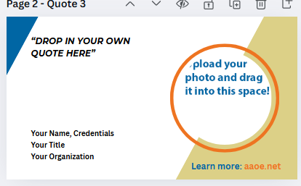
Social post image templates
Add your own short quote and your company logo or your photo.
https://www.canva.com/design/DAGj3sHODTY/QChE6h75BchS2nDDmeo2wg/edit?utm_content=DAGj3sHODTY&utm_campaign=designshare&utm_medium=link2&utm_source=sharebutton

Slide 22
Sample social media posts (use with the image on the prior page)
💬 One of the best parts of being an AAOE member? The network.
AAOE connects you with orthopedic leaders across the country—sharing real-world solutions to the same challenges we all face.
It’s helped me level up in ways I didn’t expect—and it can do the same for you. Use my code XX to take 15% off first-year membership dues! Hurry, it expires soon.
🔗 Join us: www.aaoe.net/membership-information
#AAOEMembers #OrthopedicExecutives #CareerGrowth #AAOEProud
🚀 Ready to take your career in orthopedic practice management to the next level?
AAOE has helped me grow with tools like:
✔️ The Annual Conference
✔️ An on-demand webinar library with 100+ titles
✔️ Compensation benchmarking
✔️ Strategic planning resources
🔗 Learn more: www.aaoe.net/membership-information. Use my code XX to take 15% off first-year membership dues! Hurry, it expires soon.
#OrthoLeadership #PracticeManagement #AAOEProud
Get images to accompany these posts

Slide 23
Sample Social Media Posts
(pun-ny)
Ready to bone up on your orthopedic practice management skills?
AAOE has the tools to help you strengthen your foundation:
🦴On-demand education library of 100+ titles
🦴 On-demand online courses
🦴 Annual Conference
🦴 Compensation benchmarking (because guessing is a pain in the joint)
🦴 Strategic planning resources
It’s helped me grow in all the right places—no MRI needed.
🔗 Learn more: www.aaoe.net. Use my code XX to take 15% off first-year membership dues! Hurry, it expires soon.
#BoneUpOnLeadership #OrthopedicPuns #AAOEProud
Running an orthopedic practice can feel like you’re always putting out bone fires. 🔥🦴
That’s why I rely on AAOE—a network of sharp minds (and even sharper tools) ready to help you tackle challenges head-on.
It’s the kind of support system every practice manager knee-ds.
🔗 www.aaoe.net. Use my code XX to take 15% off first-year membership dues! Hurry, it expires soon.
#NoBonesAboutIt #PracticeManagement #AAOEnetwork #OrthopedicPuns #AAOEProud

Slide 24
Tag AAOE in Your Social Posts
LinkedIn: Type @aaoe (it will auto-complete once tagged correctly).
Facebook: Type in @AAOE1
X: Type in @AAOE_OrthoExec
Instagram: Type in @aaoe_orthoexec
Hashtags: Choose 2-3 for your posts:
#AAOEProud
#OrthoProfessionalsofAAOE
#ProudAAOEMember
#AAOEMember
#OrthopedicExcellenceWithAAOE

Slide 25
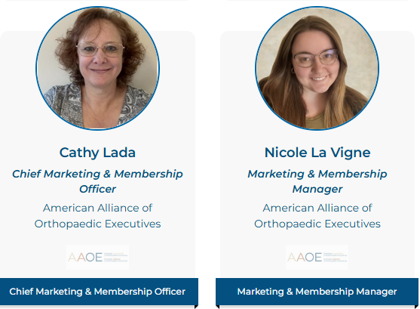
Questions?
Reach out to Nicole La Vigne (nlavigne@aaoe.net) or Cathy Lada (clada@aaoe.net) with any questions!

