Slide 1
Member-Get-A-Member
Campaign Materials
Condensed Version
2025

Slide 2
How to Use This Kit
The Ask:
Please send one of the two emails (or one you write) and post to social media at least twice through December 15, 2025. You’ll receive rewards for each new member who joins.
This Kit:
This kit is designed for AAOE members to reach out to their networks and work colleagues.
There are sample templates for social media and email to choose from.
If needed: Membership dues schedule (dues are prorated beginning in April)
Reach out to Nicole La Vigne (nlavigne@aaoe.net) or Cathy Lada (clada@aaoe.net) to get your 15% off a first-year membership coupon code!

Slide 3
Short Email Message 1
Subject: Why I’m a Member of AAOE, and You Should be, Too
Hi Name,
Healthcare is constantly evolving—and managing an orthopedic practice becomes increasingly complex every year. That’s why I rely on the American Association of Orthopaedic Executives (AAOE).
Through AAOE, I’ve gained access to valuable tools like the benchmarking survey, the physician fee schedule, webinars on hot topics, and more. Additionally, the member community is an exceptional platform for exchanging ideas and solutions.
AAOE’s education offerings—like webinars, online courses, and the annual conference—keep me informed and prepared for what’s ahead. If you’re thinking about going to the AAOE Annual Conference, you can also use my conference code, XX, to save $100 – and if you register before October 31, your rate is the lowest it will be this year! Here’s the link to register: Registration Form. Be sure to check the Join & Save option on the registration form.
If you're not already a member, I highly recommend checking it out: www.aaoe.net/join. You can use my code – XX – to take 15% off your first-year membership dues! The code is valid through December 31.
Let me know if you have any questions—I’m happy to share more about how AAOE has helped me. I’d love for you to see the value and join AAOE!
Best,
[Your Name]

Slide 4
Short Email Message 2
Subject: Want to Take Your Career to the Next Level?
Hi [Name],
If you're looking to grow professionally in orthopedic practice management, I highly recommend joining the American Alliance of Orthopaedic Executives (AAOE).
AAOE has helped me level up through strategic management education, leadership development resources, and tools like benchmarking data and operational templates. But more than that, it's connected me with a network of peers who support and challenge each other to grow.
It’s made a huge difference in my career—and it can make a difference in yours too. If you're not already a member, I highly recommend checking it out: www.aaoe.net/join. You can use my code – XX – to take 15% off your first-year membership dues! The code is valid through December 31.
If you’re thinking about going to the AAOE Annual Conference, you can also use my conference code, XX, to save $100. If you register before October 31, your rate will be the lowest it will be this year, and far lower than the value you’ll receive. Here’s the link to register: Registration Form. Be sure to check the Join & Save option on the registration form.
Let me know if you want to talk more about it—I’m happy to share how AAOE has impacted my journey.
Best,
[Your Name]

Slide 5
Sample social media posts
Copy & paste this text into a new post on your favorite social network(s) be sure to fill in your personal discount code to replace the XX below.
💬 One of the best parts of being an AAOE member? The network.
AAOE connects you with orthopedic leaders across the country—sharing real-world solutions to the same challenges we all face.
It’s helped me level up in ways I didn’t expect—and it can do the same for you. Use code XX to take 15% off first-year membership dues! Hurry, it expires soon.
🔗 Join us: www.aaoe.net/join
#AAOEMembers #OrthopedicExecutives #CareerGrowth #AAOEProud
@aaoe
Download the image on the next page to add to your post

Slide 6
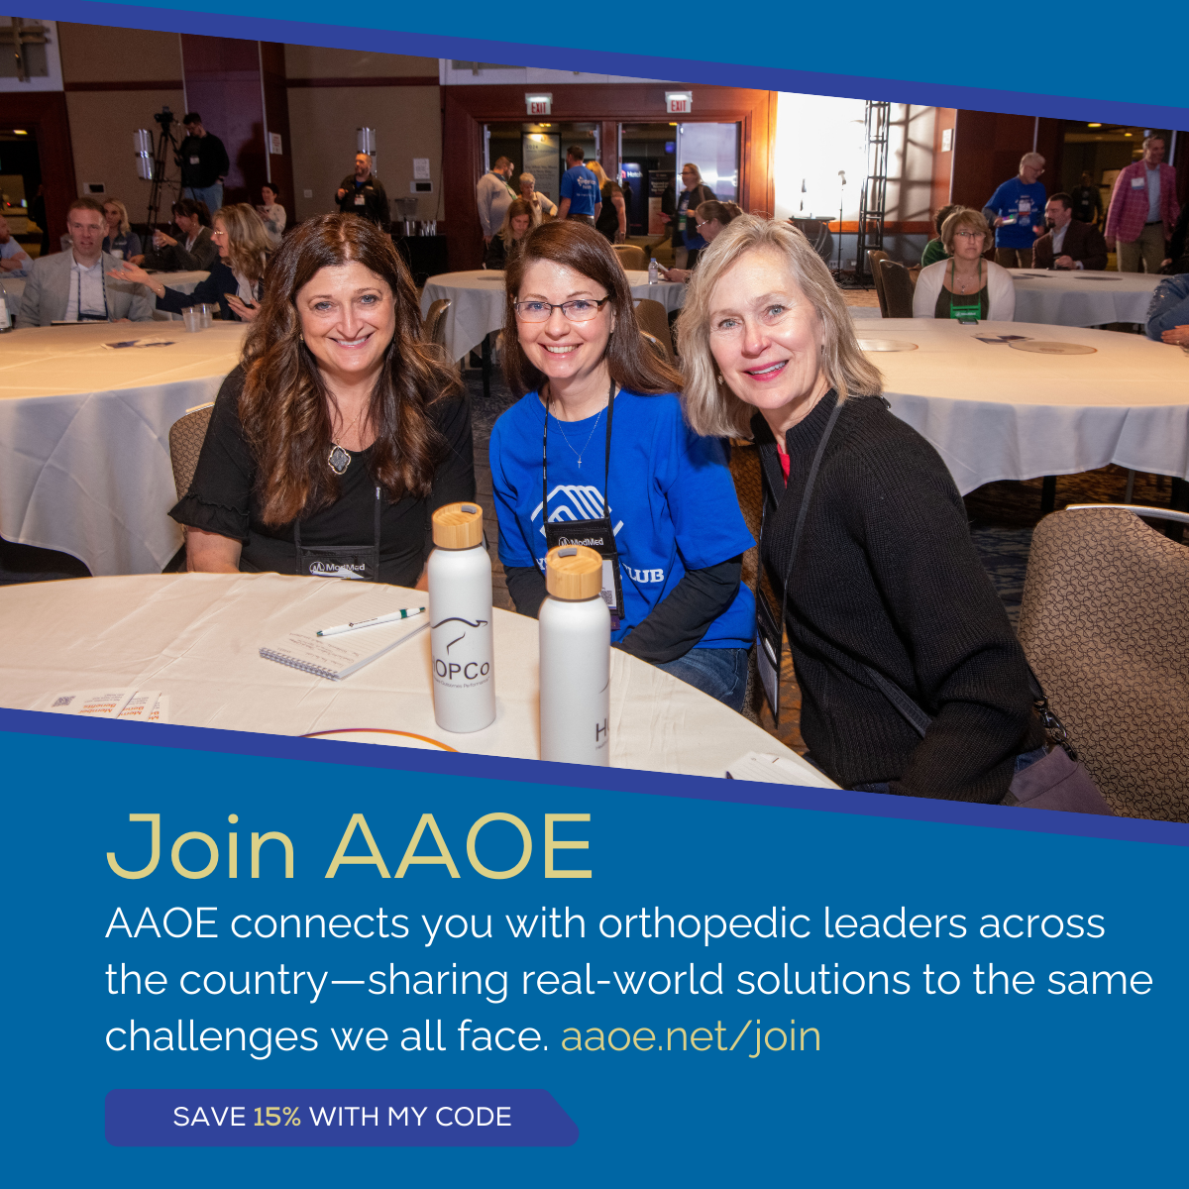
Right-click the image and click “save as” to save to the folder of your choice on your computer

Slide 7
Sample Social Media Posts
(pun-ny)
Copy & paste this text into a new post on your favorite social network(s) be sure to fill in your personal discount code to replace the XX below.
Ready to bone up on your orthopedic practice management skills?
Join me as an AAOE member!
AAOE has the tools to help you strengthen your foundation:
🦴On-demand education library of 100+ titles
🦴 On-demand online courses
🦴 Annual Conference
🦴 Compensation benchmarking (because guessing is a pain in the joint)
🦴 Strategic planning resources
It’s helped me grow in all the right places—no MRI needed.
🔗 Learn more: www.aaoe.net. Use my code, XX, to take 15% off first-year membership dues! Hurry, it expires soon.
@aaoe
#BoneUpOnLeadership #OrthopedicPuns #AAOEProud
Download the image on the next page to add to your post

Slide 8

Right-click the image and click “save as” to save to the folder of your choice on your computer

Slide 9
Sample Social Media Posts
(pun-ny)
Copy & paste this text into a new post on your favorite social network(s) be sure to fill in your personal discount code to replace the XX below.
Running an orthopedic practice can feel like you’re always putting out bone fires. 🔥🦴
That’s why I rely on AAOE—a network of sharp minds (and even sharper tools) ready to help you tackle challenges head-on.
It’s the kind of support system every practice manager knee-ds.
🔗 www.aaoe.net. Use code XX to take 15% off first-year membership dues! Hurry, it expires soon.
#NoBonesAboutIt #PracticeManagement #AAOEnetwork #OrthopedicPuns #AAOEProud
@aaoe
Download this image to include with your post

Slide 10
Right-click the image and click “save as” to save to the folder of your choice on your computer

Slide 11
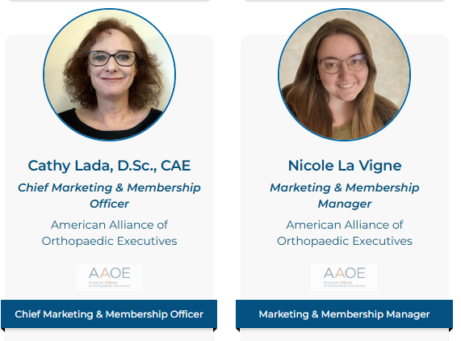
Questions?
Reach out to Nicole La Vigne (nlavigne@aaoe.net) or Cathy Lada (clada@aaoe.net) with any questions!

