Slide 1
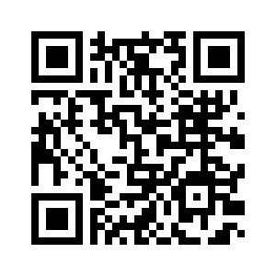
Tuesday & Wednesday May 30th & 31st, 2023 9:00 am - 4:00 pm
FREE Introduction to Maintenance as a Career
Hosted by the Apartment Association of Kansas City at Ever Ready Services 1310 Iron Street North Kansas City, MO 64116
Have you ever considered a rewarding career as an Apartment Maintenance Technician?
“Introduction to Maintenance as a Career” is for individuals looking to enter the exciting property management industry. You’ll learn:
How the Apartment Association of Kansas City can help you in your career.
Basic electrical, plumbing, drywall, & appliance repair to help jumpstart your career and have skills needed from day 1.
A typical day in the life of a Maintenance Technician.
Tips to boost career opportunities.
Starting pay ($19-$25/hr.) plus benefits.
Resources to begin interviewing immediately!
Registration is required. Starts at 9:00 sharp. You could launch your new career in as little as 1 week!

