Slide 1
Collaborating and Communicating with Publics: Engagement for Social Impact
AAAL PAEC
Summer Webinar
July 28, 2021

Slide 2
WEBINAR OVERVIEW
Meaningful projects designed & executed collaboratively with colleagues
Diverse disciplines, non-academic institutions, local communities
Communicating & collaborating with publics in real-world settings
Successes, challenges, and strategies
In-depth understanding, engagement, and impact

Slide 3
WEBINAR OVERVIEW
Overview/Introduction
2-minute Descriptions of Each Chapter
Breakout Rooms (Guiding Questions)
Large Group Discussion
Wrap Up & Next Steps

Slide 4
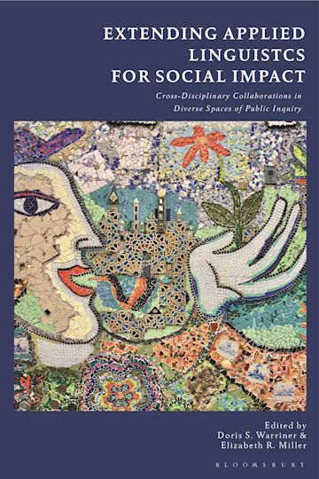
:

Slide 5
Introductory/Overview Comments (Doris S. Warriner & Elizabeth R. Miller)
An explicit focus on language practice might facilitate understanding, engagement, and impact in real-world settings and in collaboration with members of local communities
More energy and time should be devoted to clarifying, communicating, and collaboratively exploring the relevance of our scholarship to other disciplines and local communities
analyzing the role of language in society contributes to socially embedded, cross-institutional, multi-sited, and/or collaborative research projects

Slide 6
So we decided (as a group) to…
Focus on how we have moved purposefully into spaces that we might initially find unfamiliar or even uncomfortable
Explain the problem with expecting a seamless, smooth, and tension-free research-engagement process
Show that this kind of work can often be logistically and emotionally demanding, with many twists, turns, and false starts
Demystify the research process and work actively against presenting a “sanitized accounts” of research design, data collection, and data analysis

Slide 7
Authors considered these Guiding Questions:
How did you build collaboration with others (e.g., in other disciplines and/or in local communities) while undertaking this project?
Under what circumstances did language and/or literacy issues become important focus for the research context? How did you respond?
What difficulties did you encounter as a language/linguistics researcher in working with non-linguists? and how did you address them?
What can other applied linguistics/academics exploring the role of language, literacy, and/or communication in issues, problems, dilemmas of concern to the broader public learn from your approaches (methodological, theoretical, epistemological) to inquiry?

Slide 8
1. Engaging the public in sociolinguistics for social justice: advocating for pidgin speakers in Hawai’i (Christina Higgins, University of Hawai’i)
student-produced documentary film about Pidgin
museum exhibit about the development and contemporary use of Pidgin
public conference on Pidgin and education, held at a local high school

Slide 9
2. Building partnerships and expanding repertoires of practice: working with and in museums to improve informal science education for linguistically diverse children (Leslie C. Moore)
Callanan’s advice on museum-university partnerships:
• find overlapping goals
• get to know the organization
• recognize museum staff as professionals
• recognize that your outsider status has both benefits and drawbacks
• give something back
• keep an open mind
Betsy Rymes’ wonderful afterword
• Clinging to our institutional roles impedes collaborative public inquiry

Slide 10
3. An applied linguist at work: tracing language choices in a social sustainability network (Elizabeth R. Miller)

Slide 11
4. Finding the answers within the story: the transformative potential of translanguaging praxis (Obed Arango & Holly Link)

Slide 12
5. Being, seeing, and hearing white: when theater arts interrogate and make visible the power of the elephant in the room (Ellen Skilton)

Slide 13
6. Language as a social determinant of health: Partnerships for health equity (Emily Feuerherm, Rachel E. Showstack, Maricel G. Santos, Glenn A. Martinez & Holly E. Jacobson)

Slide 14
7. “It depends case by case”: understanding how the practices of cultural health navigators impact healthcare access and delivery for refugee-background families (Katherine E. Morelli & Doris S. Warriner)

Slide 15
8. Applied linguistic anthropology: balancing social science with social change (Netta Avineri, Eric J. Johnson, Bernard C. Perley, Jonathan Rosa & Ana Celia Zentella)
Applied Linguistic Anthropology: Observation, Centering Language, Recognition of Positionalities, Collaboration, Raising Awareness
4 Case Studies (AAA Language & Social Justice Task Group)
Who is linguistically ‘isolated’?: Challenging a damaging US Census category
Debating the language of migrant “illegality”: Connecting linguistic advocacy to broader struggles
Mascot names and the naturalization of public racism
(Mis)understanding the “30 million word gap”
Time, Scale, Audience, Positionality, Modality, and Impact

Slide 16
Afterword: Crossing Borders, Rethinking Expertise, and Becoming Collaborative Linguists (Betsy Rymes)

Slide 17
Breakout Rooms & Sharing Out
Chapter authors and webinar participants
Q & A with the chapter author(s)
General discussion/interaction
Sharing highlights with the larger group

Slide 18
Guiding Questions for Breakout Rooms
How have you collaborated with others (e.g., in other disciplines and/or in local communities)?
Under what circumstances did language and/or literacy issues become important focus for the research context? How did you respond?
What difficulties have you encountered as a language/linguistics researcher while working with non-linguists? And how did you address them?
What can other applied linguistics/academics exploring the role of language, literacy, and/or communication in issues, problems, dilemmas of concern to the broader public learn from your experiences and approaches to inquiry?

Slide 19
What’s Next?
Connect with one another
Applied Linguistics & Social Justice listserv (300 members)
Applied Linguistics Briefs (guidelines coming in August)
Webinars
Your ideas…!
Contact paec@aaal.org
https://www.aaal.org/volunteer

