Slide 1
Keep the Beat CPR
Exploring Life Saving CPR

Slide 2
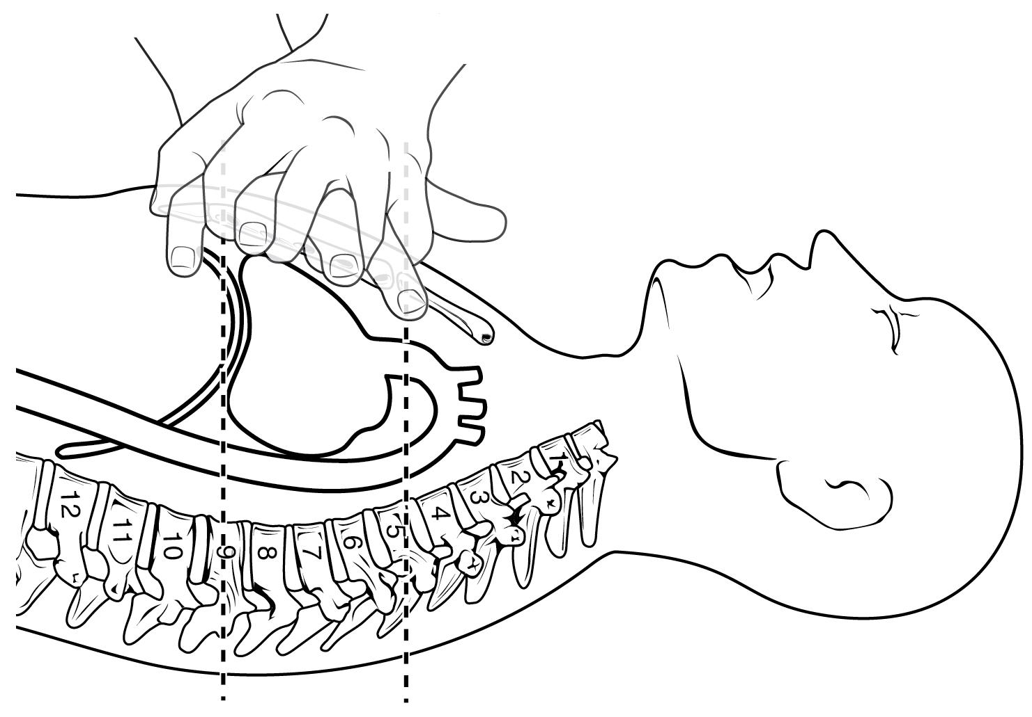
What exactly is CPR?
Notes:
Your are manually pumping the heart because it is not working. As long as you are pumping the heart you are moving oxygen to the brain.

Slide 3
CPR is an emergency lifesaving procedure performed when the heart stops beating.
Notes:
Giving compressions assists in circulating the blood to the brain
and other vital organs until further trained help arrives.

Slide 4
When should CPR be Administered?
When a person becomes unresponsive and has no pulse.
Starting immediate CPR can double or even triple the chances of survival after cardiac arrest.

Slide 5
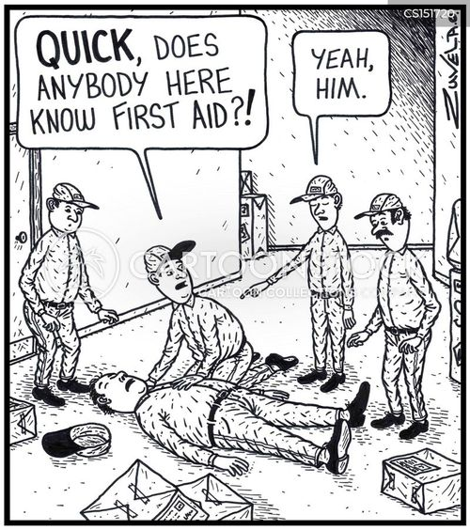
Who should know CPR?
EVERY ABLE BODY!
Notes:
he truth is emergencies are unpredictable. The more people trained in life saving CPR, the better chance of survival for a victim of cardiac arrest.

Slide 7
CPR requires extensive medical training.

Slide 8
False
While getting CPR training from a certified instructor is beneficial, the reality is that anyone can learn how to perform CPR.

Slide 9
Breaths are always necessary when performing CPR.

Slide 10
False
When you have no breathing device available it is not recommended to give breaths.

Slide 11
Why?
Risk of disease transmission.
In case of an overdose, you can ingest the drugs yourself.
Breaths can interrupt life saving compression.

Slide 12
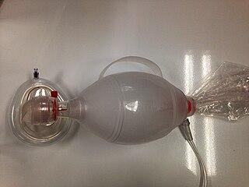
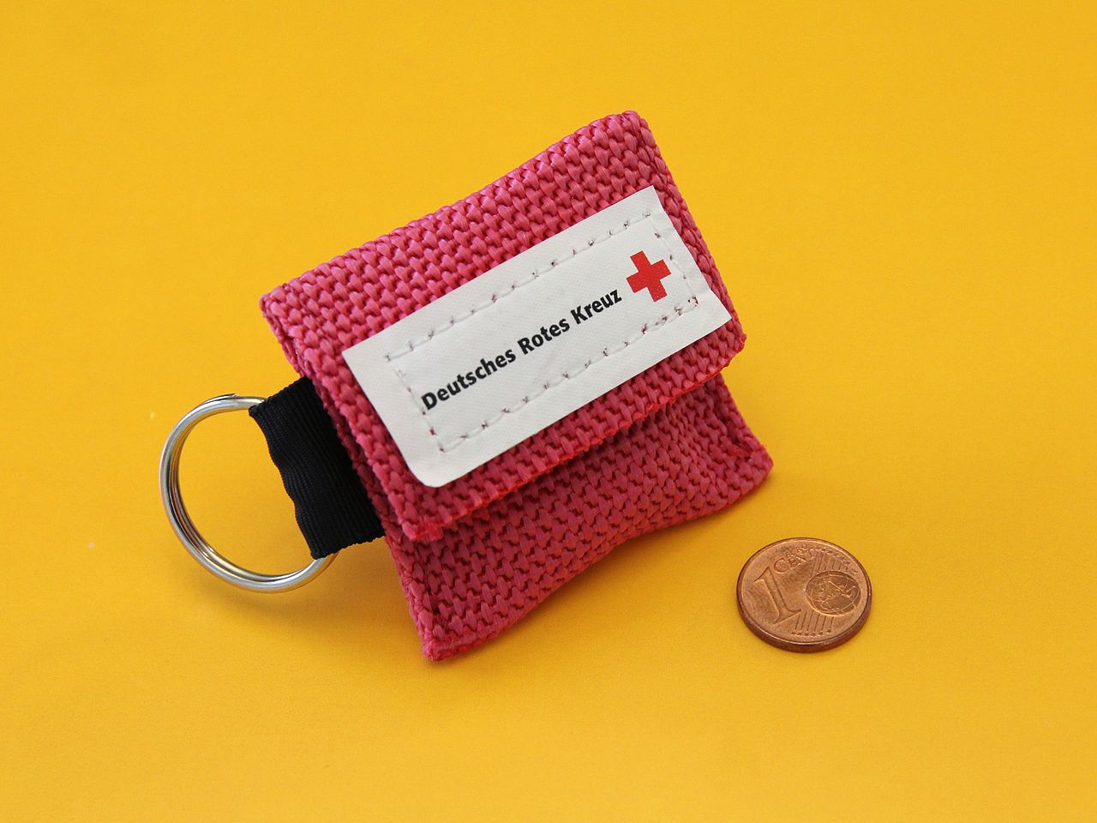
Examples of approved breathing devices

Slide 13
I can learn CPR by watching a video online
Notes:
Truth meter and make your next slide the “Why” slide

Slide 14
False
While it is true that you can learn the steps of CPR from an online class it is far more beneficial to get hands on training!

Slide 15
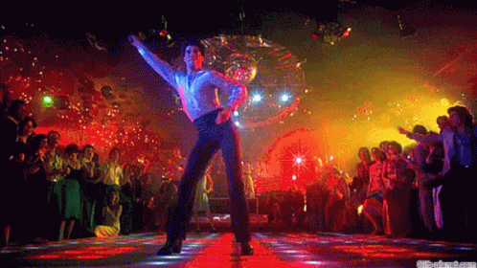
CPR Songs
100-120 BPM
Staying Alive
Another One Bites the Dust
Baby Shark
Sweet Home Alabama
Just Dance
Outkast- Roses
T. swift - The Man
…….. And many more!

Slide 16
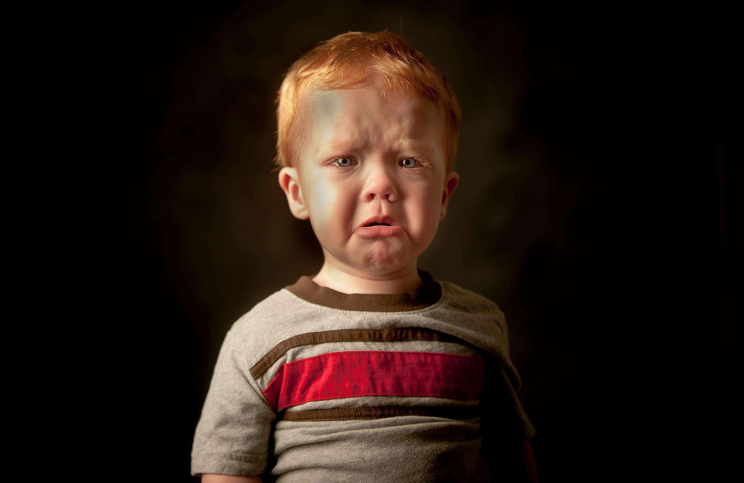
Common Medical emergencies in children

Slide 17
Choking
Every 5 days an estimated 1 child in the U.S. dies from choking.
Notes:
Move the paragraph one space up and maybe underline choking?

Slide 18
Common foods that cause choking

Slide 19
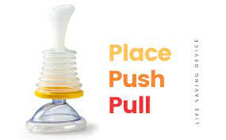
Anti-Choking device

Slide 21
Anaphylaxis
(severe allergic reaction)
Food allergens, especially milk and wheat, are the most common cause of anaphylaxis in children.
- Severe allergic reactions can be fatal!
Common symptoms include tightness or swelling of the throat and tongue, trouble breathing, hives, and itching.

Slide 22
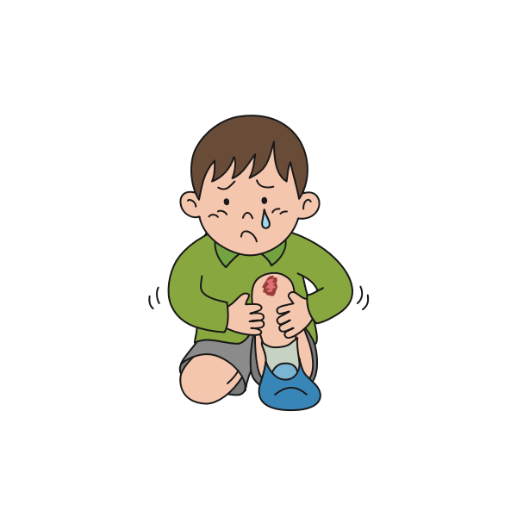
Falls
Falls are a common cause of injuries and may result in fractures, cuts, or head injuries.

Slide 23
AEDs are crucial!
An AED is a portable electronic device used to treat sudden cardiac arrest by delivering an electric shock to the heart to restore its normal rhythm
A person's chance of surviving drops by 7 to 10% every minute a normal heartbeat isn't restored.
AEDs can increase the survival rate for people experiencing sudden cardiac arrest by up to 75%.

Slide 24
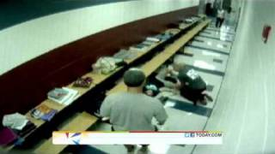

Slide 25
In conclusion
- Immediate CPR can double or triple the victim's chance of survival from cardiac arrest.
-Anyone can and should learn high-quality CPR.
Hands on training is the most effective way to learn high-quality CPR.

Slide 26
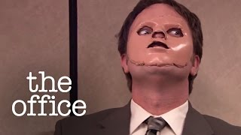

Slide 27
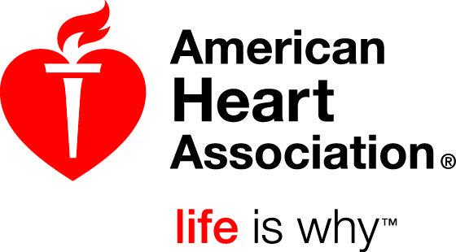
Thank you for Keeping the Beat!

