Slide 1
Good Hiring Practices
Presented by:
Jenna Rubin
Fisher Phillips LLP
www.fisherphillips.com

Slide 2
Today’s Session: Good Hiring Practices
Today we’ll cover the gamut of hiring issues: recruiting, interviewing, and on-boarding.
We will focus on best practices and strategies to make sure we’re legally compliant.
Please remember, employment law compliance depends on multiple factors – particularly those unique to each employer’s circumstances. Numerous laws, regulations, interpretations, administrative rulings, court decisions, and other authorities must be specifically evaluated in applying the topics covered by this webinar. The webinar is intended for general-information purposes only. It is not a comprehensive or all-inclusive explanation of the topics or concepts covered by the webinar.

Slide 3
Program Reminders
Questions any time!
Engage with each other for a discussion
Focused on “best practice”
Not one-size-fits-all

Slide 4
At-Will Employment
Any reason, right?
Good, bad, no reason at all

Slide 5
Unlawful Reasons*
Race
Color
Religion
Sex/Sexual Orientation
Gender/Gender Identity
Age
*Independent contractors
Disability
National Origin
Citizenship
Military Service
Retaliation
…

Slide 6
Legal Considerations
How does employment at-will relate to recruiting, interviewing, and hiring?
Discrimination claims
Negligent hiring and retention claims

Slide 8
Beginning the Process
Establish recruiting objectives
Identify requirements/opportunities
Determine appropriate sources
Referrals!
Job posting
Know exactly what job requires
Job description
Closing date?

Slide 9
Job Descriptions
Essential duties/key responsibilities
Qualifications
Ensures people know their job functions
“Ideal candidate”
Used for evaluating job performance

Slide 10
Application Process
Develop and use the School’s required form
Ensure candidate completes everything
Don’t accept just a resume
Review responses carefully
Verify information

Slide 11
Reviewing Applications
Gaps in employment
“Interesting” reasons for leaving prior employers
Shifting blame for why prior jobs didn’t work out
Information missing from employment history
P.O. Boxes
Questions left blank

Slide 12
The Interview
Prepare!
Review interview evaluation form
Review application materials
Try to put candidate at ease
Protect the School’s reputation
Clarify information from application

Slide 13
The Interview
Obtain additional information not on application
Personality, character, motivation
Appearance and professionalism
Test candidate’s truthfulness
Inform candidate about position/association – maybe!
Close with next steps

Slide 14
Virtual Interviews
Follow HR’s standardized process
Communicate clearly and thoroughly with candidates about expectations
Test your tech!
Choose a clean, quiet, well-lit space for interviews
Be as professional and personable as for on-site

Slide 15
The Interview Questions
Treat all candidates the same
Ask every candidate same core questions
Questions to avoid:
Children, childcare, or childbearing plans
Marital status
Age or graduation dates
Church or religion
Ancestry (family, accent)

Slide 16
So…What Can You Ask?
Do not ask:
When did you graduate?
Do you have reliable childcare?
Where do you go to church?
What is your nationality?
Ask:
Do you have a degree?
Can you work flexible hours?
Can you work Saturdays and Sundays?
What languages do you speak, read, or write fluently?

Slide 17
Basic Question Types
Direct: Have you ever been terminated?
Open: What were your duties in your last job?
Situational: Provide an example of a time you were challenged by a student and how you handled it?
Problem-Solving: How would you handle the following problem…

Slide 18
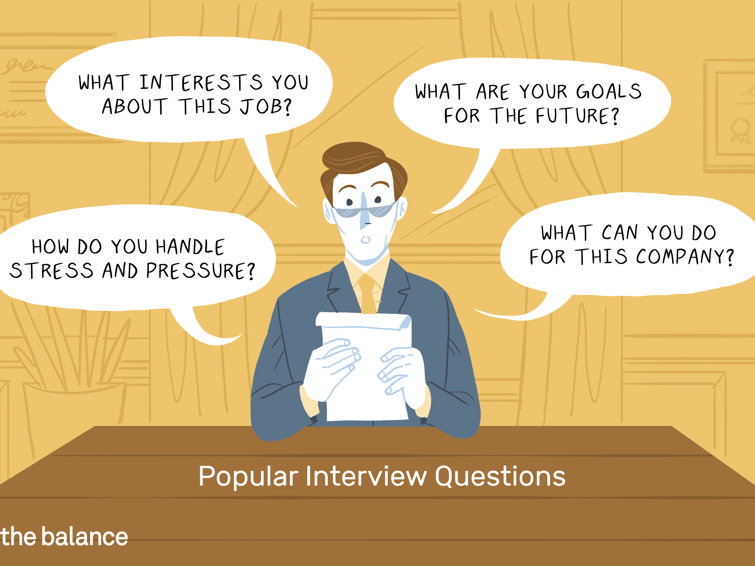
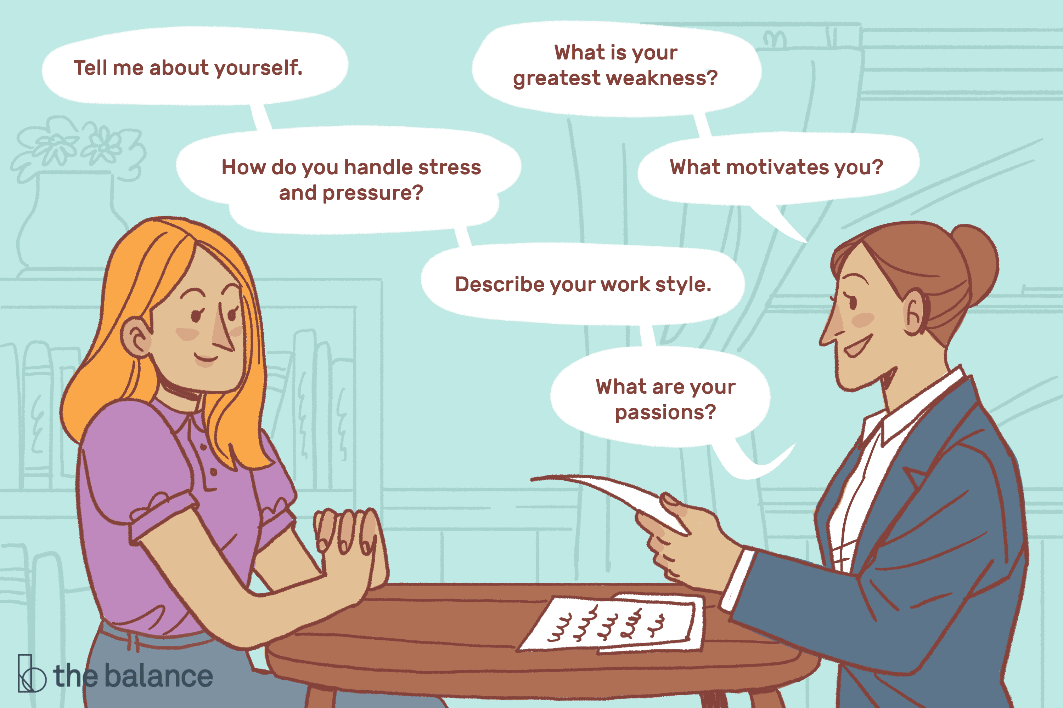
What are your favorite interview questions?

Slide 19
Common Interview Mistakes
Inadequate preparation
Wasting time
Making the interview an interrogation
Failing to listen carefully and ask follow up questions
End the interview appropriately
Next steps
Do not make promises

Slide 20
1-Minute Reflection
Think about an interview you’ve been on (or that you’ve conducted) that did not go well because of something the interviewer did. How would you improve it today?

Slide 21
Post-Interview
Offer letter
Use your template
Don’t create a contract
Salary
Start date
Conditions
Reference Checks
Background Checks
Drug Testing
Medical Testing

Slide 22
Considerations for Hiring Minors
Referral sources
First-time applicants
Establishing boundaries
Adult/minor interactions
Some states require work permits or age certifications
Interns

Slide 23
Restrictions on Work Days/Hours
Ages 16-17 – Federal law allows minors aged 16 and 17 to work for unlimited hours in any occupation so long as it’s not hazardous.
Some state laws differ such as Kentucky and Ohio.
Ages 14-15 –limited days and hours :
Outside school hours;
No more than 3 hours on a school day, and no more than 8 hours on a non-school day;
No more than 18 hours in a week when school is in session and no more than 40 hours in a week when school is not in session; and
Cannot work before 7 a.m. or after 7 p.m., except from June 1 through Labor Day when they may work until 9 p.m.

Slide 24
Considerations for Seasonal Employees
IRS definition: 6 months or fewer, need starts and ends about the same time each year
Overtime? Maybe
Misclassifications – not always independent contractors
Applicable leave policies

Slide 25
Effective Orientation
Orient on DAY ONE
Consider assigning a mentor/buddy
Explain basic policies/rules
Explain important policies (discrimination/harassment)
Set performance expectations

Slide 26
2-Minute Reflection
What can you take away from today’s session and put into practice tomorrow? Have you identified any “action steps”?

Slide 27
Final Questions?
Presented by:
Jenna Rubin
www.fisherphillips.com

