Slide 1
Who owns - what – when?
February 5, 2024
Chattanooga, TN

Slide 2
Who owns - what – when?
Tom Owenby - Director of Facilities
towenby@portergaud.edu
404-427-6163
Joey Ferrelli - Director of Auxiliary Programs jferrelli@portergaud.edu 843-402-4679

Slide 3
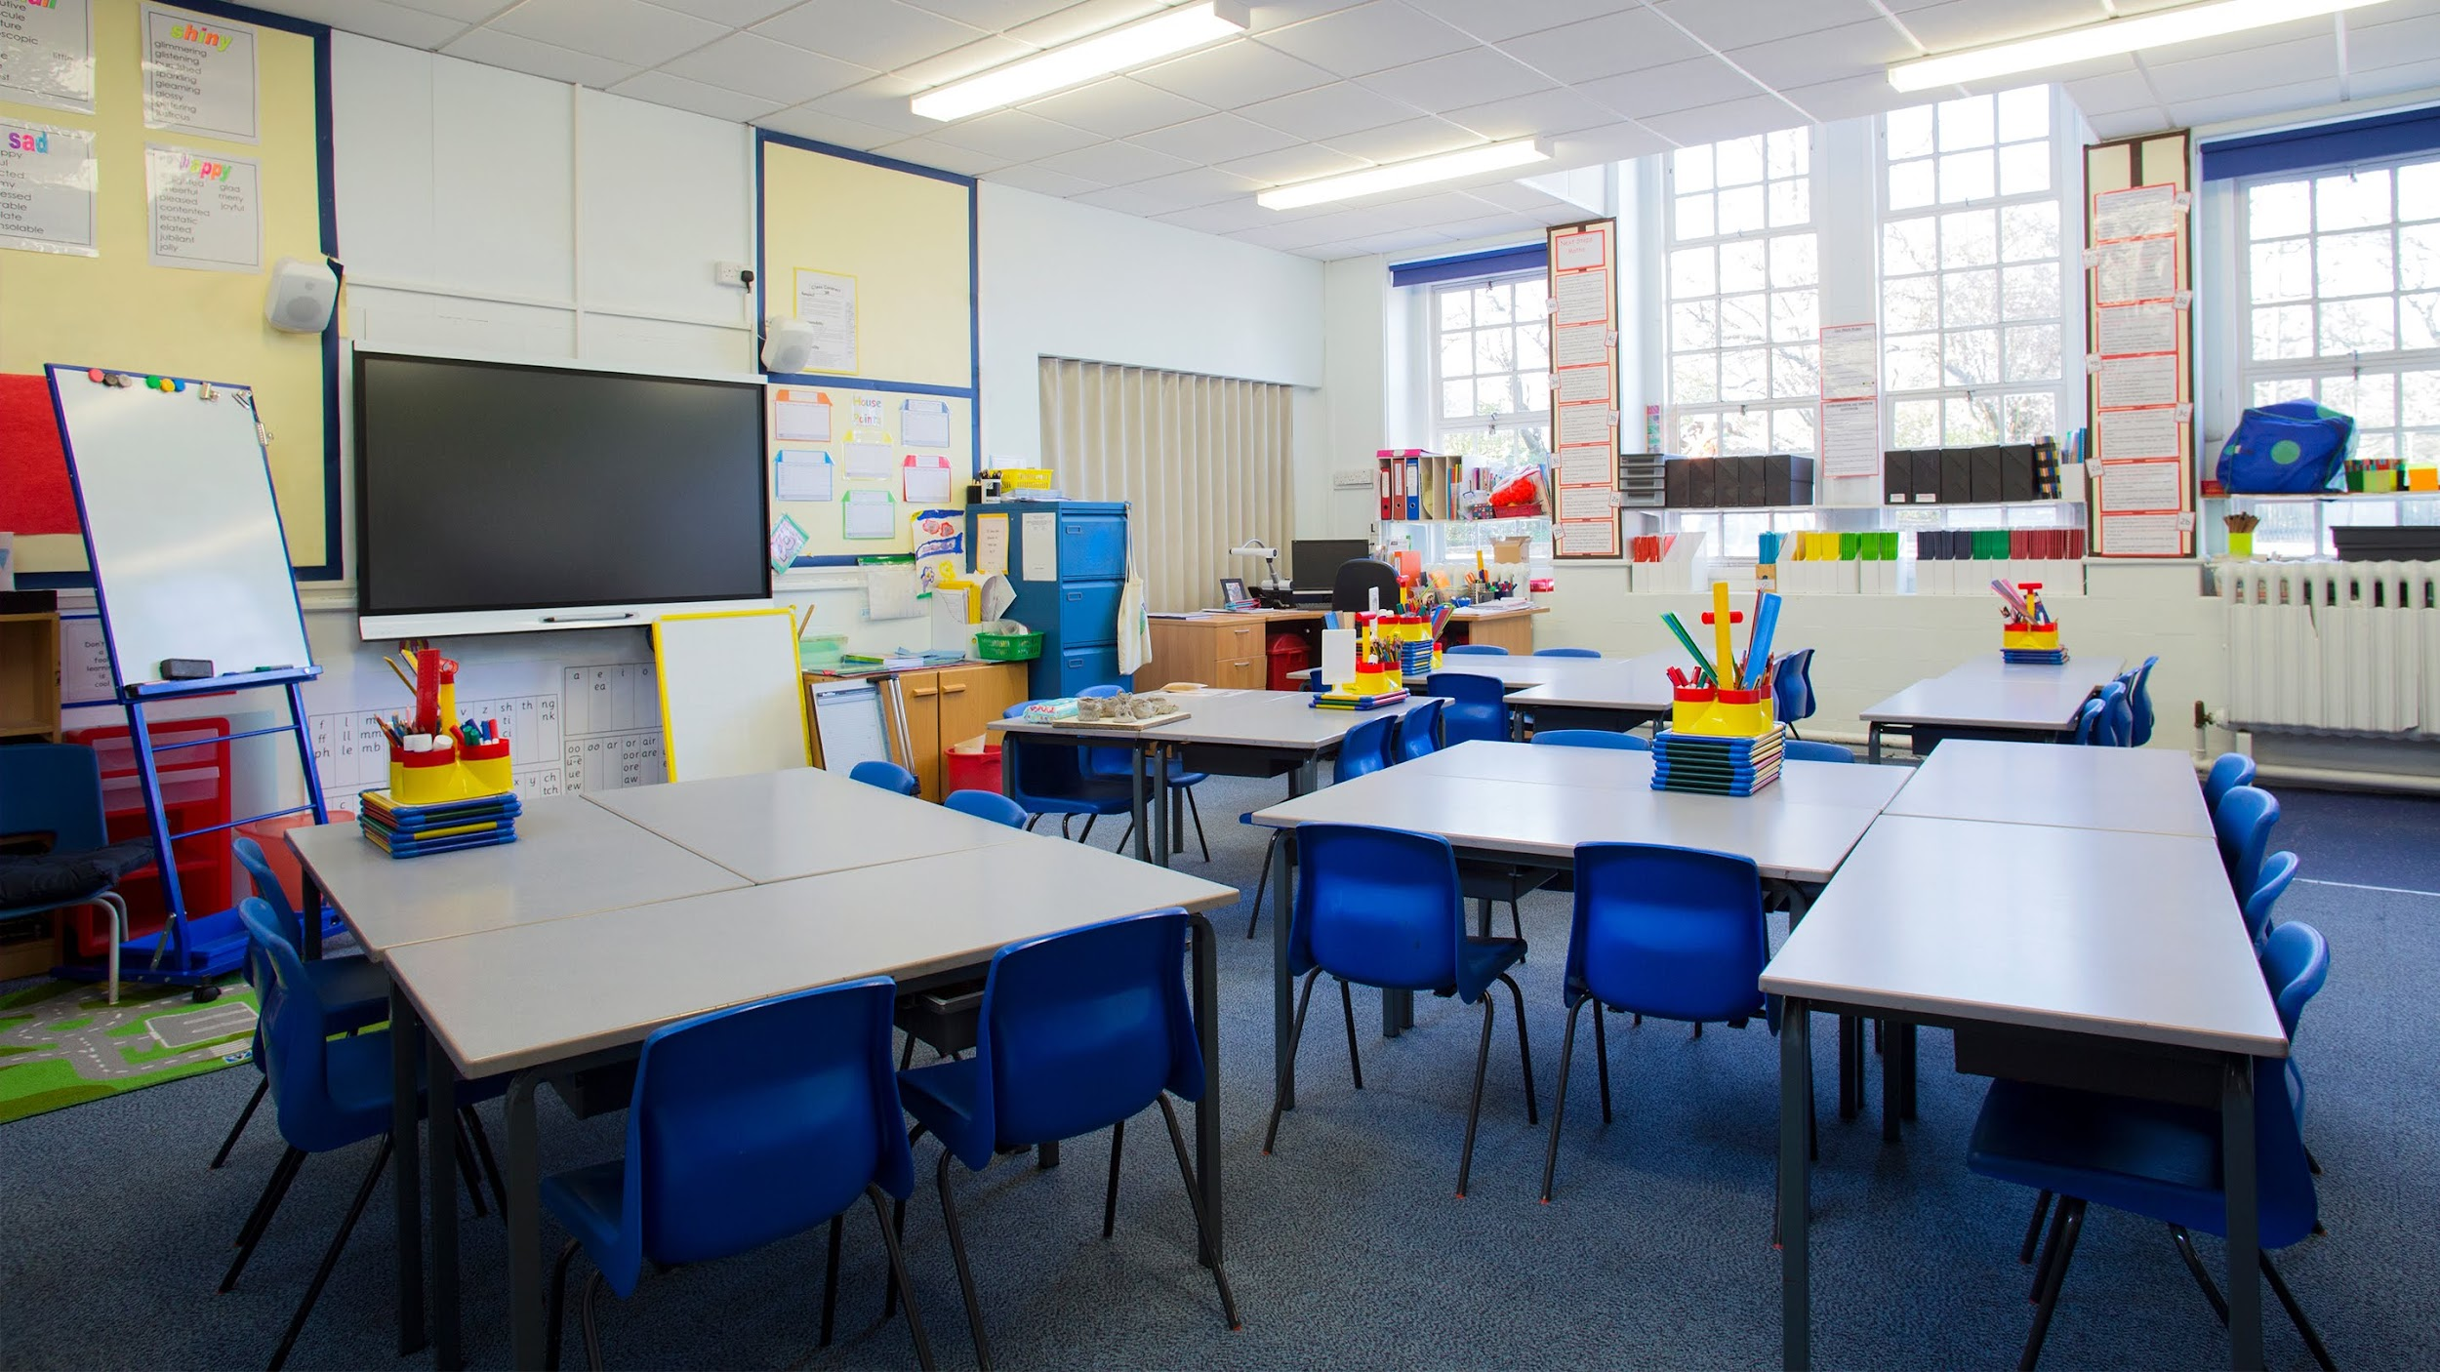
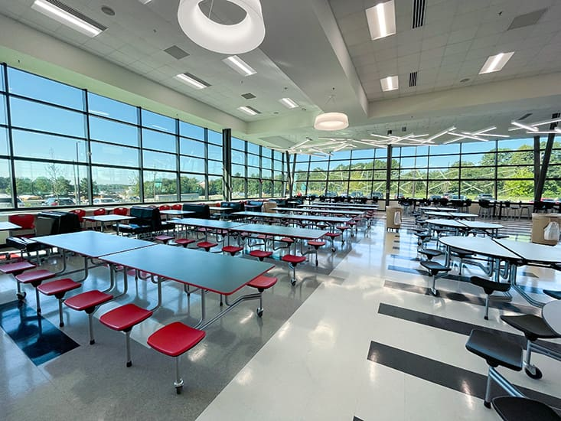
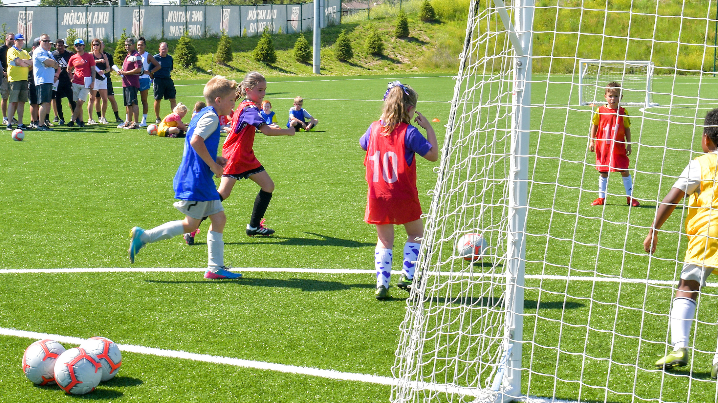
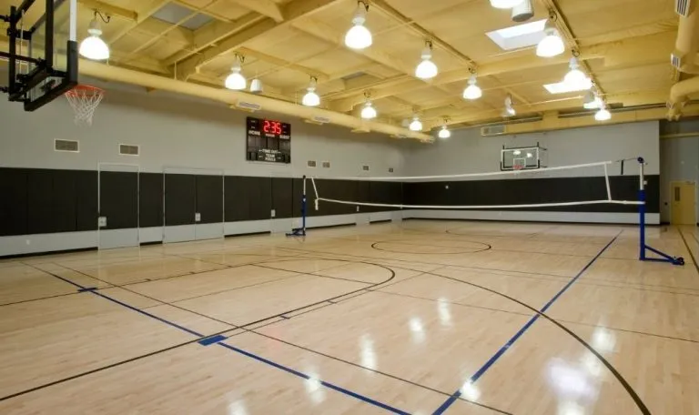

Slide 4
FAMOUS RIVALRIES
Yankees vs Red Sox
Chris Evert vs Martina Navratilova
Muhammad Ali vs Joe Frazier
Lakers vs Celtics
Packers vs Bears
Marvel vs DC
Facilities vs Auxiliary
Everyone vs Athletics

Slide 5
3 step process
1. Acknowledge different viewpoint
Behavioral styles
2. Agree to disagree
We have different goals
3. Look for the Win-Win
Communication

Slide 6
Acknowledge a different viewpoint…

Slide 8
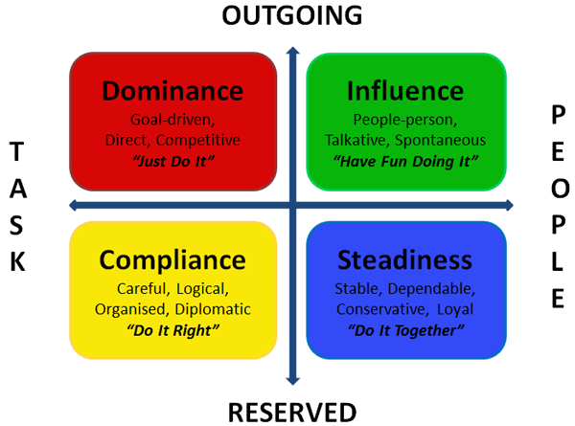

Slide 9
Agree to disagree…

Slide 10
Porter-Gaud Auxiliary Mission Statement
We believe in building self-esteem and character, while making new friends with lasting memories. Experience something new or enhance your everyday skills, whichever path you take, our main goal is for our students to grow and have fun!

Slide 11
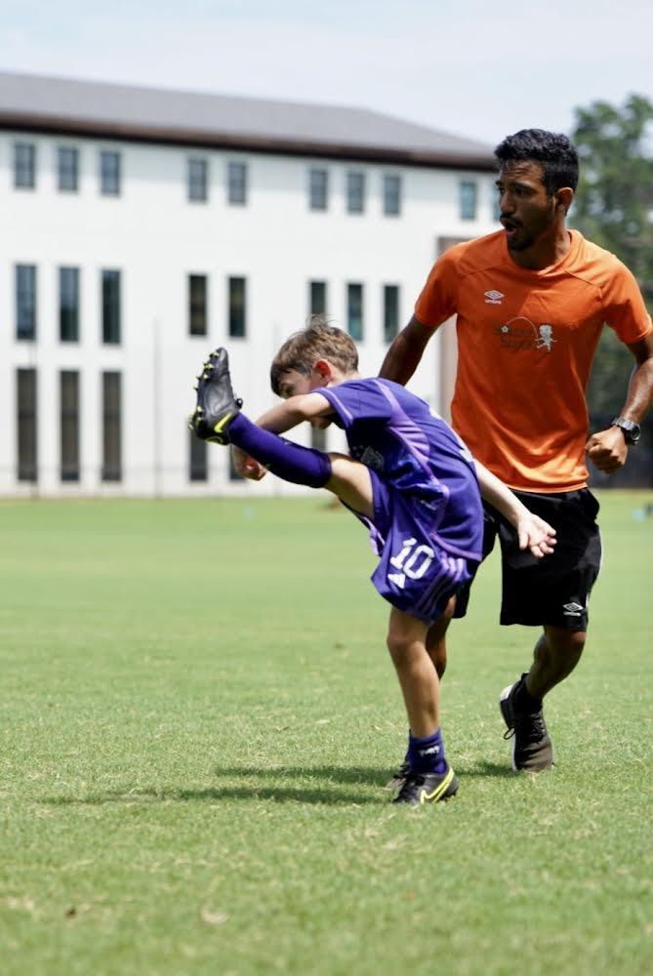
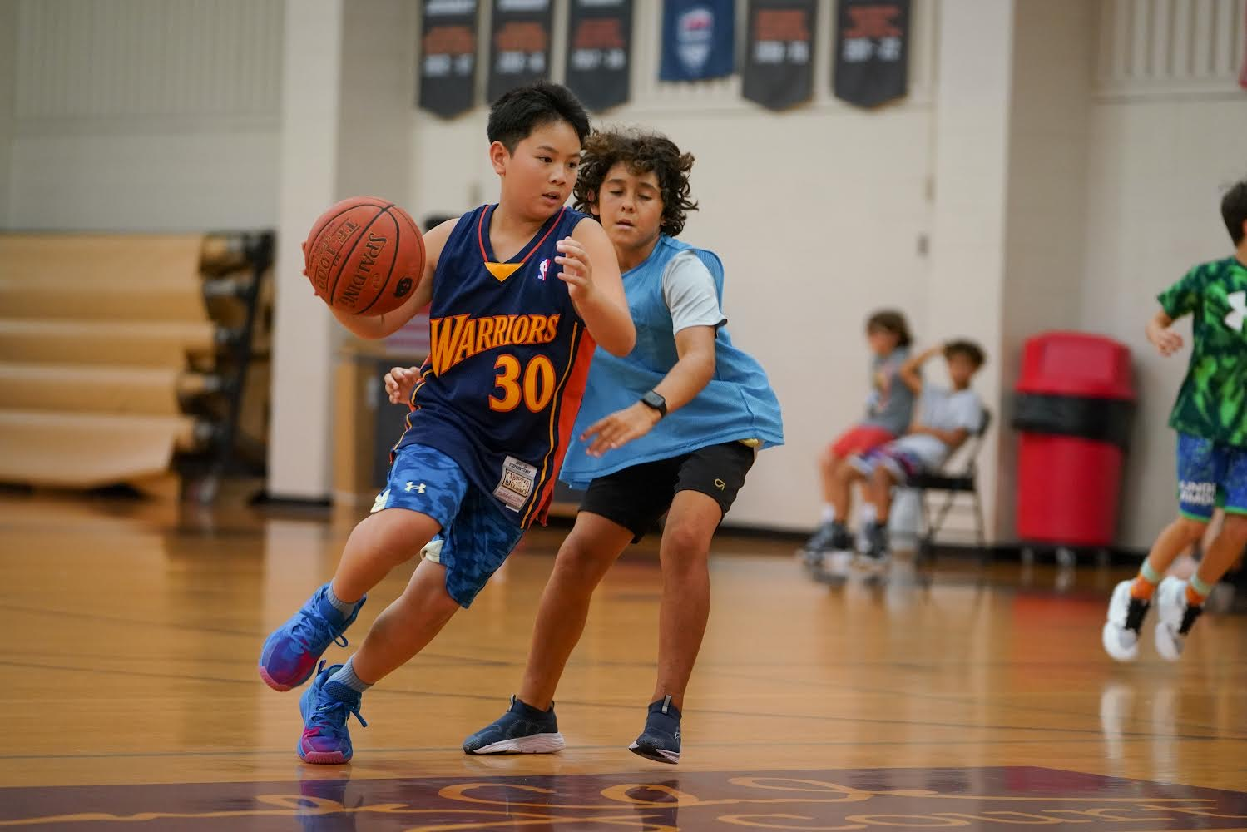
Camp Cyclone

Slide 12
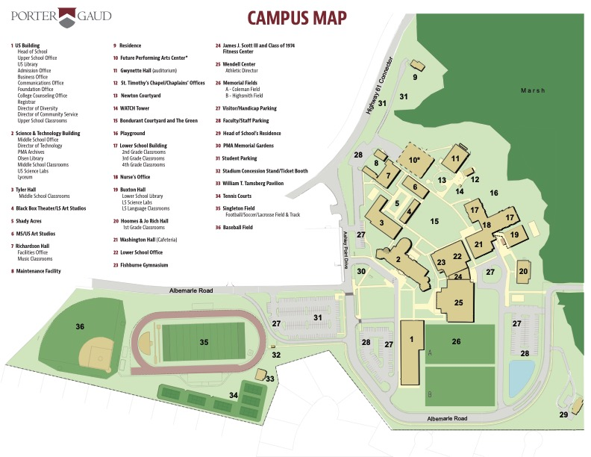

Slide 13
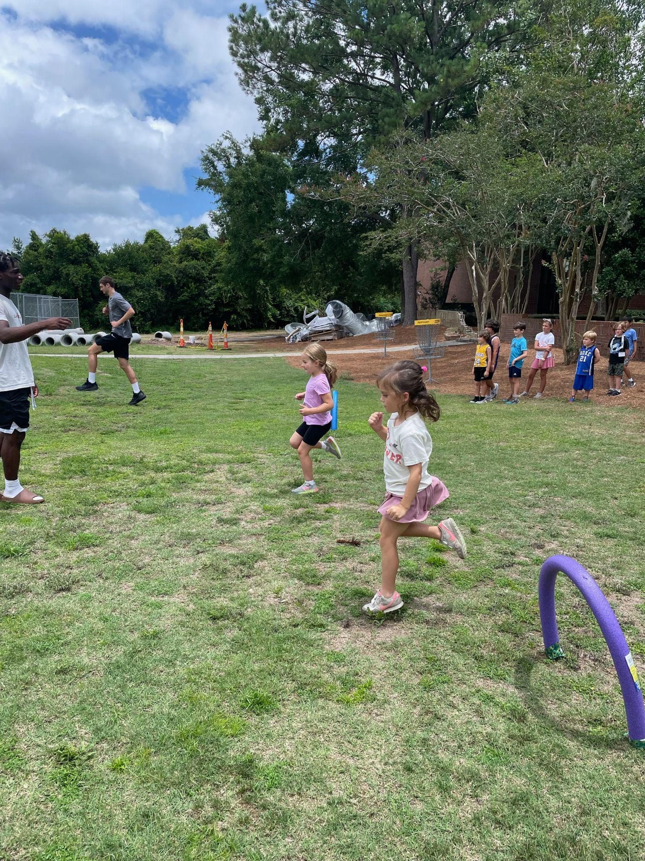
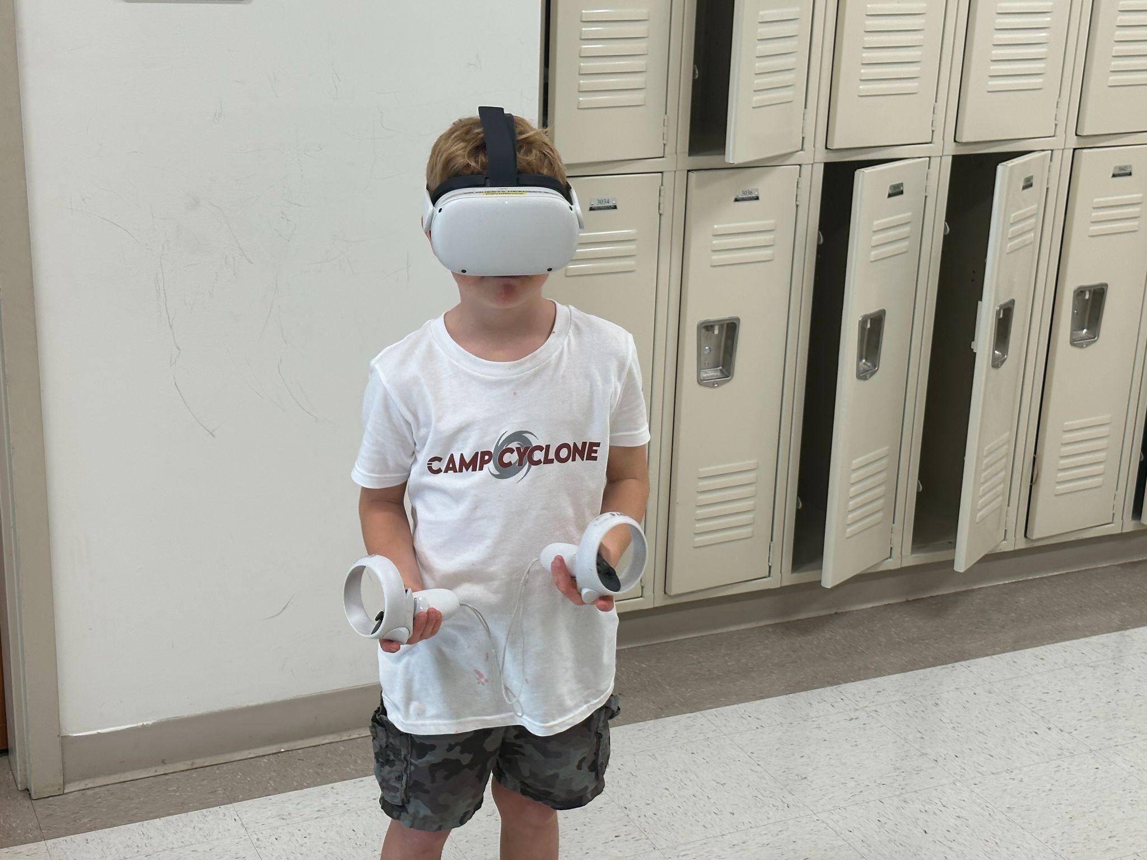
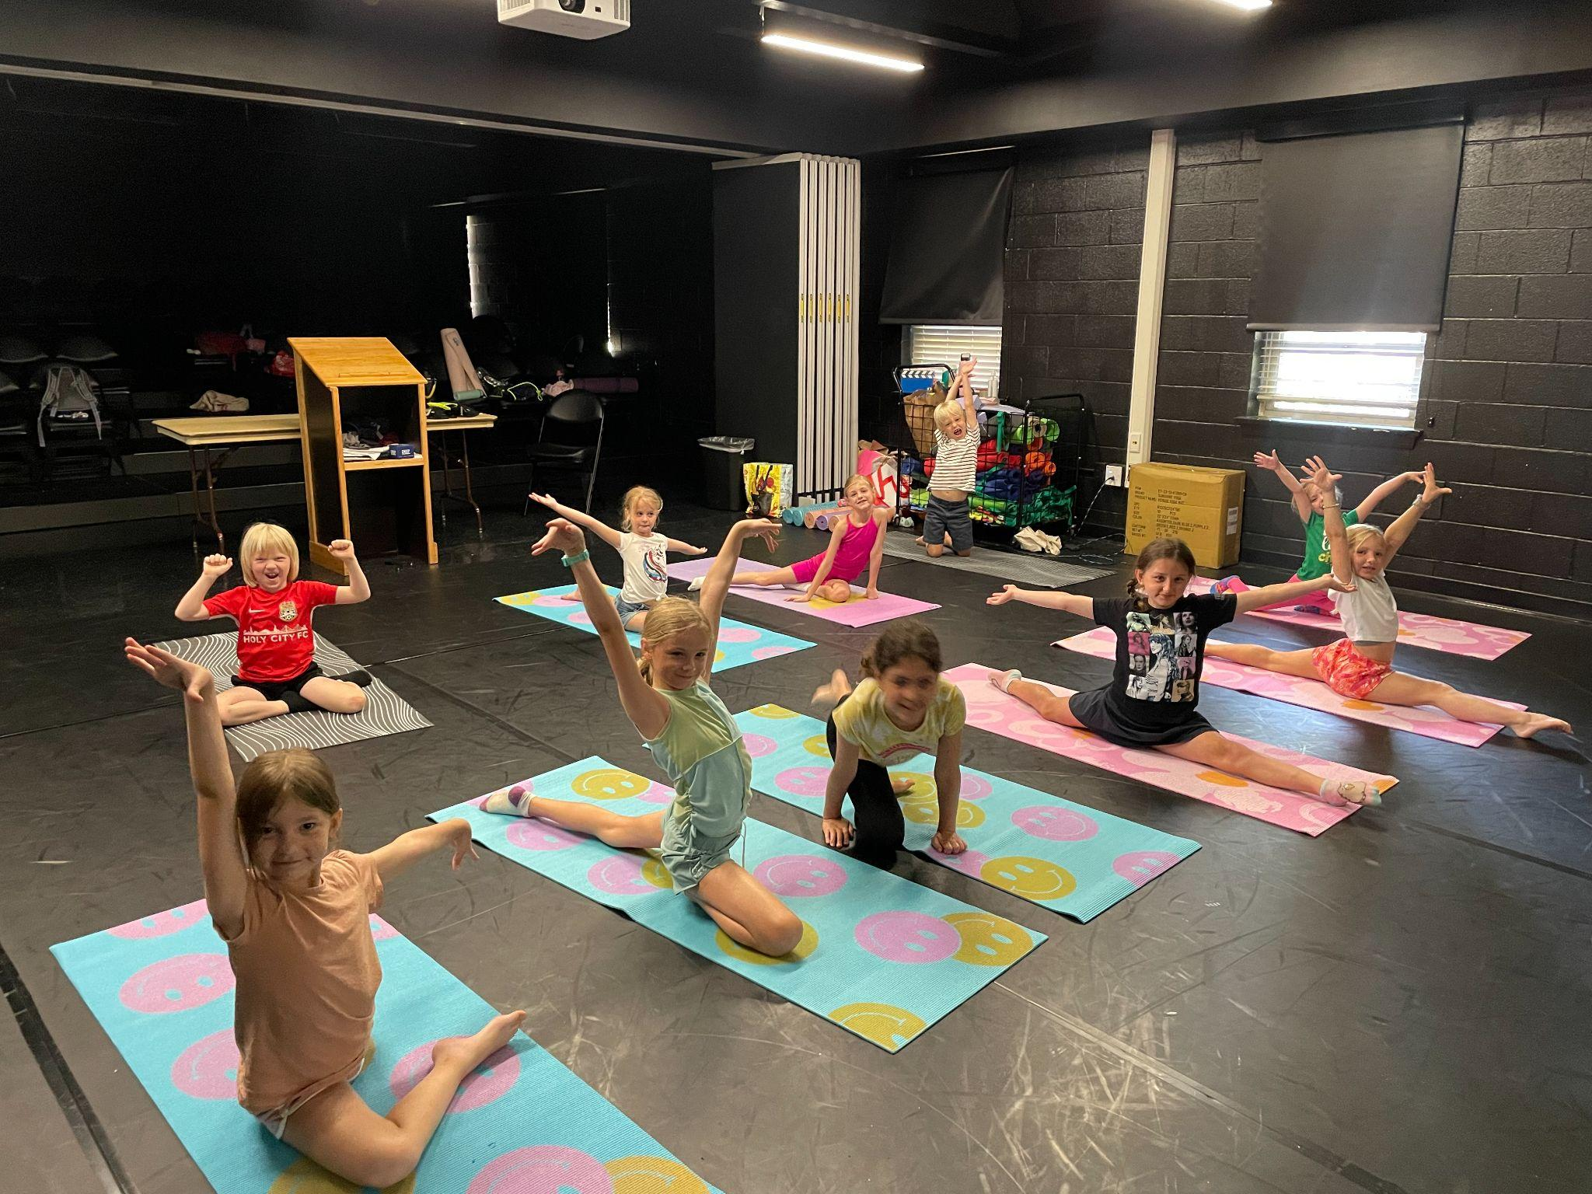
Space Utilization

Slide 14
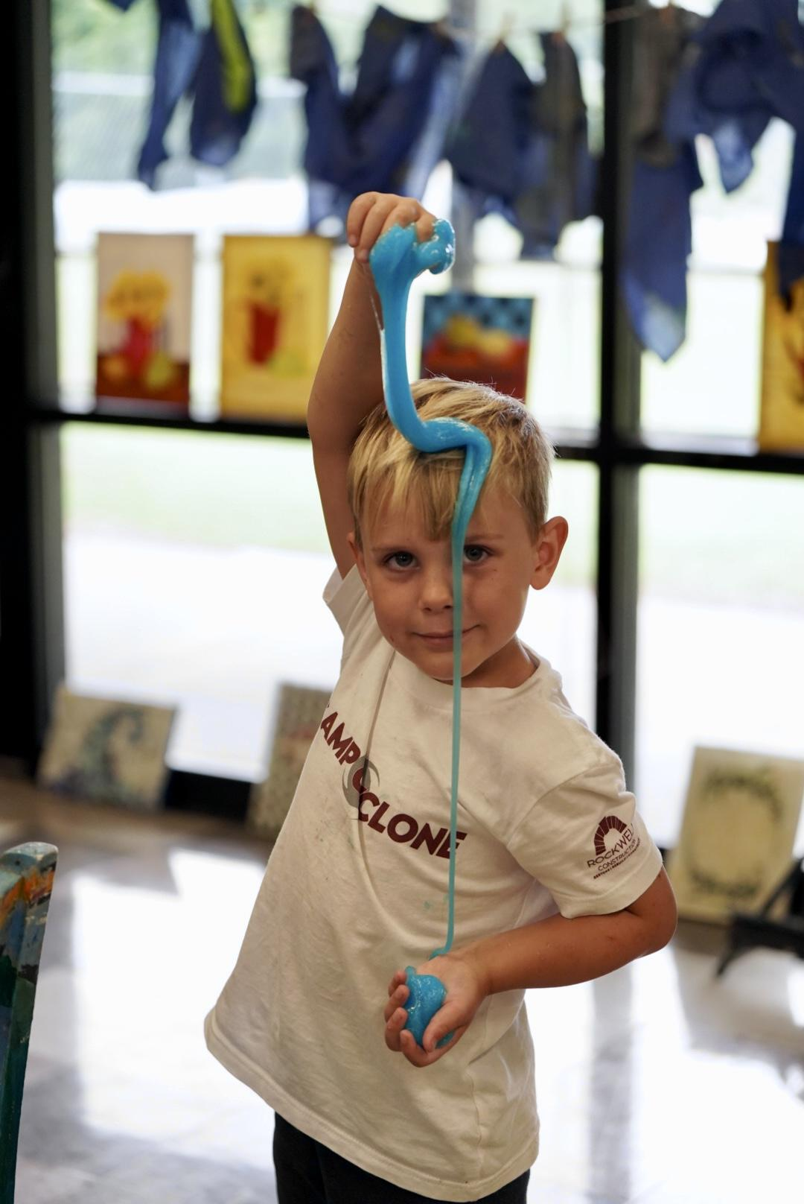
Classroom ownership

Slide 16
Summer - HVAC

Slide 17
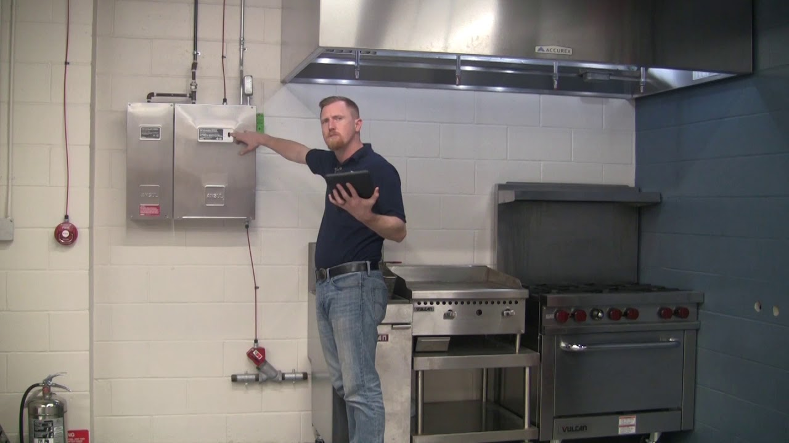
Summer – Kitchen

Slide 18
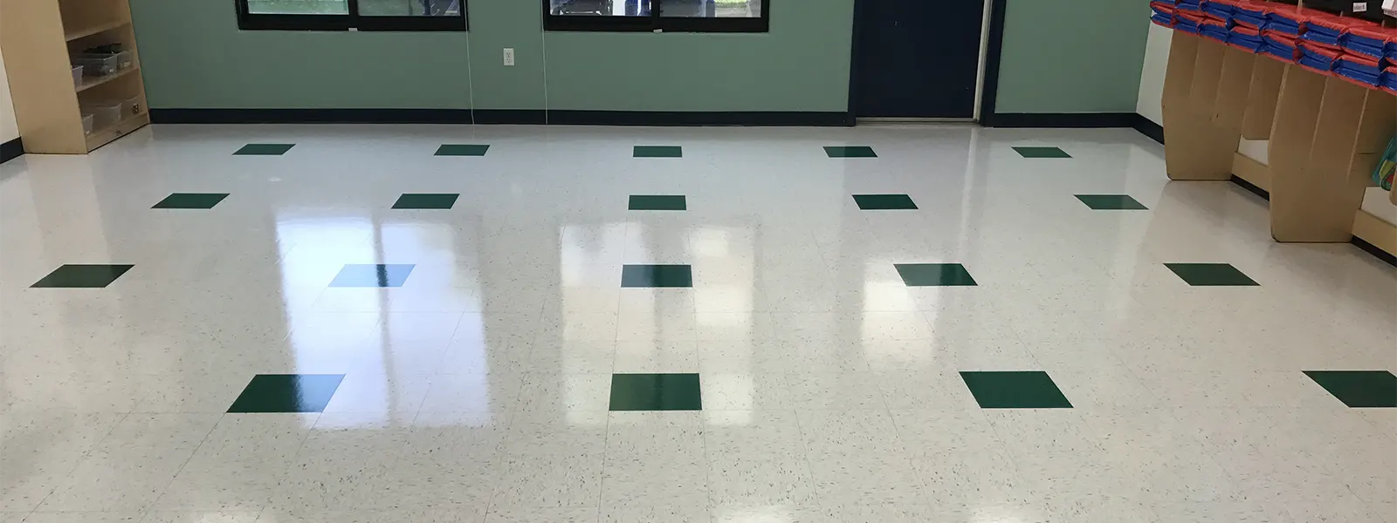
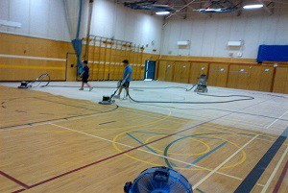
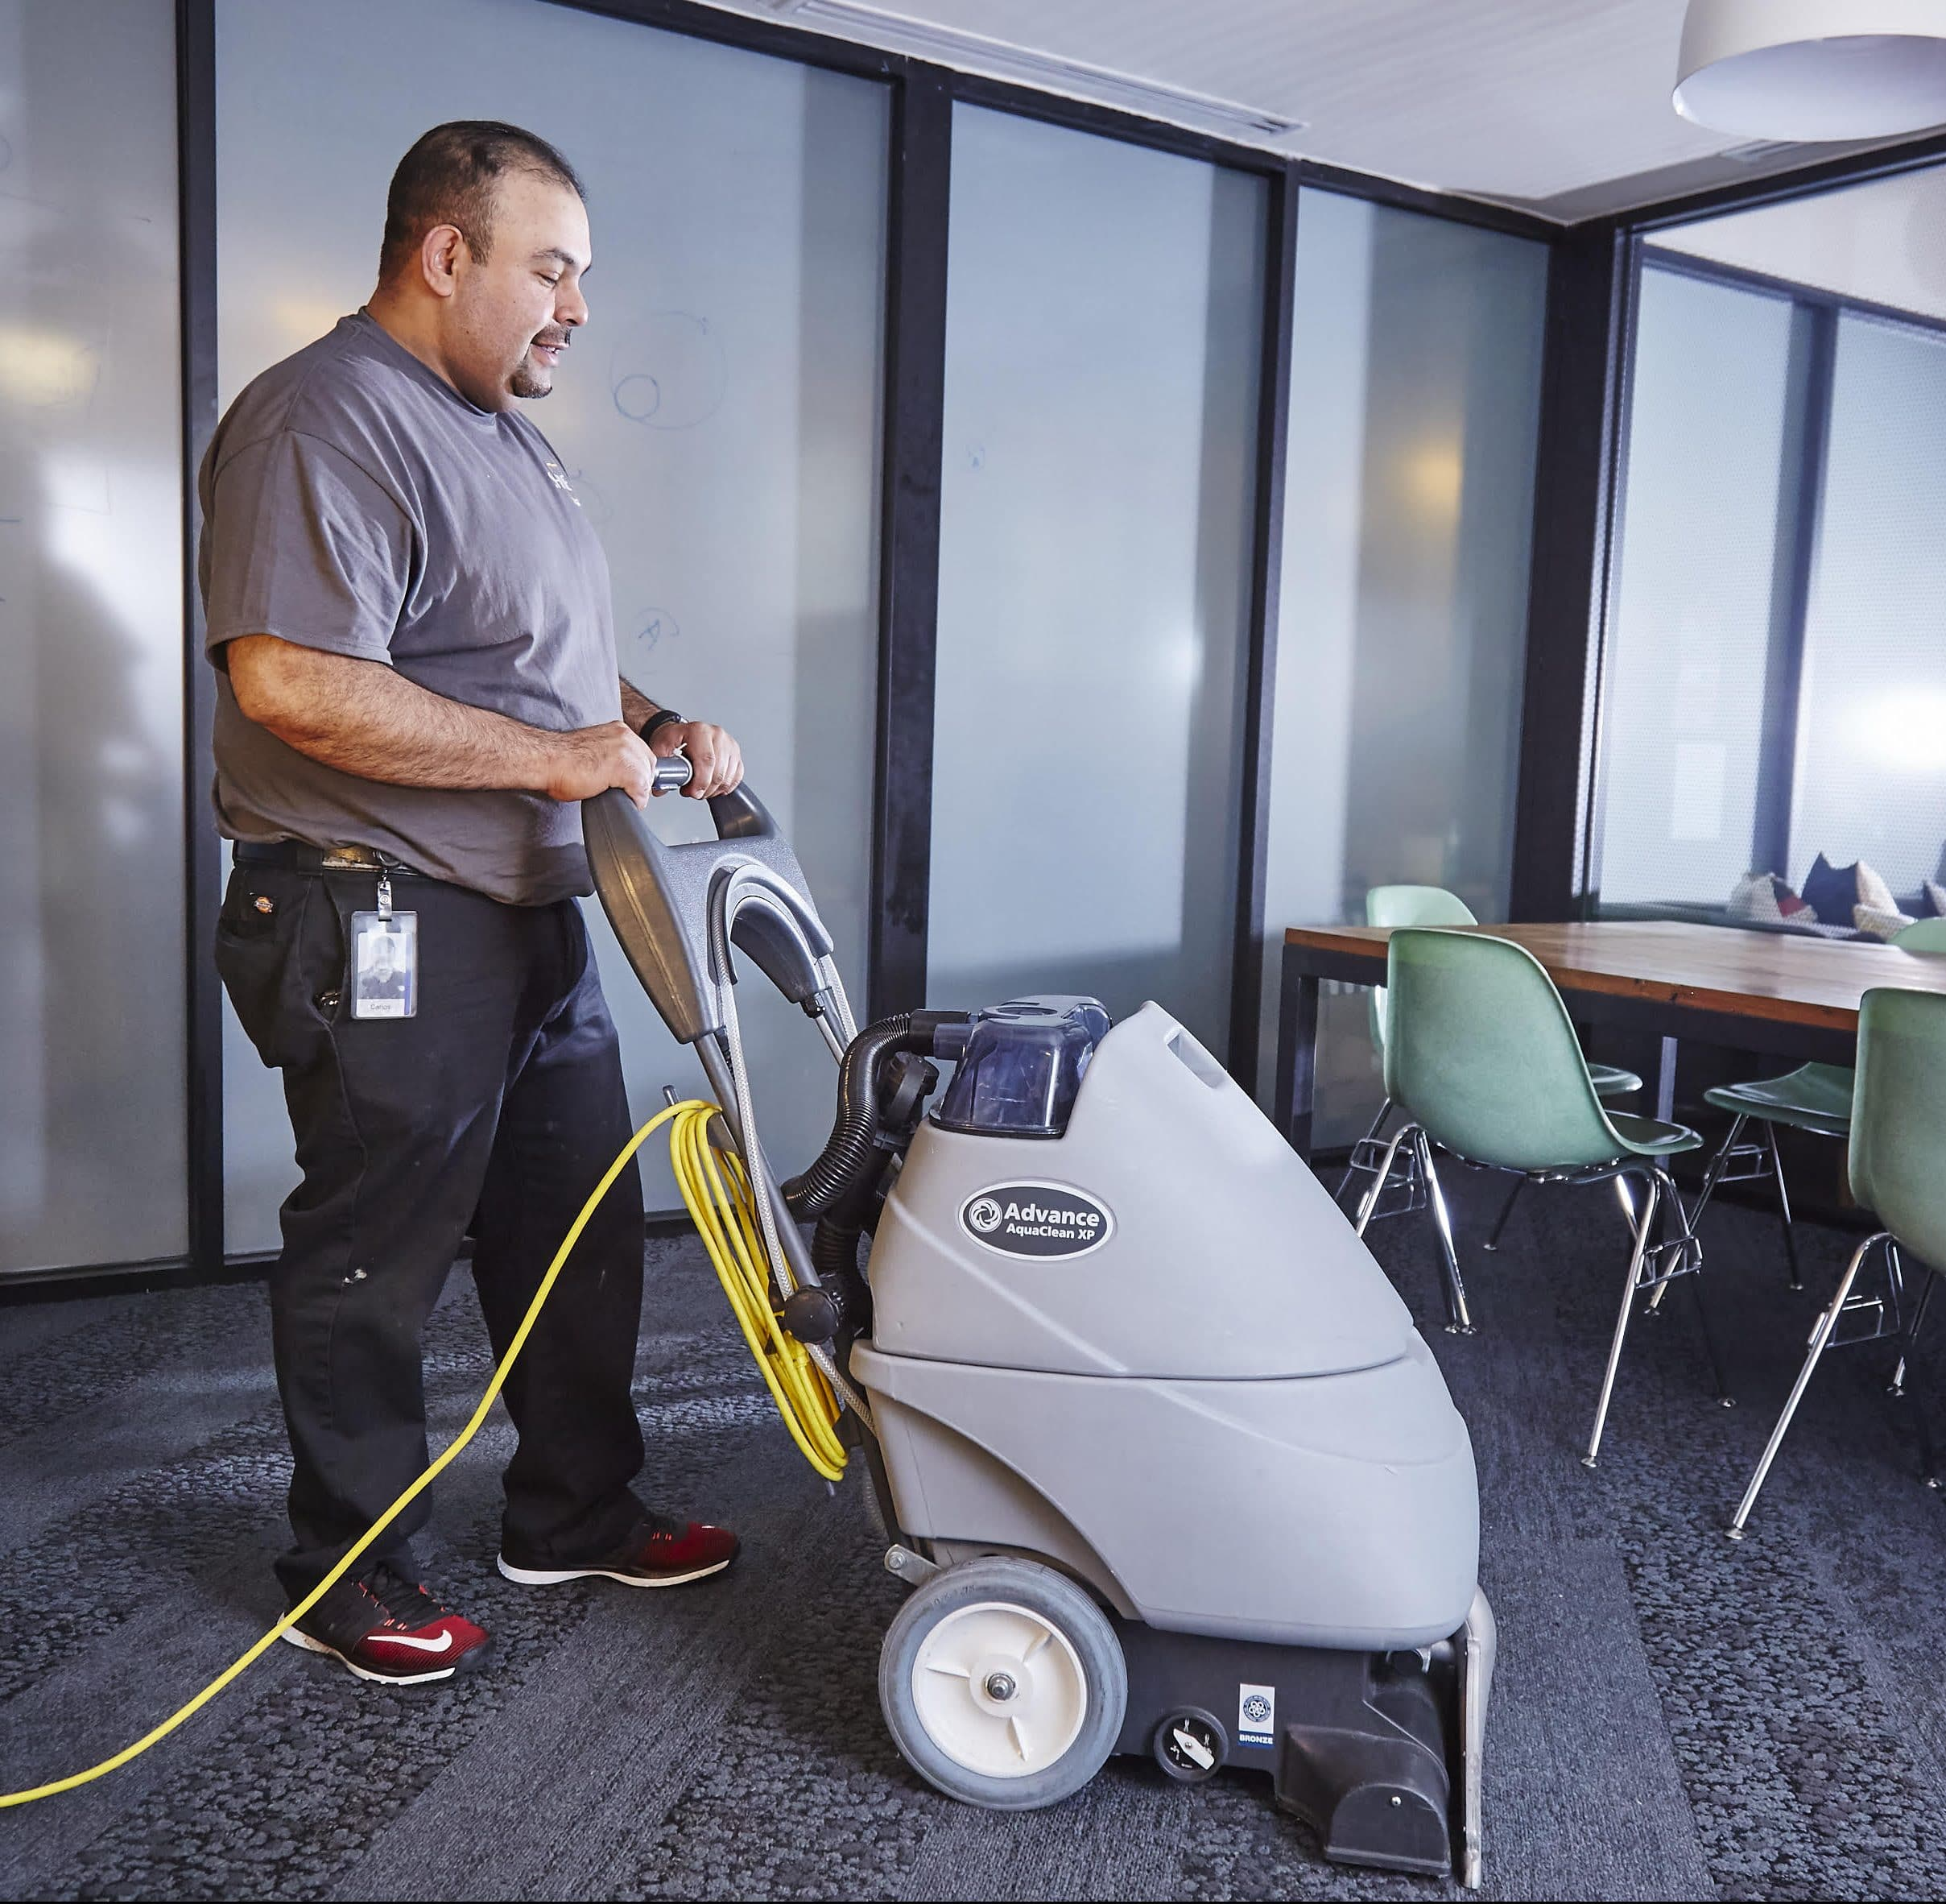
Summer - Floors

Slide 19
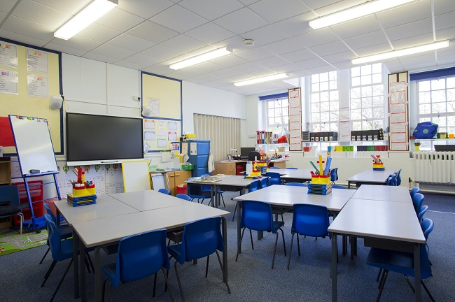
Summer - Classrooms

Slide 20
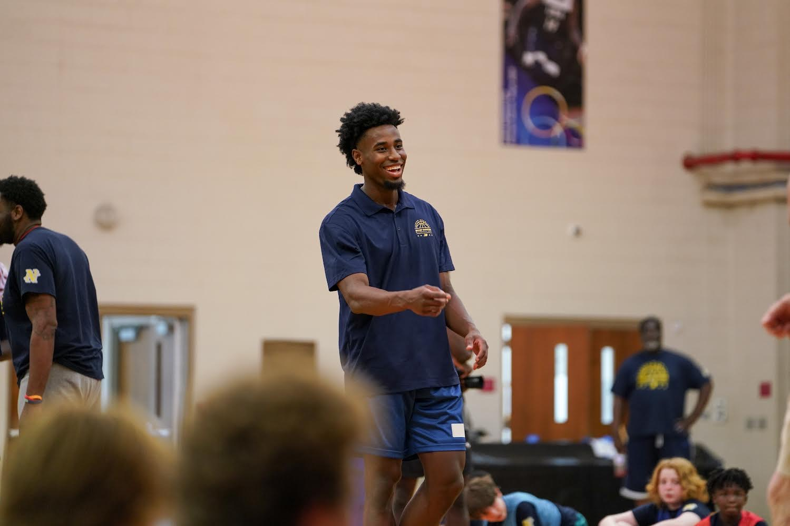
Academic Year -Facilities Use
FUA’s
Private Training
Rentals

Slide 21
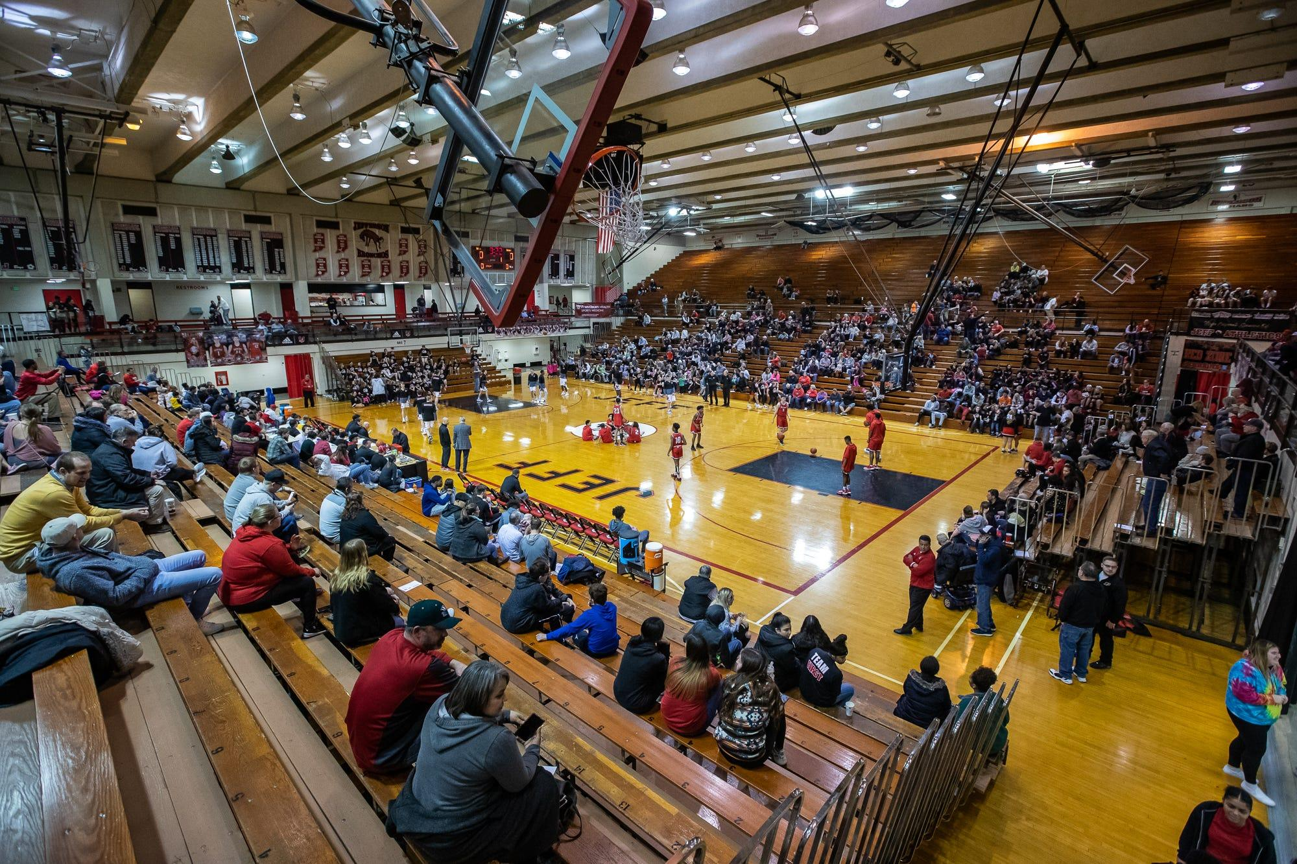
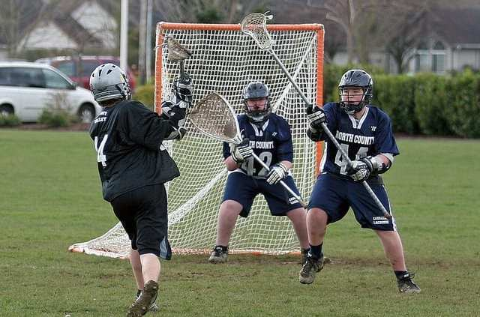
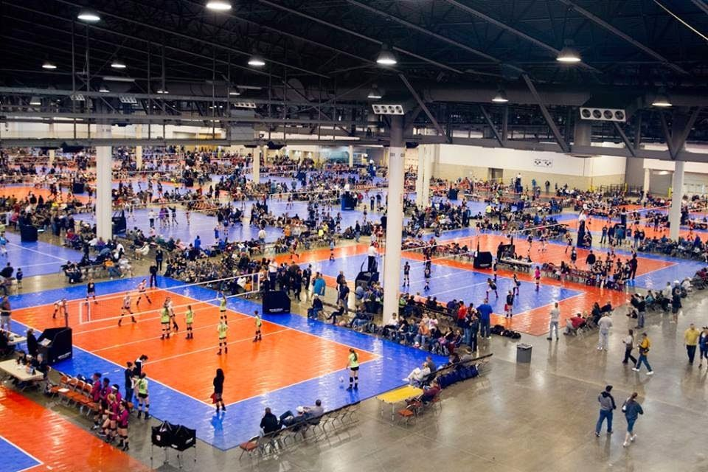
School year tournaments

Slide 22
Look for the Win-Win

Slide 23
Who owns - what – when?

Slide 24
Who owns - what – when?

Slide 25
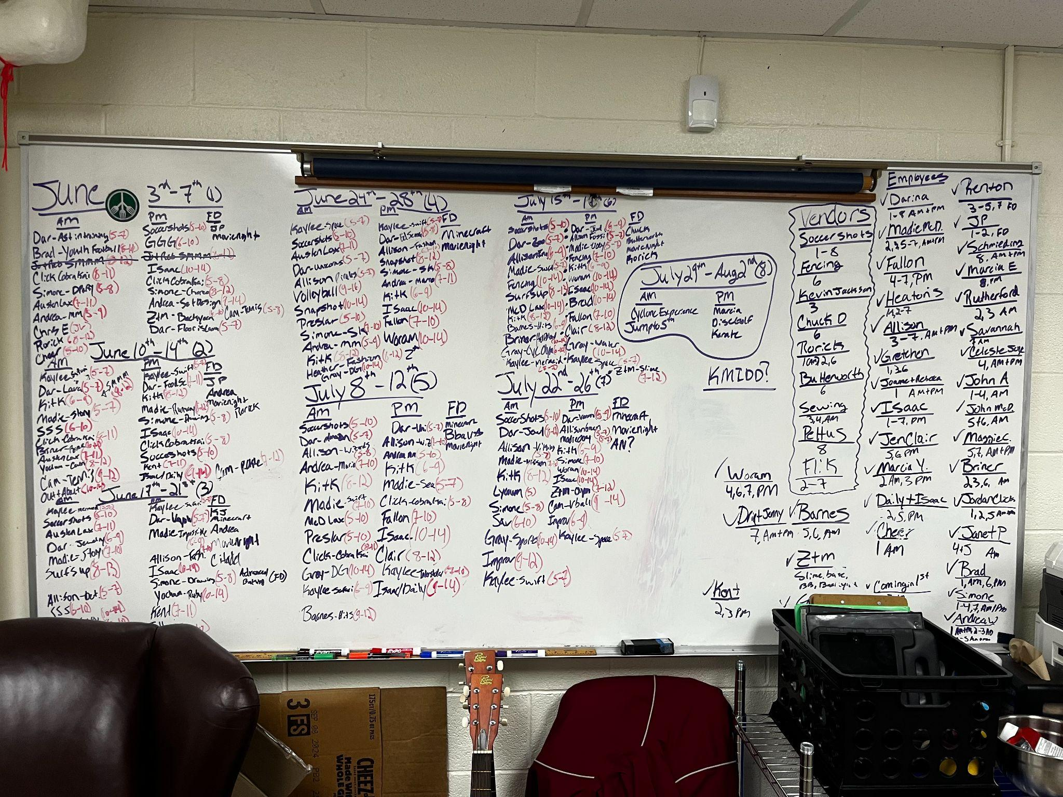
Insert Auxiliary schedule

Slide 26
Who owns - what – when?
Scheduling techniques
Expectations to teachers & building owners
Weather contingencies

Slide 27
Who owns - what – when?
Thank you!
Questions

