Slide 1
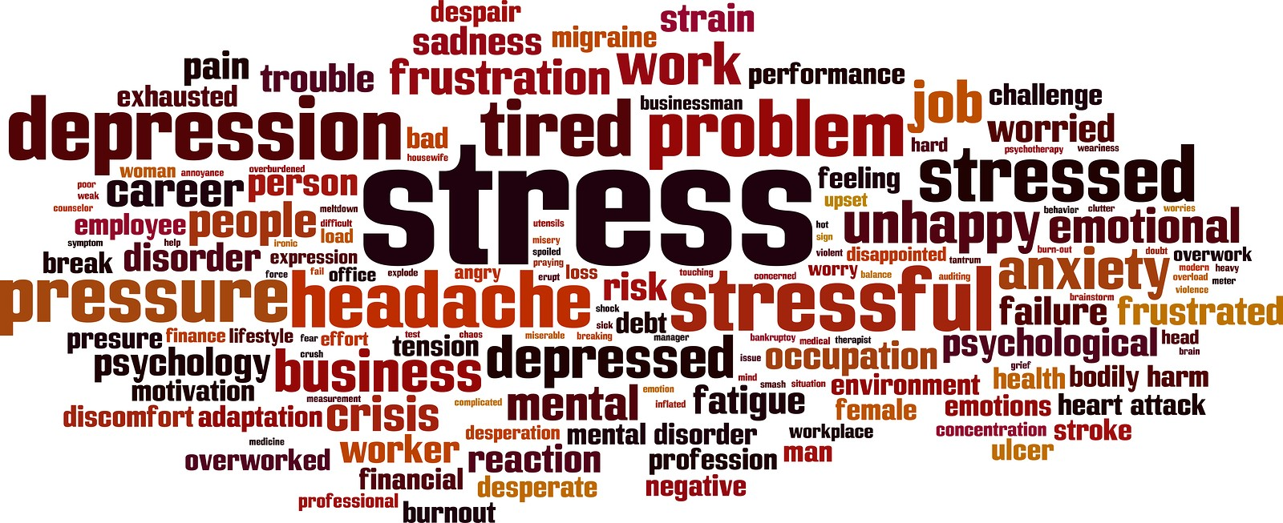

Stress & Emotional Intelligence
What Triggers You?
Russ Webb
RUSSWEBB@GMAIL.COM

Slide 2
Emotional Intelligence
The ability to recognize and understand emotions in oneself and others

Slide 3
Five Key Elements of EI
Self-awareness.
Self-regulation.
Motivation.
Empathy.
Social skills.

Slide 4
Self-Awareness
Those who are self-aware are in tune with their feelings, and understand how their actions affect those around them.
People with high self awareness know their triggers and have a good understanding of their strengths and weaknesses.

Slide 5
Self-Regulation
Those who can self-regulate aren’t prone to outbursts. They don’t make rushed decisions and they stay calm in difficult situations.
Self-regulation is all about being in control of your emotions.

Slide 6
Motivation
Self-motivated leaders don’t need outside influence to work hard. They remain focused on their goals, and typically set higher standards for themselves than others set for them.

Slide 7
Empathy
An empathetic leader has the ability to put themselves in someone else's situation. Empaths have a high success rate in connecting with their teams and understand the power of a critique versus criticism.
Simply put, empathetic leaders are the best listeners.

Slide 8
Social Skills
Leaders who do well in the social skills element of emotional intelligence are effective communicators. They're just as open to hearing bad news as good news, and they're expert at getting their team to support them and be excited about a new mission or project.
Leaders who have good social skills are also good at managing change and resolving conflicts diplomatically.

Slide 9


Slide 10


Slide 11
Emotional Intelligence Science
Thalamus
Processes information and sends signals out
The Limbic System
Emotional Response
The part of the brain involved in our behavioral and emotional responses
Amygdala
Processes fearful and threatening stimuli

Slide 12
The Way We Process Information
Emotional Regulation
Kids
Maturity
Intelligence
Adults
Radical Sincerity
Immediate Response
House Rules
Emotional Response

Slide 13
Sooooo can I improve my emotional intelligence?
5 Questions to Increase Emotional Intelligence
Self-Awareness | What am I feeling right now?
Empathy | What is the other person feeling right now?
Self-Regulation | What can I do to control my emotions?
Social Skills | How can I show interest in this person?
Motivation | Is it easy? Or difficult? And why?

Slide 14
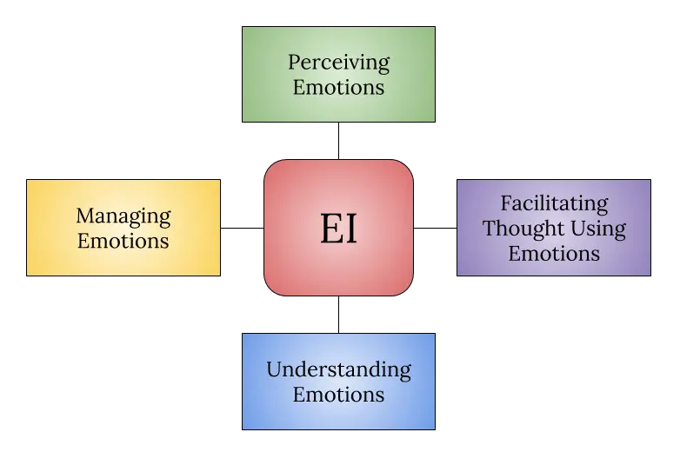
Source: Fiori & Vesely Maillefer, 2018

Slide 15
Become More Aware
How to Increase Your EQ
Area | Method
Self-Management | Stress Management
Self-Awareness | Mindfulness
Social Awareness | Effective Communication
Relationship Management | Empathy

Slide 16
IQ versus EQ
IQ
Vs
EQ
Concentration
Comprehension
Analytical Skills
Multi-talented
Memory
Focus
Self-Awareness
Self-Regulation
Motivation
Empathy
Social Skills
Perseverance

Slide 17
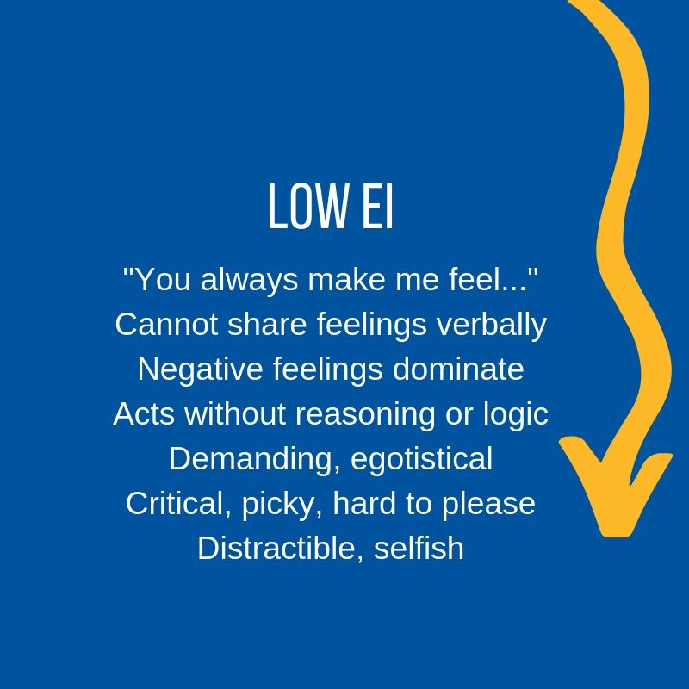
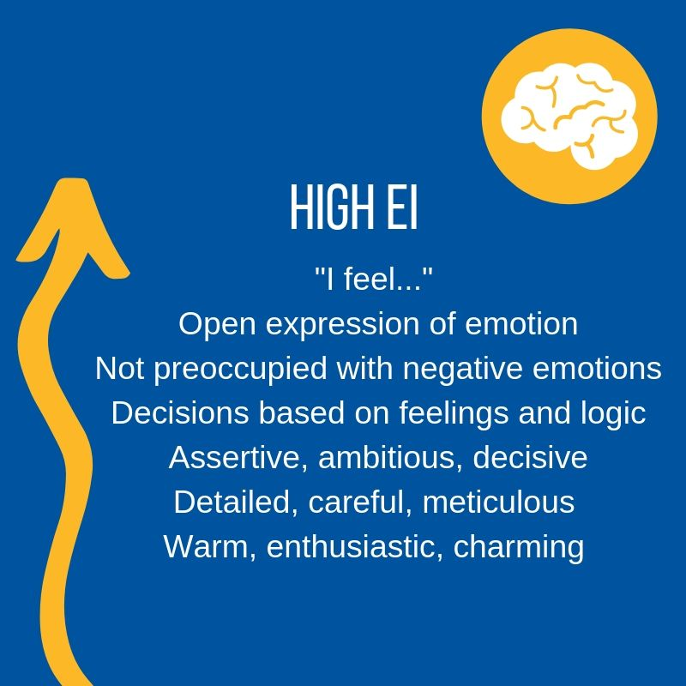

Slide 18
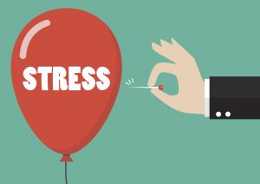
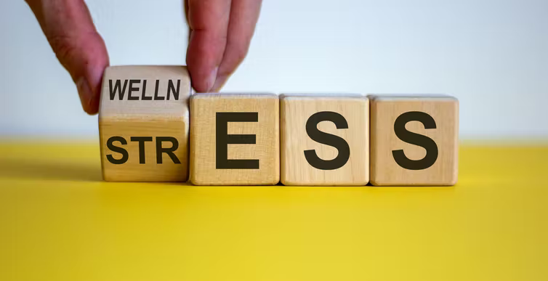
Stress is our body's response to pressure.

Slide 19

Self Awareness & Stress
Before you can make changes in yourself, you have to know what there is to work with. Becoming self-aware is about the process of understanding yourself. We all have strengths and limitations.
Self-awareness can be developed and identifying your strengths and weaknesses can help with this development. Spend some time recognizing areas you need to develop and intentionally make an effort to develop or strengthen that aspect of yourself.

Slide 20
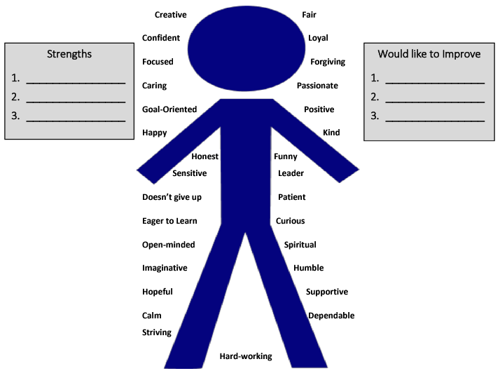
Self Awareness & Stress
Choose three strengths for yourself, and three you would like to improve on.
If you don’t see a trait listed here, feel free to write your own!
Once you’ve chosen traits that need improving, think about and describe how you will attempt to improve those traits.

Slide 22
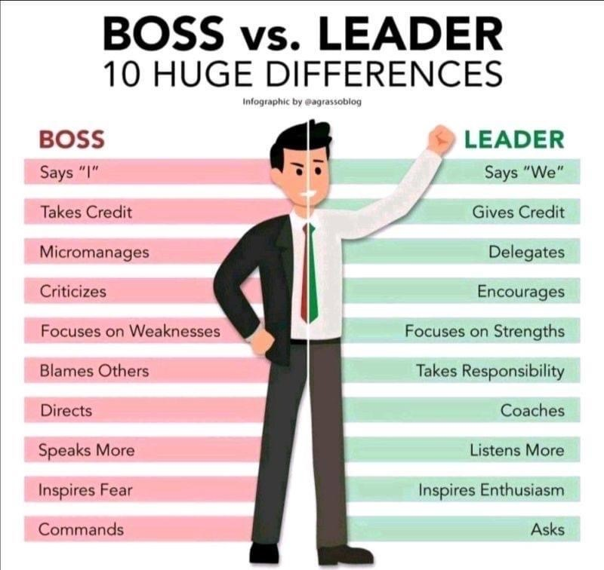

Slide 23


Slide 24
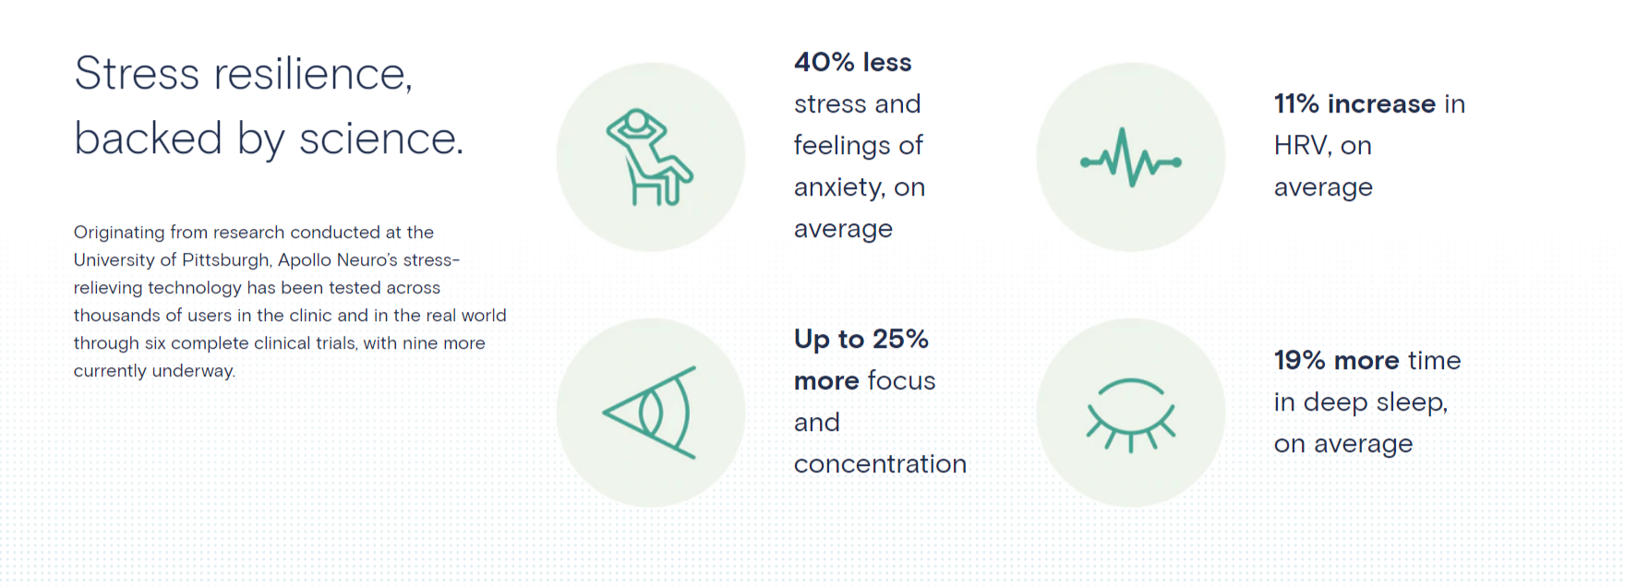

Slide 25
How Do We React to Stressful Situations
Passive
Assertive
Aggressive
Ignore it and do nothing
EQ kicks in
Knee-Jerk Reaction
Others decide
Turns a bad situation into a worse one
Processes Info
Chooses Path

Slide 26
How Can We Use EI to Process Stressful Situations
01
02
Be Aware
Self Regulation
What triggers me and how can I prepare for it
Is this my battle?
03
04
Empathy
Check Your Emotions
How can I reshape my response?
What is the other person feeling right now?

Slide 27

TRIGGERED!
Common major life events that can trigger stress include:
job issues or retirement
lack of time or money
bereavement
family problems
illness
moving home
relationships, marriage, and divorce

Slide 28
TRIGGERED!
When I’m stressed, I need my co-workers to do the following…
When I’m stressed, what my co-workers should NOT do…

Slide 29
STRESS AT WORK
The workplace can for many people a huge source of stress due to issues such as:
Difficult relationships with colleagues, team members or senior members of staff
Team dynamics, including favoritism, laziness, stolen ideas
Discrimination of any kind, e.g. ageism, bigotry, racism
Lack of promotion prospects, or being passed over for a pay rise
Being promoted and facing additional responsibilities
Long, unsociable or unpredictable hours and/or shift-patterns
Dealing with constant criticism at work
Being forced to move to a different department or even another location.

Slide 30
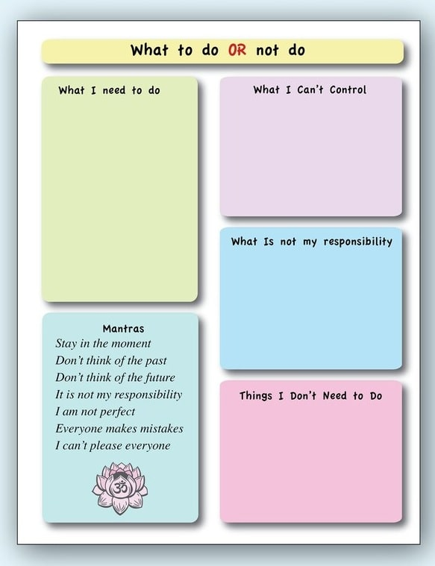

Slide 31


Slide 32
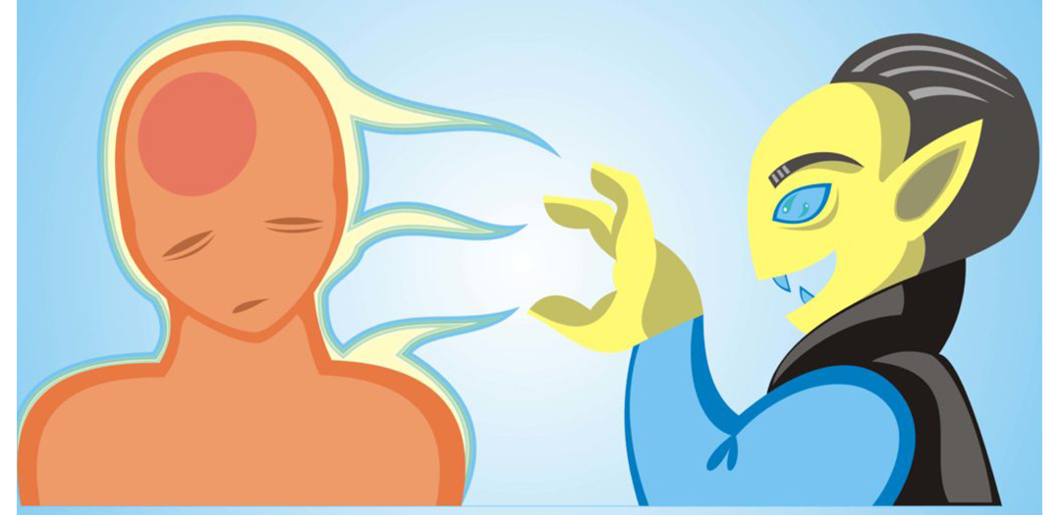

Slide 33


Slide 34
How are you today?

Slide 35
Become an Empath
Cognitive Empathy
Understanding another’s feelings
Taking another’s perspective
Types of Empathy
Emotional Empathy
Developing empathetic skills will help you process every situation
Sharing an emotional experience
Distress in response to pain
Somatic Empathy
Physical level
Someone cries, you cry

Slide 36

The 7 Habits of Highly Effective People®
Habit 5: Seek First to Understand, Then to Be Understood®
Because most people listen with the intent to reply, not to understand. You listen to yourself as you prepare in your mind what you are going to say, the questions you are going to ask, etc. You filter everything you hear through your life experiences, your frame of reference. You check what you hear against your autobiography and see how it measures up. Consequently, you decide prematurely what the other person means before they finish communicating.

Slide 37
Stress & Emotional Intelligence
What Triggers You?
Russ Webb
RUSSWEBB@GMAIL.COM

