Slide 1
Securing Schools Safely with AI Video Intelligence
Franklin M. DiGioia Channel Manager
Claro Enterprise Solutions

Slide 2
AI-Powered School Safety with AI VIDEO ANALYTICS
NOTE: This presentation is intended to provide a general overview of the service. Please consult your account executive to obtain additional information.
© 2024 Claro Enterprise Solutions, LLC. All rights reserved.

Slide 3
School Safety Vulnerabilities: A Data-Driven View
Last school year, more than
School shootings increased by
⁺124%
From 2020–2021 to 2021–2022¹
School crime directly costs victims
⁺$600^{M}
in expenses ranging from medical care to lost work time or stolen property²
1,150 guns
were brought to K-12 campuses³
AI algorithms swiftly identify anomalies like smoke, fires, weapons, or
intruders, enabling quick action to enhance safety
¹ “The Latest Government Data on School Shootings.” USAFacts, Feb 2024
² School Crime Costs Victims More Than $600 Million Every Year, Report Finds" RTI International | RTI Research, 2019
³ ”Guns are seized in U.S. schools each day. The numbers are soaring”. The Washington Post, October 2023
3

Slide 4
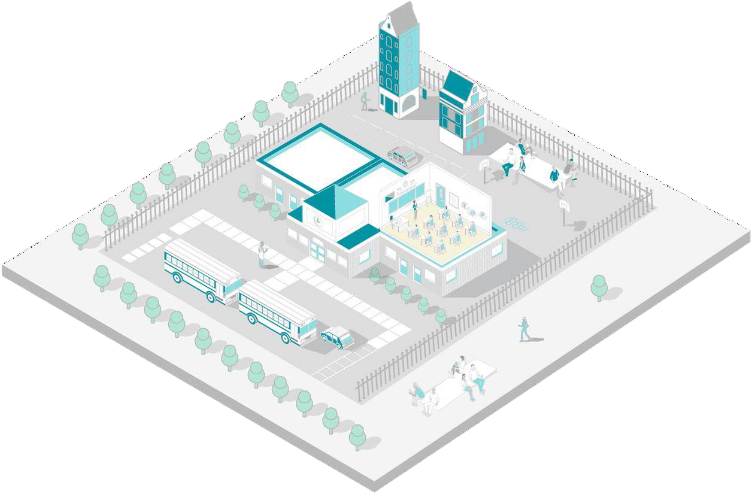
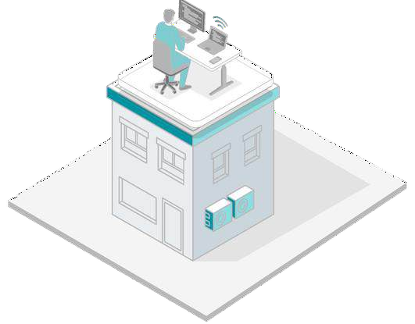
Increase Security and Efficiency for Students, Teachers, & School Administrators
Rapidly detect
a potential shooter
Improve response time with Mobile Alerts
Real-time alerts for events like loitering or illegal parking
Monitor overcrowding issues at on-campus events
Enable quick search of a missing person
using simple attributes
NOTE: Individual results will vary based on local network performance, technical architecture and other variables beyond the control of the individual product. The scenarios shown are for illustrative purposes only.

Slide 5
School Security Challenges and AI Video Analytics Use Cases
CHALLENGES
SOLUTIONS
Slow incident response times due to manual monitoring and false alarms
Real-time alerts with over 95% accuracy in detecting vehicles, objects, and people.
Liability concerns over accidents or injuries on campus
Weapons Detection, Fall Detection, Fire and Smoke Detection
Inability to effectively monitor all entry/exit points,
Intrusion Detection, License Plate and
Face Recognition, Loitering Alerts
parking areas, or buildings due to limited staff
Managing large crowds during school events
People Counting, Crowd Monitoring,
Parking Detection

Slide 6
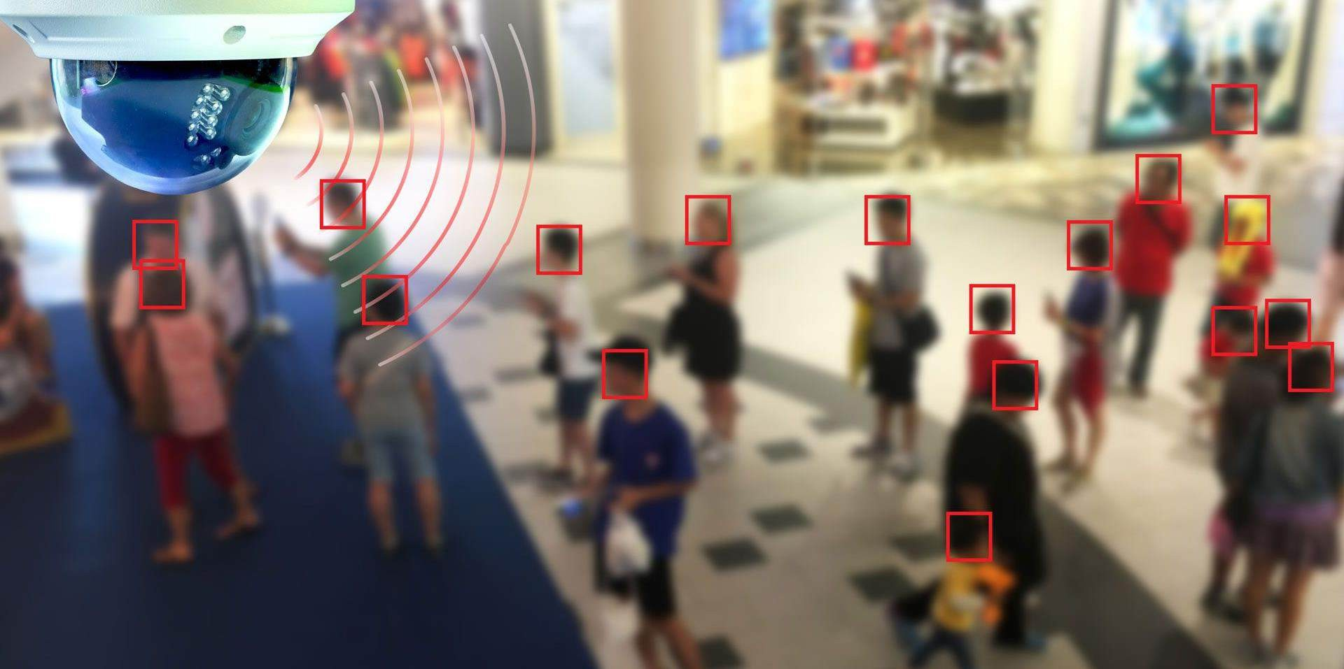
Visible Weapons Detection
Detect handgun, shotgun, rifle, assault
rifle, machine gun, machetes and knives
Access Control
Face Recognition
License Plate Recognition
Perimeter Protection
Intrusion Detection
Parking enforcement
No driving / parking areas
Person of Interest
Suspicious Persons
Parents under restraining orders
Suspended students
Incident Detection by combining:
Vehicle Detection
Face Recognition
Weapon Detection
Administration
Attendance check
Test Identification
Campus Management / Parking
Management
Flexible alert rules based on Search and Object Detection
Parking Management
Alerts when cars are in bike lanes, bus lanes, no parking zones
Tailgating when accessing secure areas
License Plate Recognition
Campus Safety
Vaping and Bullying Detection
Fire Detection
Cross Camera Tracking
Crowd Detection
Fall Detection
Loitering Detection
People Counting
Forensic Analysis
Video Search
People
Object
Vehicles

Slide 7
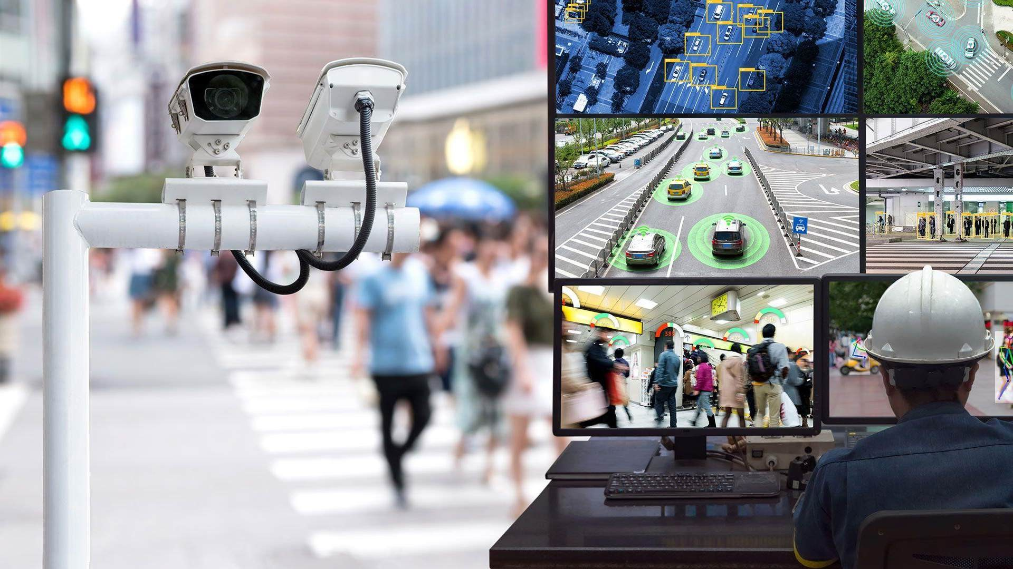
AI Video Analytics
Certified by:
Department of Homeland Security
under the “Safety ACT” since 2009
© 2024 Claro Enterprise Solutions, LLC. All rights reserved.

Slide 8
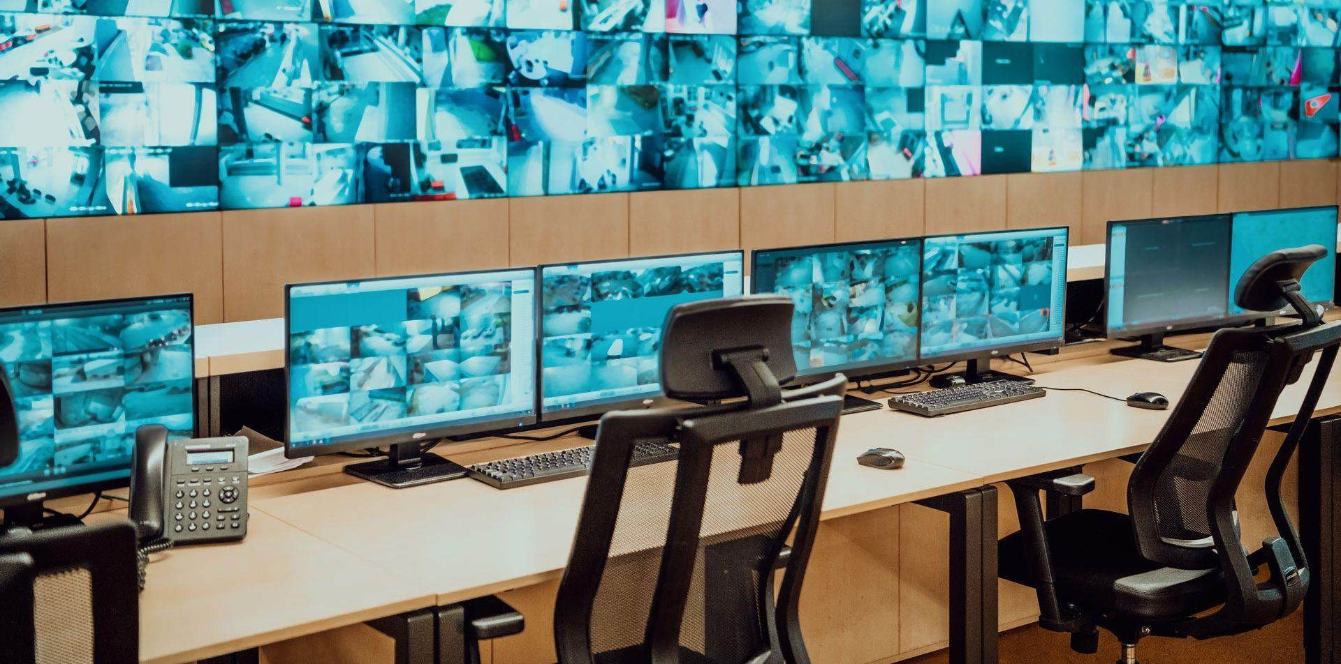
Unique Value Proposition
Using your existing video surveillance cameras (ONVIF compliant )
Security personnel cannot watch all streams concurrently
Interruptions and distractions can cause a missed event
AI Video Analytics always watches the Video Streams
Multiple conditions are analyzed concurrently
Generate Alerts if conditions are met
Raise Situational Awaremess
Speed
Accuracy
Scalability
Google-like search:
Most search queries complete in < 2 seconds
(4500x faster than manual search)
> 95% accuracy in vehicle, object and people detection with appropriate camera settings
From a few cameras to thousands of cameras

Slide 9
Key Applications
VISIBLE WEAPONS DETECTION
Detect visible weapons in
< 3 seconds across multiple cameras.
Seamlessly integrate with
third-party systems
to trigger lockdowns upon detection.
FACE RECOGNITION
Instantly capture and analyze facial images and identify individuals to track attendance or
spot unauthorized individuals on school grounds.
FIRE & SMOKE DETECTION
Detect smoke and fire in real time. Receive alerts and seamlessly integrate with fire alarm systems to call the fire department (via an API).
VIDEO SEARCH
High-speed video search of live or recorded video.
120-hour search in
< 2 seconds, 4,500x faster than manual search.
NOTE: Individual results will vary based on local network performance, technical architecture and other variables beyond the control of the individual product. The scenarios shown are for illustrative purposes only.

Slide 10
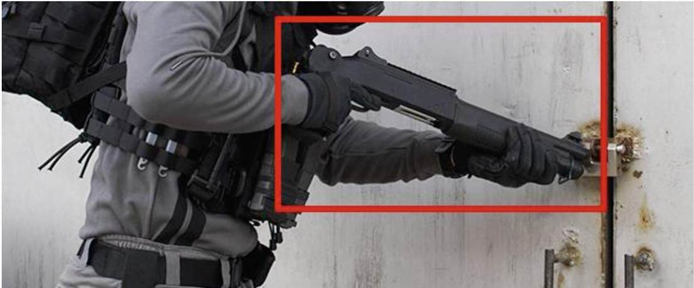
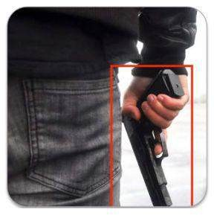
Weapons Detection
Detect:
Handguns
Rifles
(Shotguns & Machine guns)
Machetes and Large Knives
Generate Real time Alerts:
Sent to Distribution List by Alert Type
This use case enhances situational awareness for the current physical security team.
It is possible to get a “false positive” alert based on the fact that for example an umbrella
being held like a rifle can appear as such both to the human eye and the AI.

Slide 11
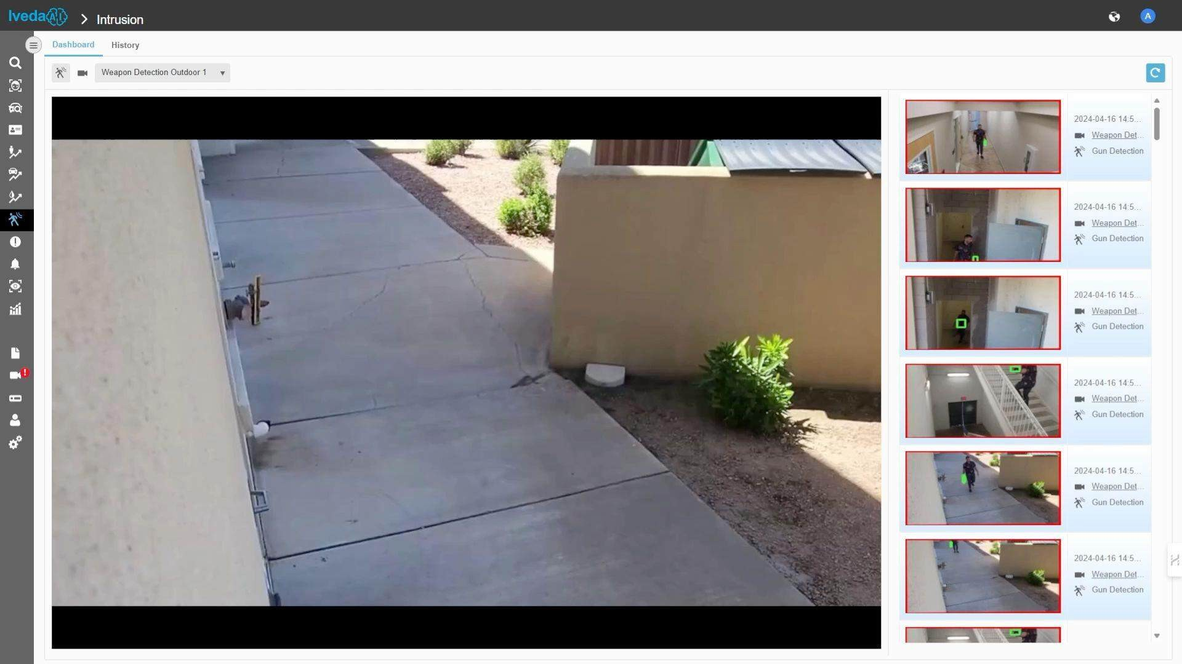
Weapons Detection

Slide 12
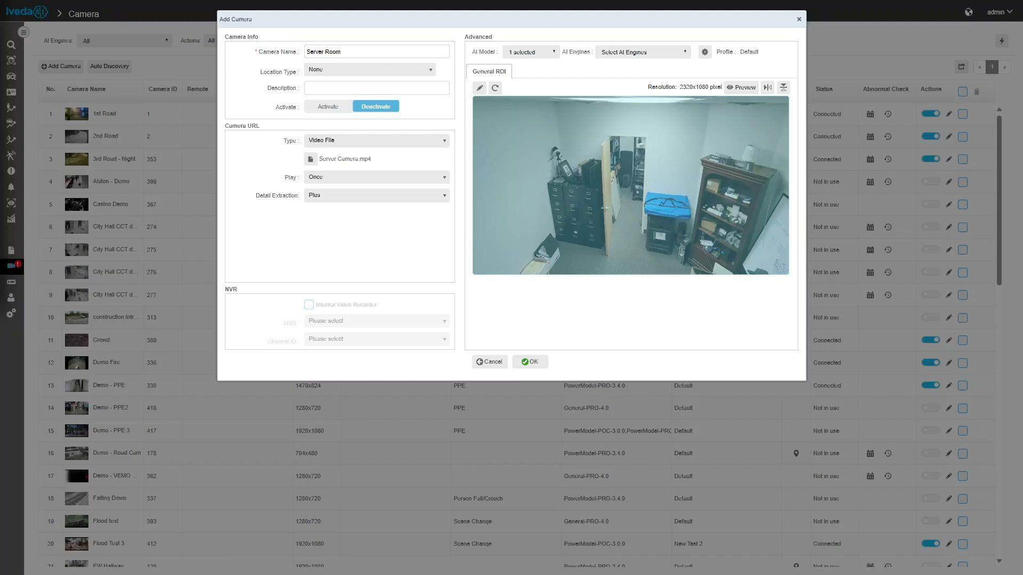
Intrusion Detection

Slide 13
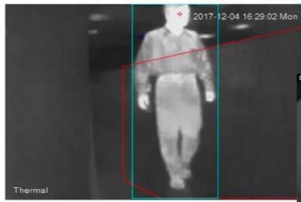
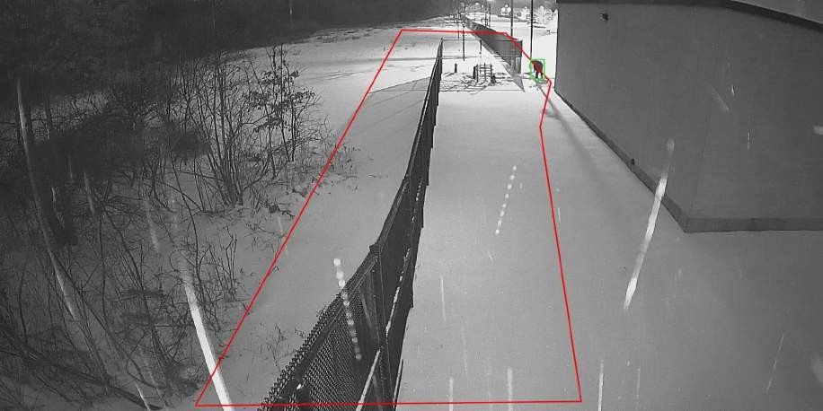
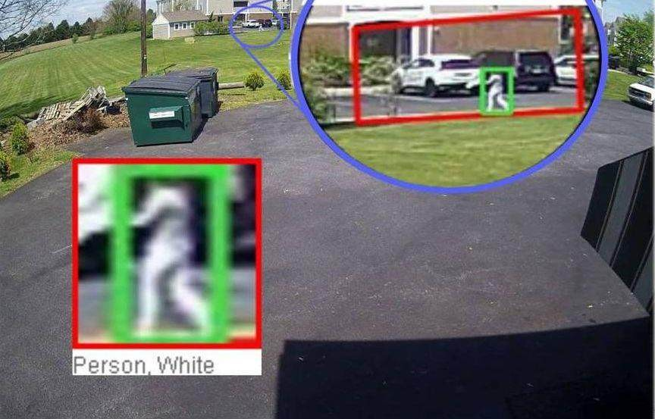
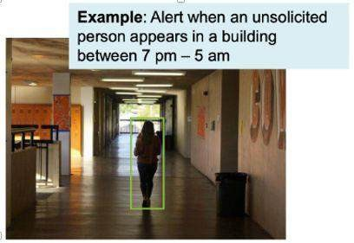
Intrusion Detection
Intrusion can be configured
By day of week
By time of day
Region of Interest
Using a 1080p
minimum resolution camera

Slide 14
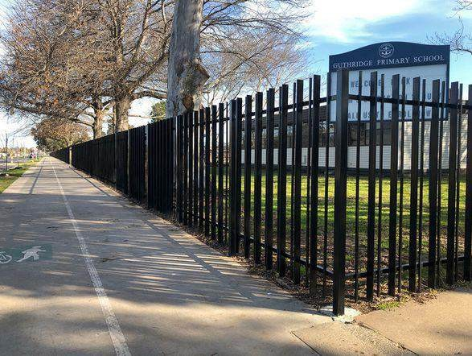
Intrusion Detection: Perimeter Protection, Vehicle Detection
Region of Interest
Region of Interest

Slide 15
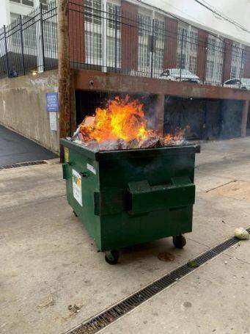
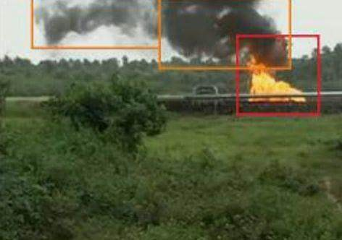
Smoke & Fire Detection
Detect Smoke & Fire Indoors and Outdoors
Generate Alerts
INDOORS
OUTDOORS

Slide 16
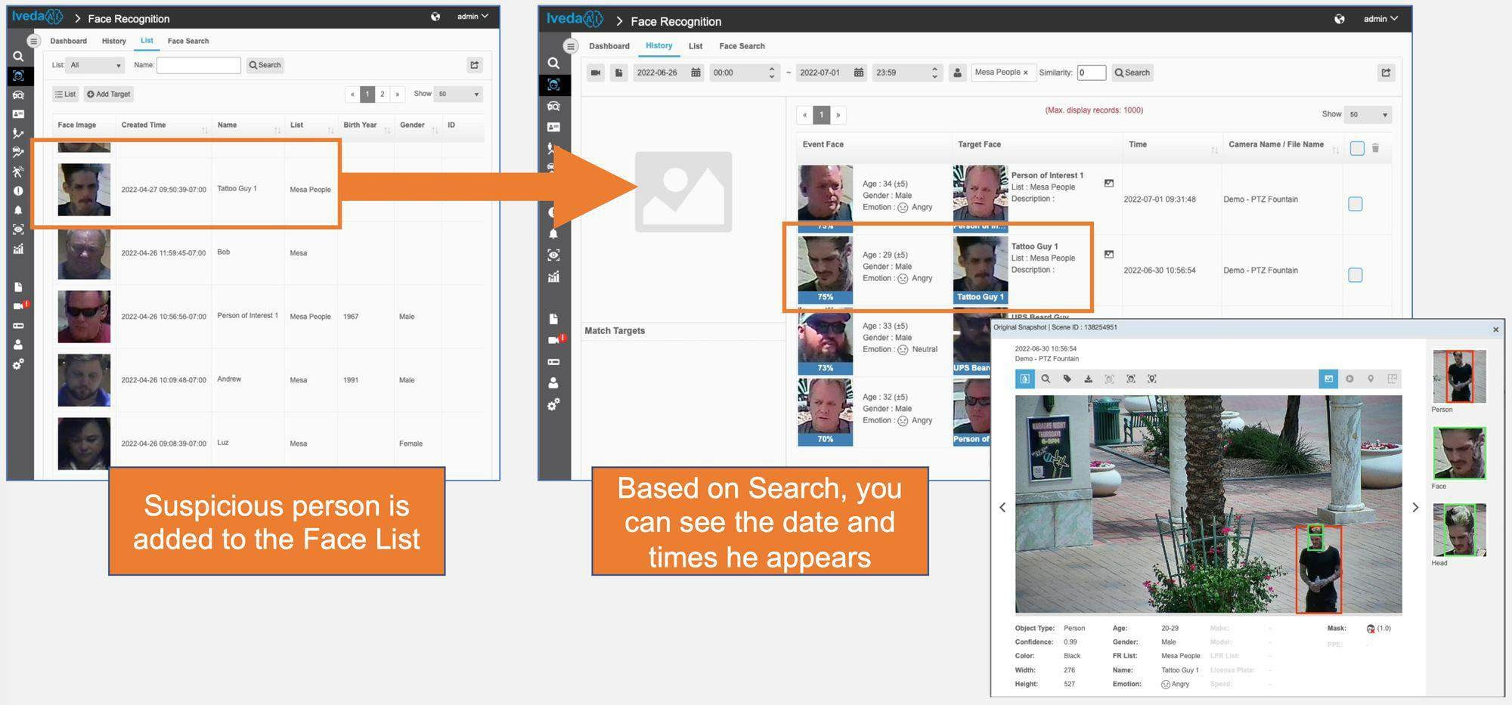
Face Recognition & Search
Find a face that was uploaded or captured using active video or uploaded from a stored image in a database (Example Employees)
Match List and generate alerts
Simultaneous recognition across multiple cameras
Use for Access control or Customer Management

Slide 17
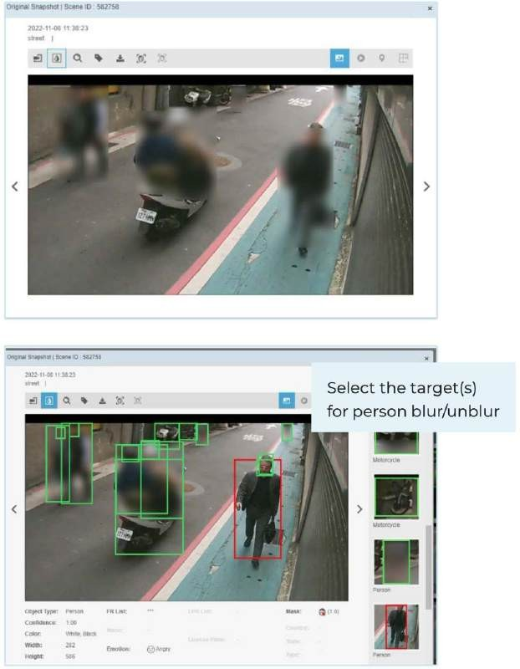
Privacy Protection
When Privacy Protection is turned ON
Detected person(s) are blurred in search & alert results for all cameras activated in the appliance
Blurred detail page, thumbnails, exported data
thumbnails
Restrictions: no video playback, no live view
Blurring is applied right after analysis, and images processed before turning on Privacy Protection cannot be unblurred
Admin and User with Privacy Protection unblur
permission can unblur face in the detail page
User has permission to select all or one detected person once the icon is clicked to Unblur
Note: with Privacy Protection, the system requires double storage
AI Video Analytics complies with:
US Privacy Laws, including California Privacy Laws
EU GDPR

Slide 18
SenseAI - Vaping and Bullying Sensor
Accelerometer – detect tampering
Vape Sensor – an internal airflow system that enables a wide range of vape detection
Protective Filter – shield against unwanted particles
Sound Sensor – Measures frequency and decibel level, and sound patterns to identify acts of aggression
LED – shows operational status
Proximity Sensor – detects the presence or proximity of objects to alert for tampering
Motion Sensor – detects motion

Slide 19
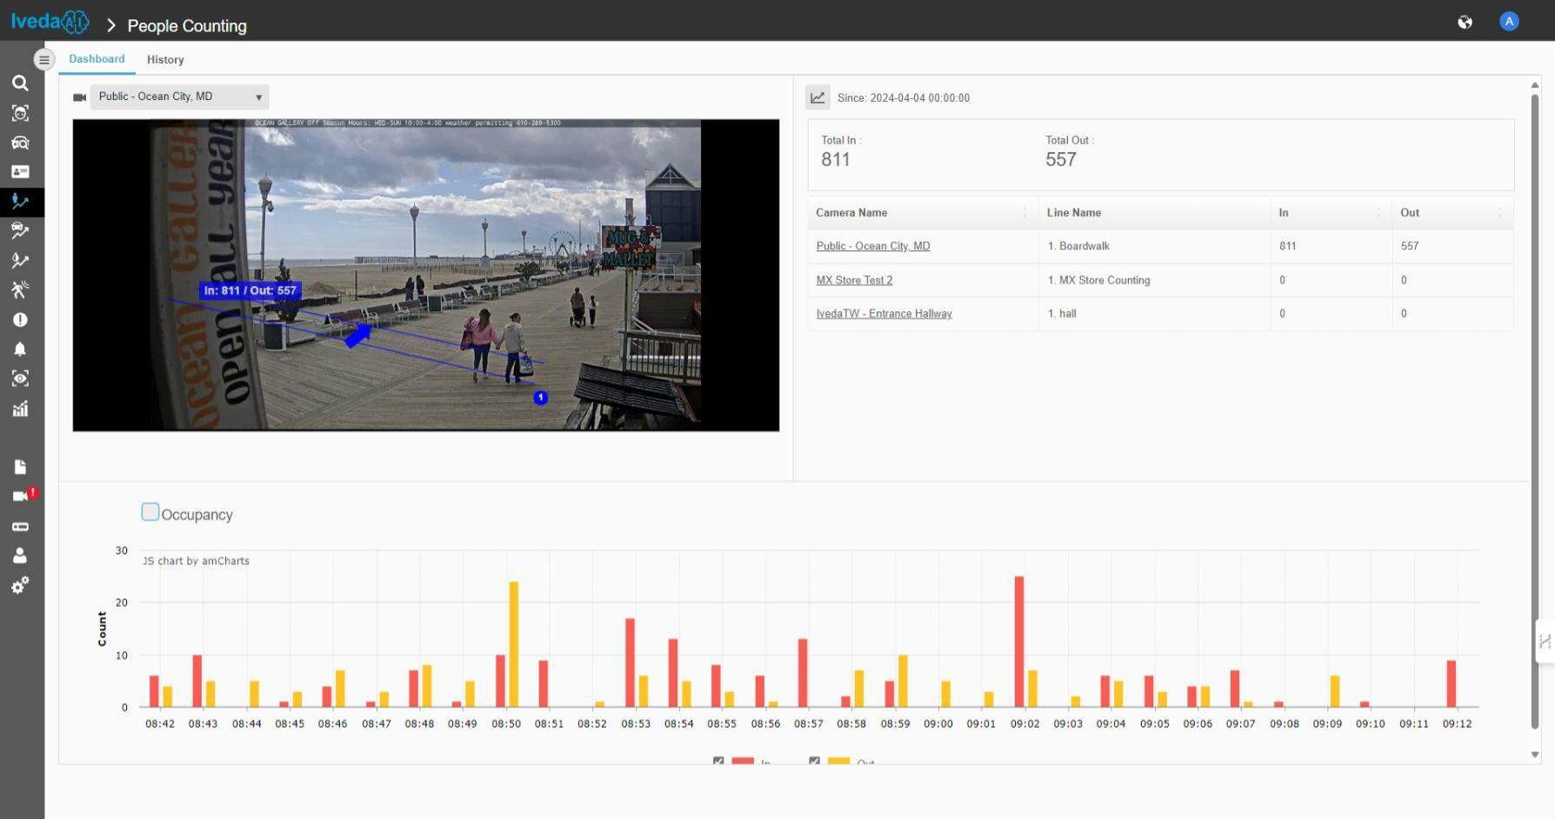
People Counting

Slide 20
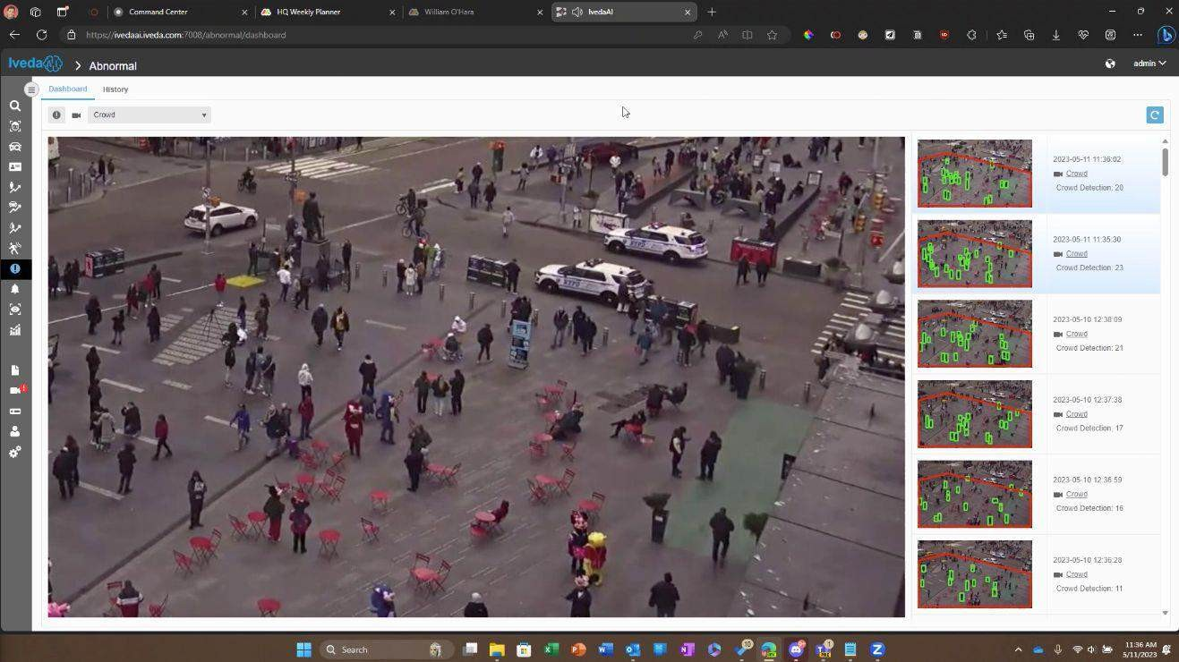
Crowd Detection
Threshold for this example is > 10 people.
Configurable “cool down” or interval before next detection.
Reports when crowd threshold is crossed.
Allows the user to determine if the crowd is getting larger or thinning out.

Slide 21
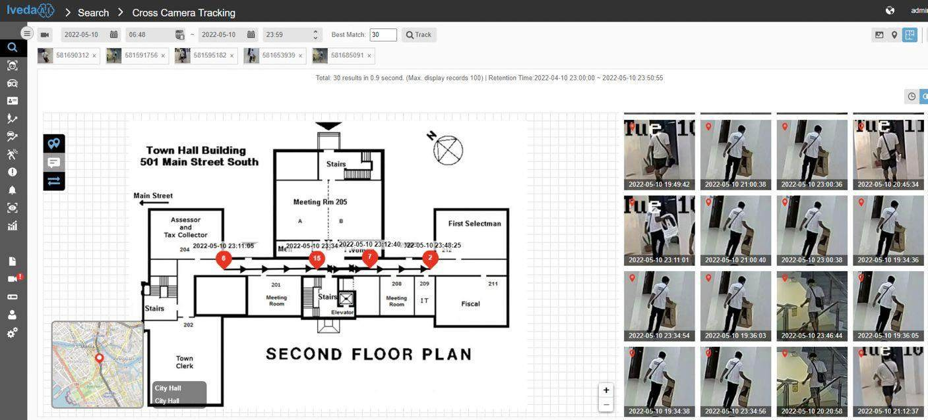
Cross Camera Tracking
Immediate identification of subject of interest without pretraining or pre-loading a database.
AI-enabled forensic tracking across entire camera networks.
Tracking across multiple cameras without the use of Face Recognition.
Map view (GPS and indoor floor plan) of subject path across the network can be added.

Slide 22
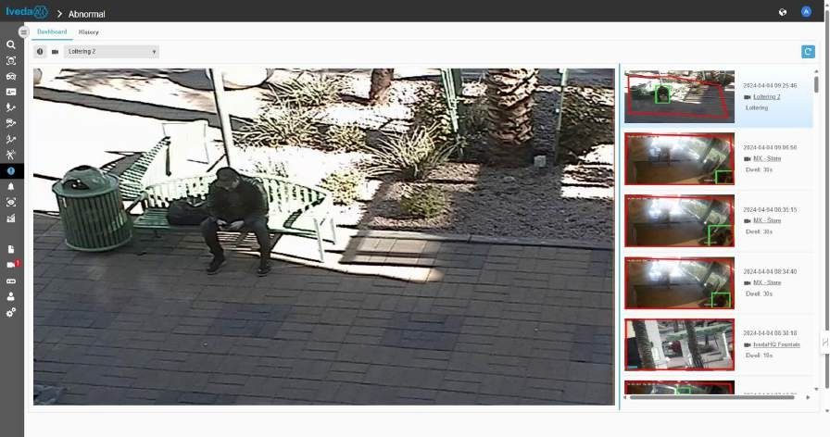
Fall Detection and Loitering Alert
Fall Detection Alert
Loitering Alert

Slide 23
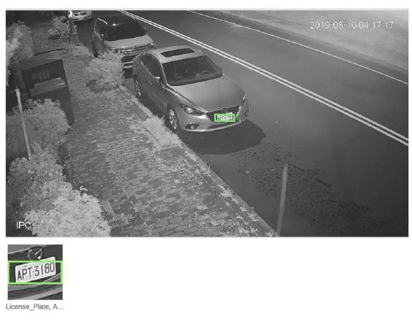
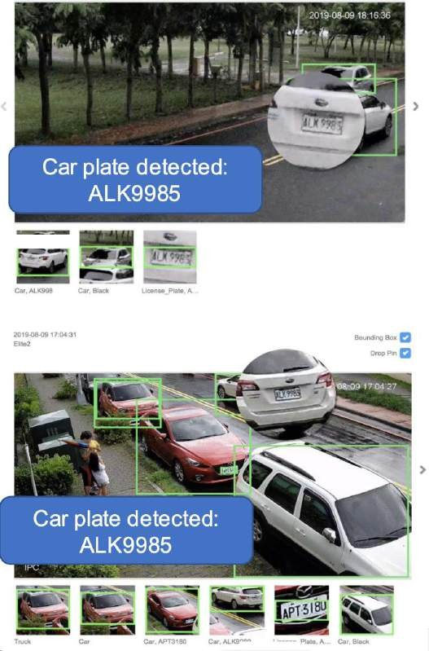
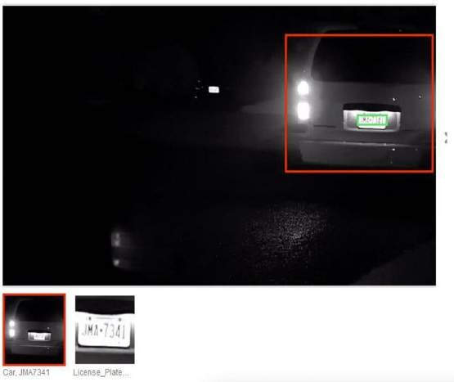
License Plate Recognition
Across multiple cameras
Parked or moving
Slow, city speed or highway speed

Slide 24
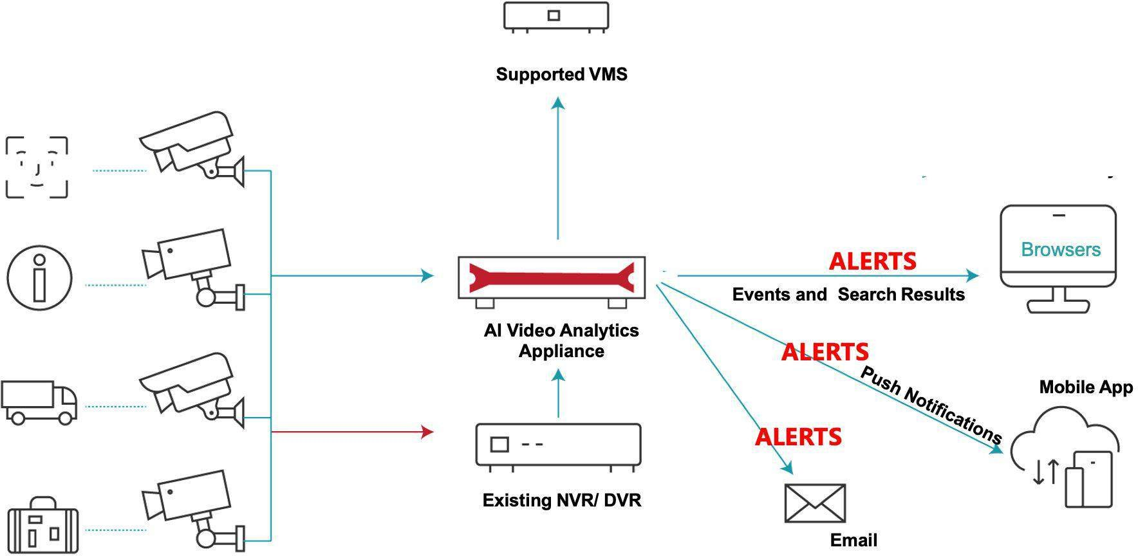
Where are Alerts Delivered?
OPTIONAL SMS SERVICE
OPTIONAL API DELIVERY

Slide 25
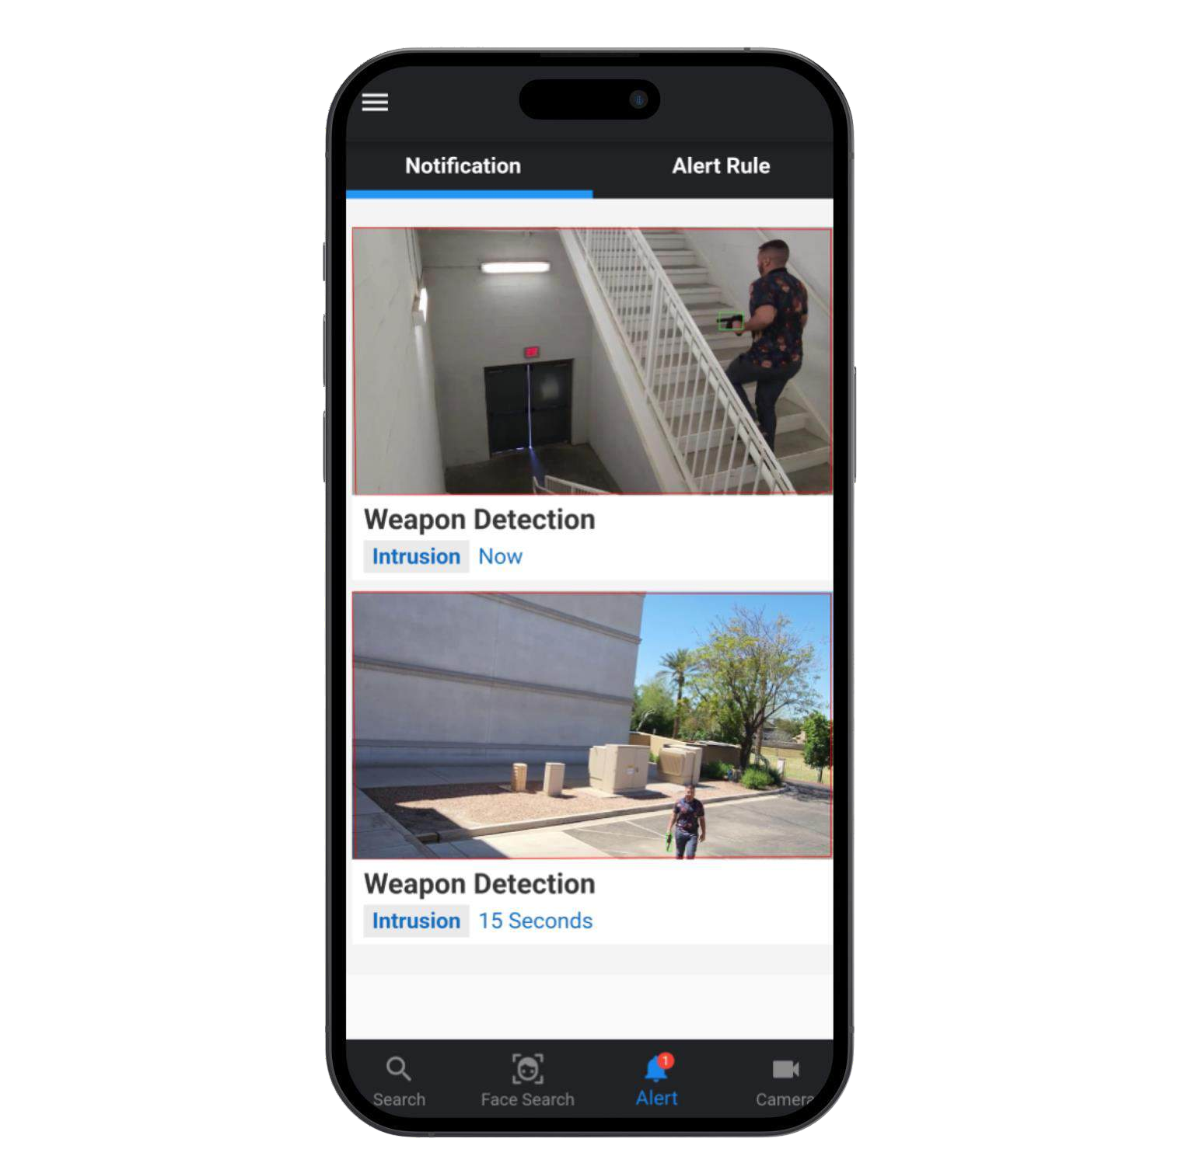
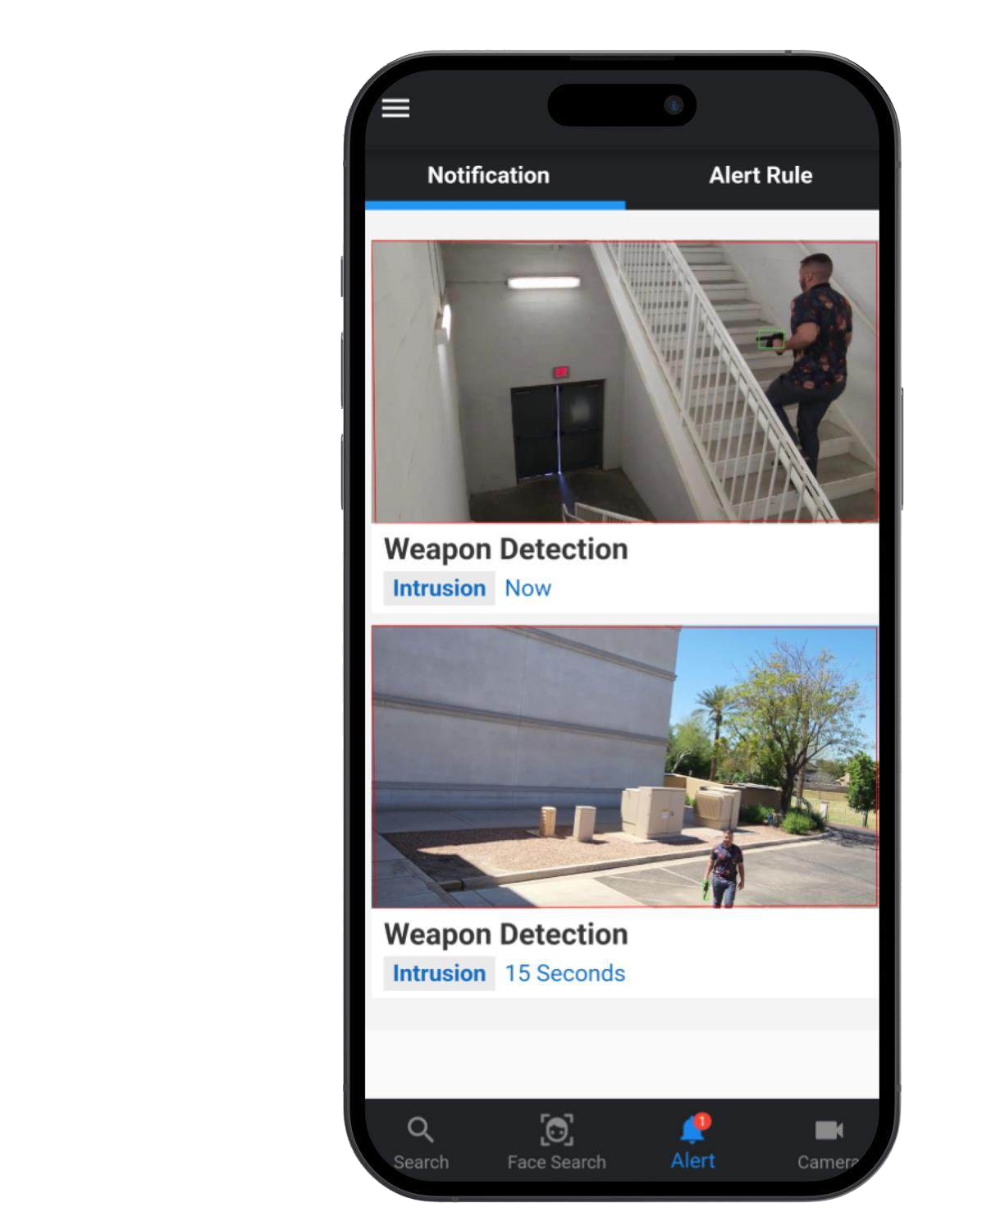
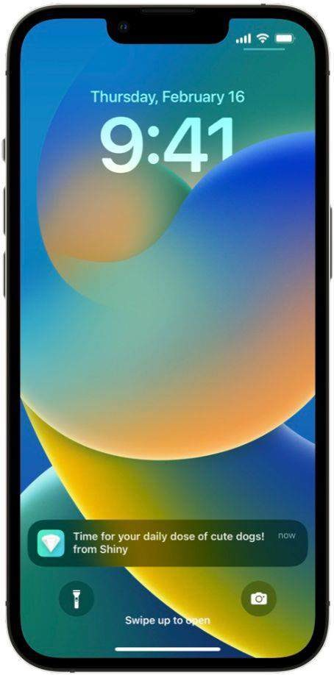
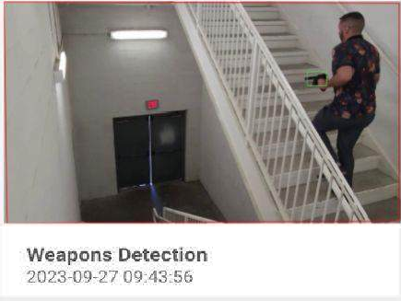
“CES AI Video” Mobile App – Push Notification Alert Example
Weapons Alert!
Push Notification iOS and Android devices

Slide 26
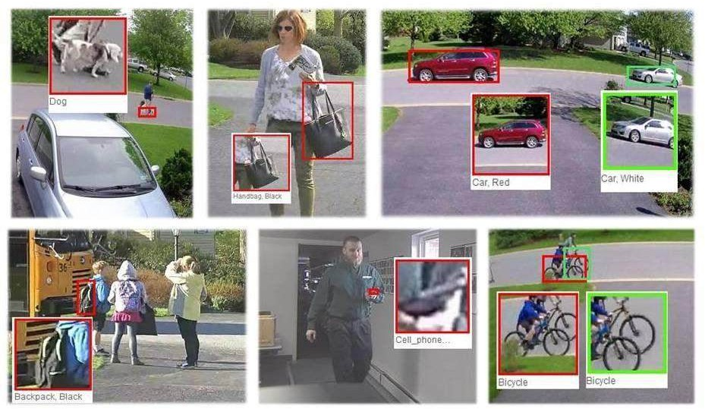
Video Search
Using attributes:
Color
Quantity
Gender
Age
Object Type
Search can be used on live camera feeds or recorded video
Search for
People
Objects
Vehicles

Slide 27
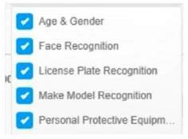
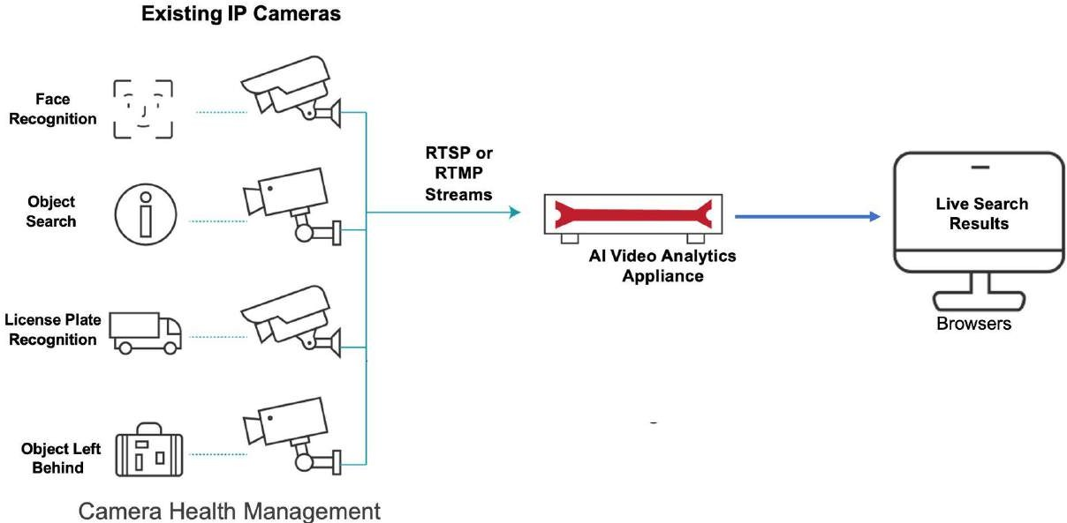
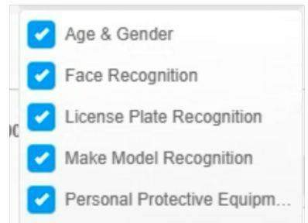
Search for Objects, People or Vehicles
.
Live Search

Slide 28
Video Search / Object Search

Slide 29
Partial License Plate Recognition Search

Slide 30
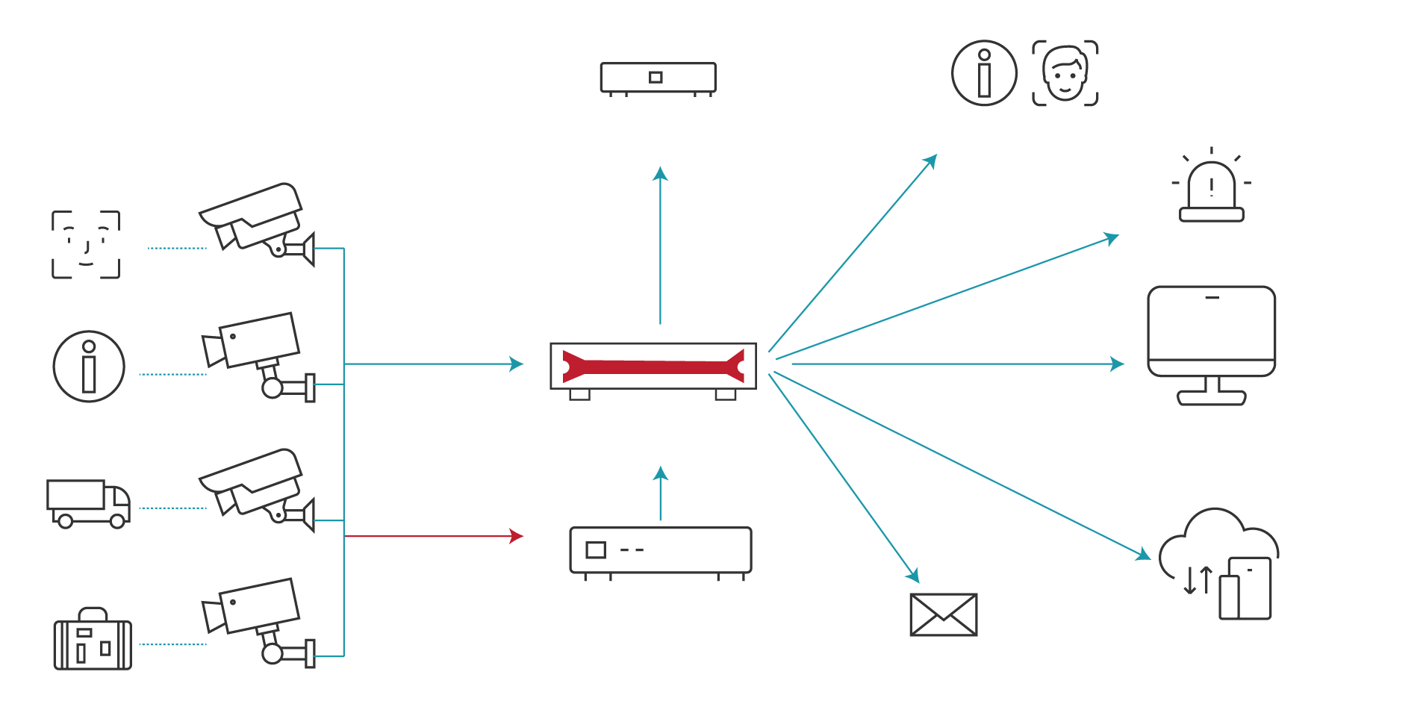
AI Video Analytics Architecture
Existing IP Cameras
Supported VMS
Access Control System
Alarm System
RTSP or RTMP
Streams
ALERTS
Events and Search Results
Browsers
AI Video Analytics Appliance
ALERTS
RTSP or RTMP
Streams
Mobile App
ALERTS
Existing NVR/ DVR
Email
Camera Health Management included for all AI enabled cameras

Slide 31
AI Video Analytics Managed Service
The Managed Service includes:
Configuring System Settings
Connecting the Cameras to AIVA Appliance if required
A Camera inventory and the associated Use Case licensing to be enabled.
Camera credentials (user, password) if required.
Access to Camera configuration if required (Frames per Second, Codec, etc.).
Setting up the Software Licenses.
Use Case testing.
Ongoing Management and Monitoring including Moves, Adds and Changes
Applying Software updates as required.
Maintaining Use Case configuration.
Maintaining Face Recognition Images.
Maintaining of the Alert Distribution Lists.
Configuration changes due to physical camera relocation (add, change, replace).
License reassignment.
User Security Management.
Alert Configuration Management.

Slide 32
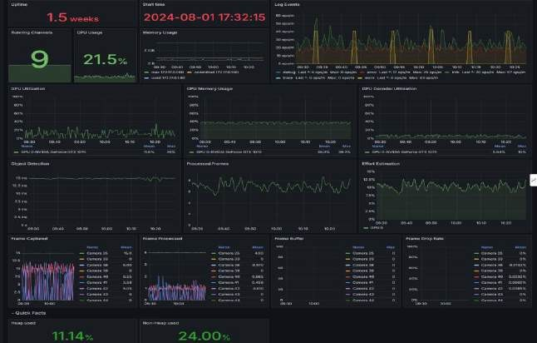
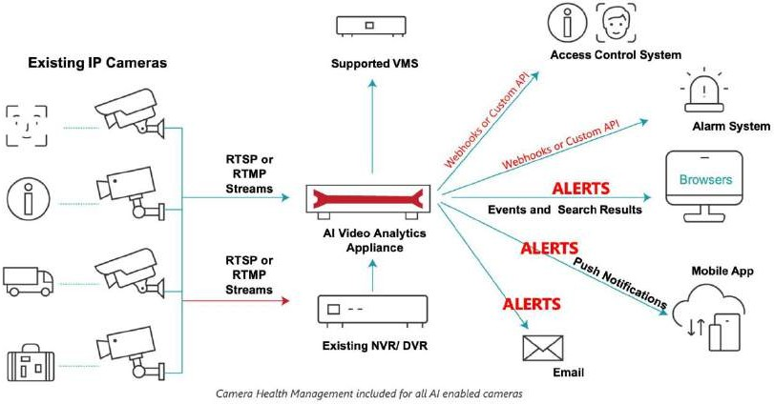
AI Video Analytics Managed Service
System Monitoring
Internet
AIVA Managed Service
Customer Premise
The Service uses secure encrypted communications The Monitoring runs 24/7
Support is available 24/7 via the GNOC
Note: monitoring does not include Use Case Alerts

Slide 33
Thank you For
Your Attention!
Franklin M. DiGioia Channel Sales Manager Claro Enterprise Solutions
Franklin.digioia@usclaro.com
305-525-1484

