Slide 1
Starting From Scratch:
The Blueprint for Building a Successful Auxiliary Department
02.04.2025
MISBO Auxiliary Programs Conference 2025
Presentator: Joey Ferrelli
Porter-Gaud School
Charleston, SC

Slide 2
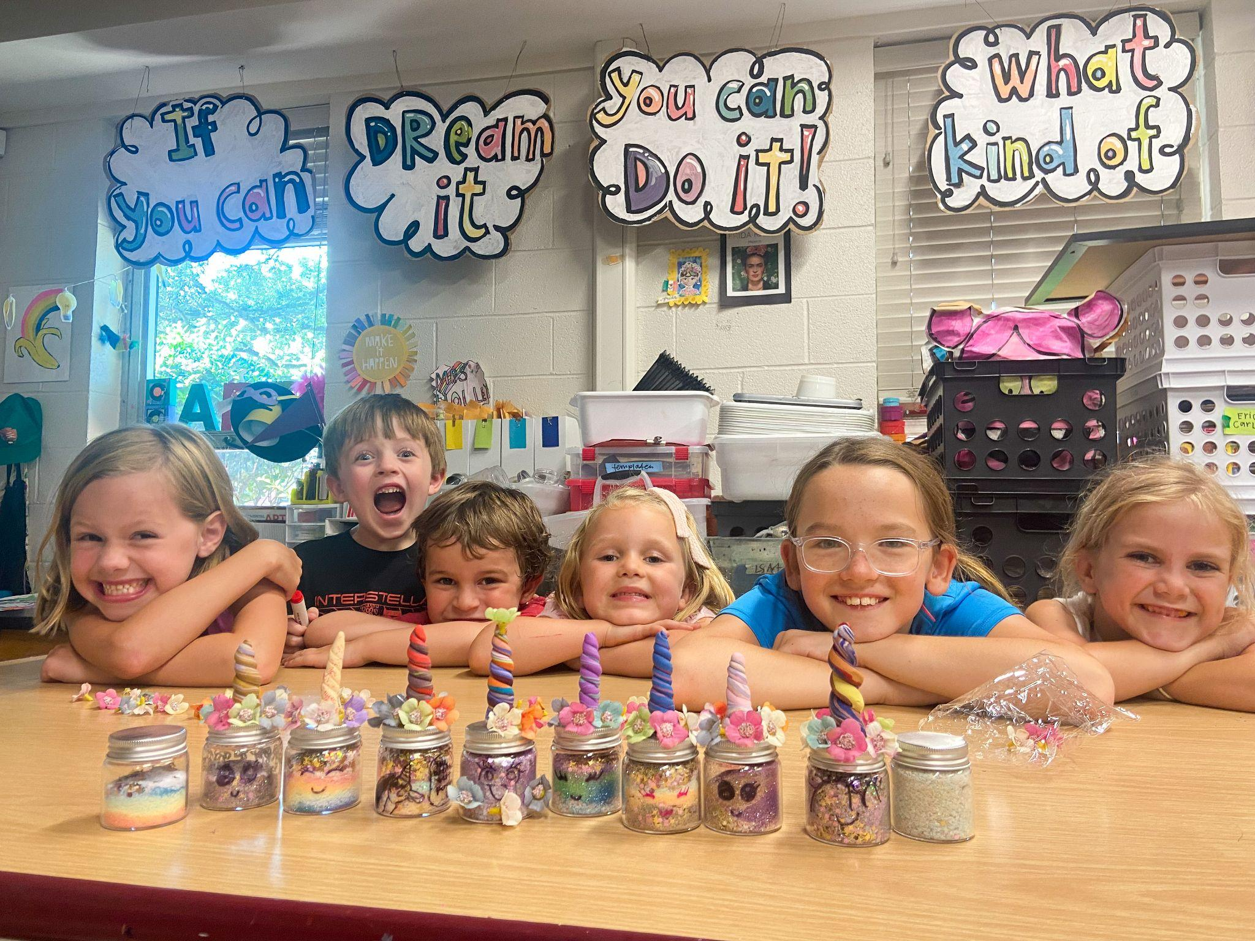
Mission Statement:
We believe in building self-esteem and character, while making new friends with lasting memories. Experience something new or enhance your everyday skills. Whichever path you take… our main goal is for our students to grow and have fun!

Slide 3
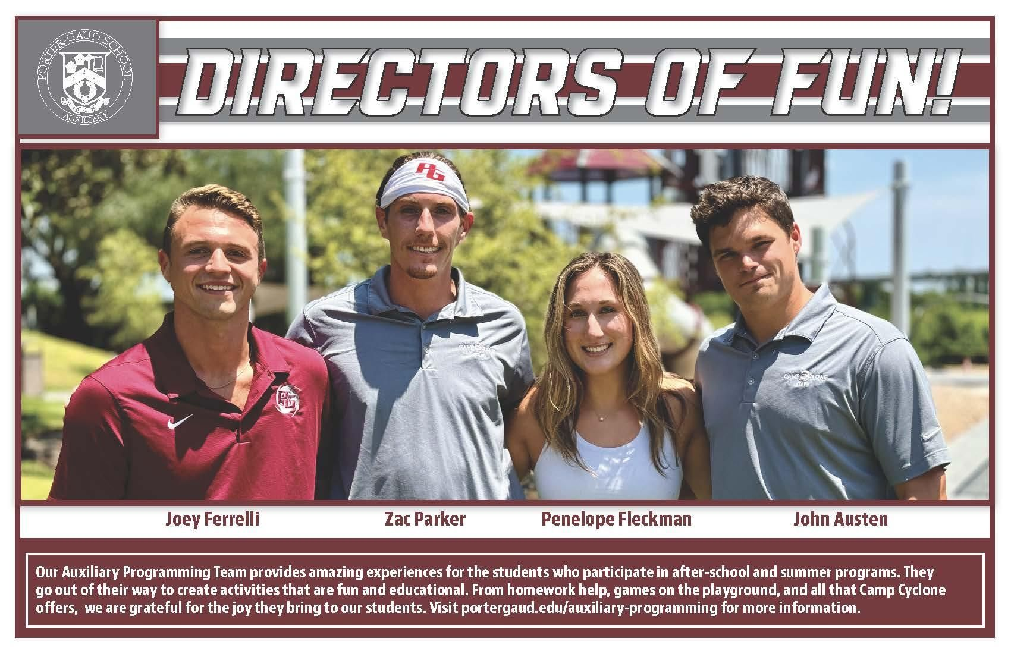

Slide 4
The 3 Branches of Auxiliary:
Enrichment Programs
Summer Camps
Extended Day

Slide 5
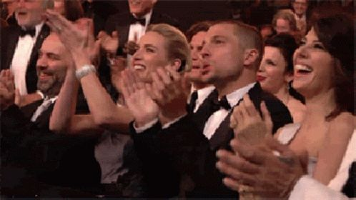
Where We Started:
“The Extended Day Guys”

Slide 6
Extended Day Staffing

Slide 7
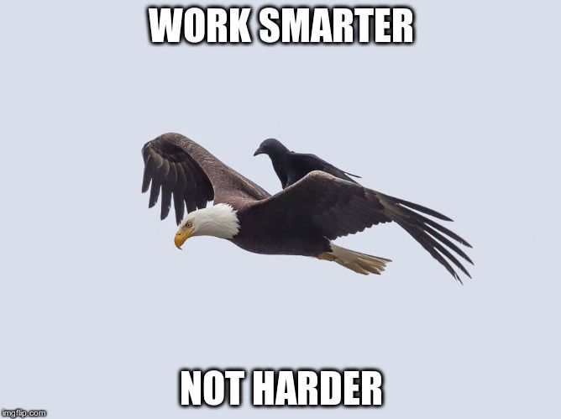
Good People Know Good People

Slide 8
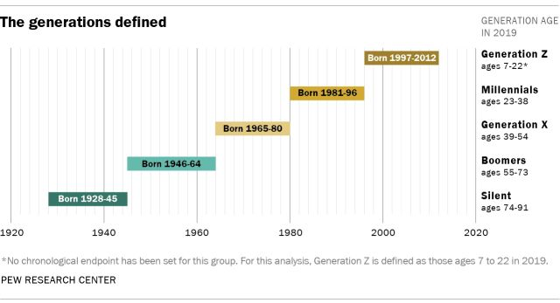
Managing Millenials and Gen Z:

Slide 9
Managing Millenials and Gen Z:
Be Blunt and Direct
Set realistic expectations
This, most likely, won’t be where you retire
If..than.. (positive and negative outcomes)
Be yourself, be real, connect - that’s how you gain respect
Admit when you’re wrong (be transparent)
Communication

Slide 10
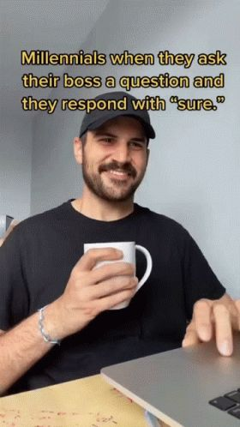

Slide 11
A Few Specific Techniques:
“Hey Team”
Weekly check-in
Monthly meetings (ask questions)
Temporary employees - resume, interview, references
Use your knowledge regarding purchases - car, insurance, homes/rentals, vacations..(financial advice)
Forced resignation if its not working out (try not to fire and ruin their next job attempt, just because they don’t get it yet)

Slide 12
Enrichment Programming
After-School Enrichment
Music Lessons
Private Training
Holiday Camps
Spring Break Camps
Weekend Clinics
Preseason Clinics
Be creative - utilize mornings

Slide 13
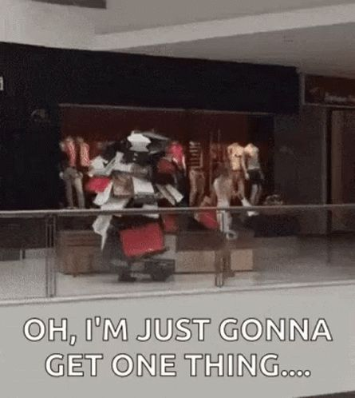
Become a one-stop-shop

Slide 14
Our After-School Enrichment Structure
Session I: Starts off each semester. Each program’s sessions are 1 hour and 15 minutes long, held once a week for 8 total sessions
Session II: Later in the semester. Each program’s sessions are 1 hour and 30 minutes long, held twice a week for 6 total sessions

Slide 15
The Auxiliary Handbook: Policy Over Preference
❖ Mission Statement and Beliefs
❖ Purpose of Auxiliary Department Internal Policies and Guidelines
❖ Personnel Policies
➢ Code of Conduct
➢ Auxiliary Employee Roles
❖ Procedures
➢ Enrichment Programs
➢ Private Performance Training
➢ Private Music Lessons
➢ Extended Day/Cyclone Club
➢ Camp Cyclone
➢ Refunds
➢ New Hire Process
➢ Employee Change of Address/Information
❖ Compensation
➢ Enrichment Instructor/Vendor Payouts
➢ Camp Cyclone Instructor/Vendor Payouts
➢ Private Music Instructor Payouts
➢ Private Performance Trainer Payouts
➢ Pay Rates

Slide 17
Summer Camps: Marketing Tools
Facebook/Instagram ads
Google ads
Social media presence
Local magazines/newspapers
NextDoor/Neighborhood Facebook Groups
Tables at local events (sports, concerts, Second Sunday)
Fans, pens, drawstring bags, water bottles etc.
Word of mouth

Slide 18
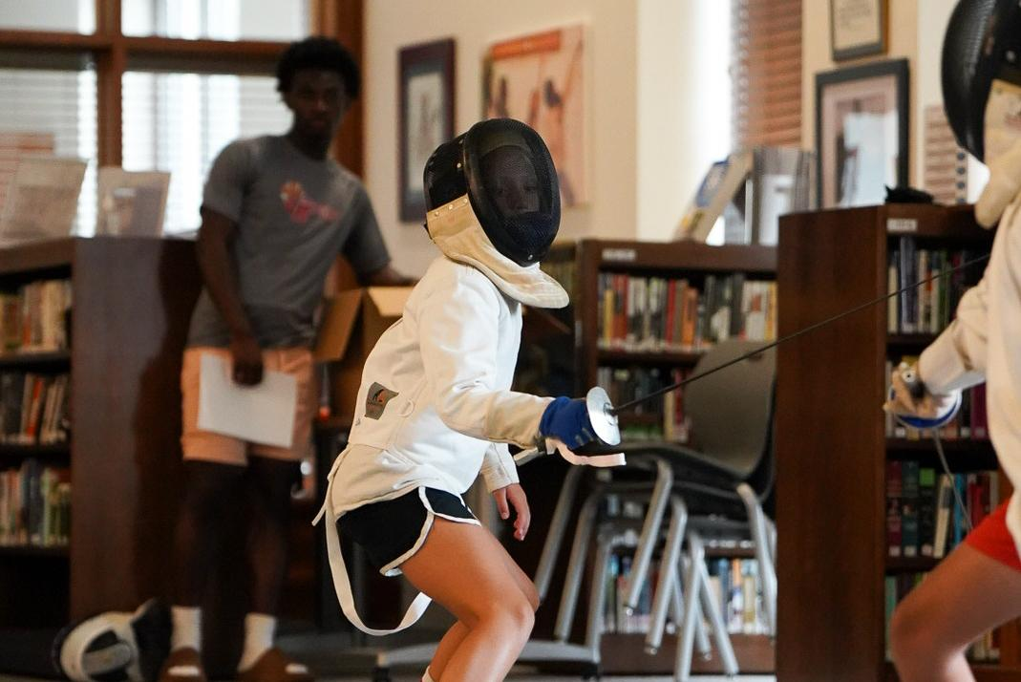
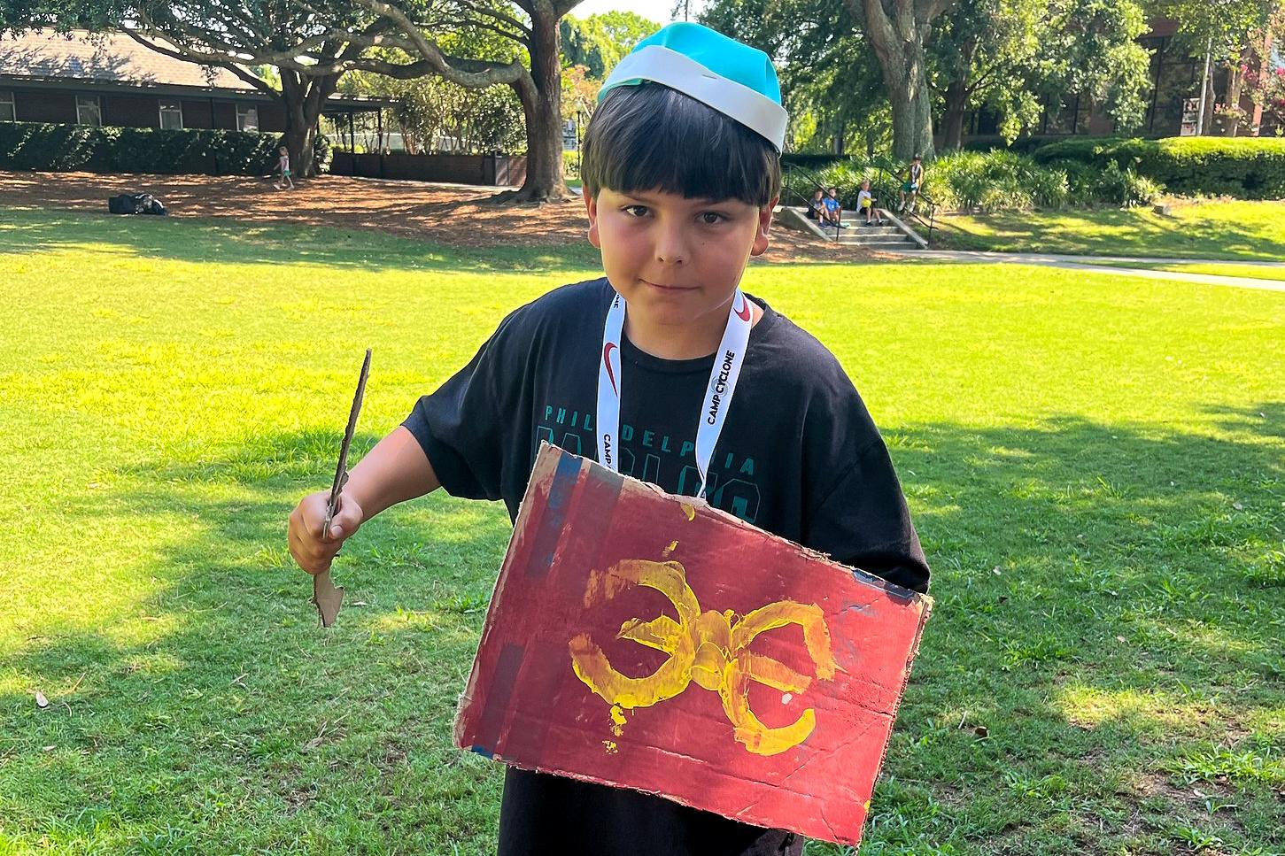
Specialty Camps vs Day Camps

Slide 19
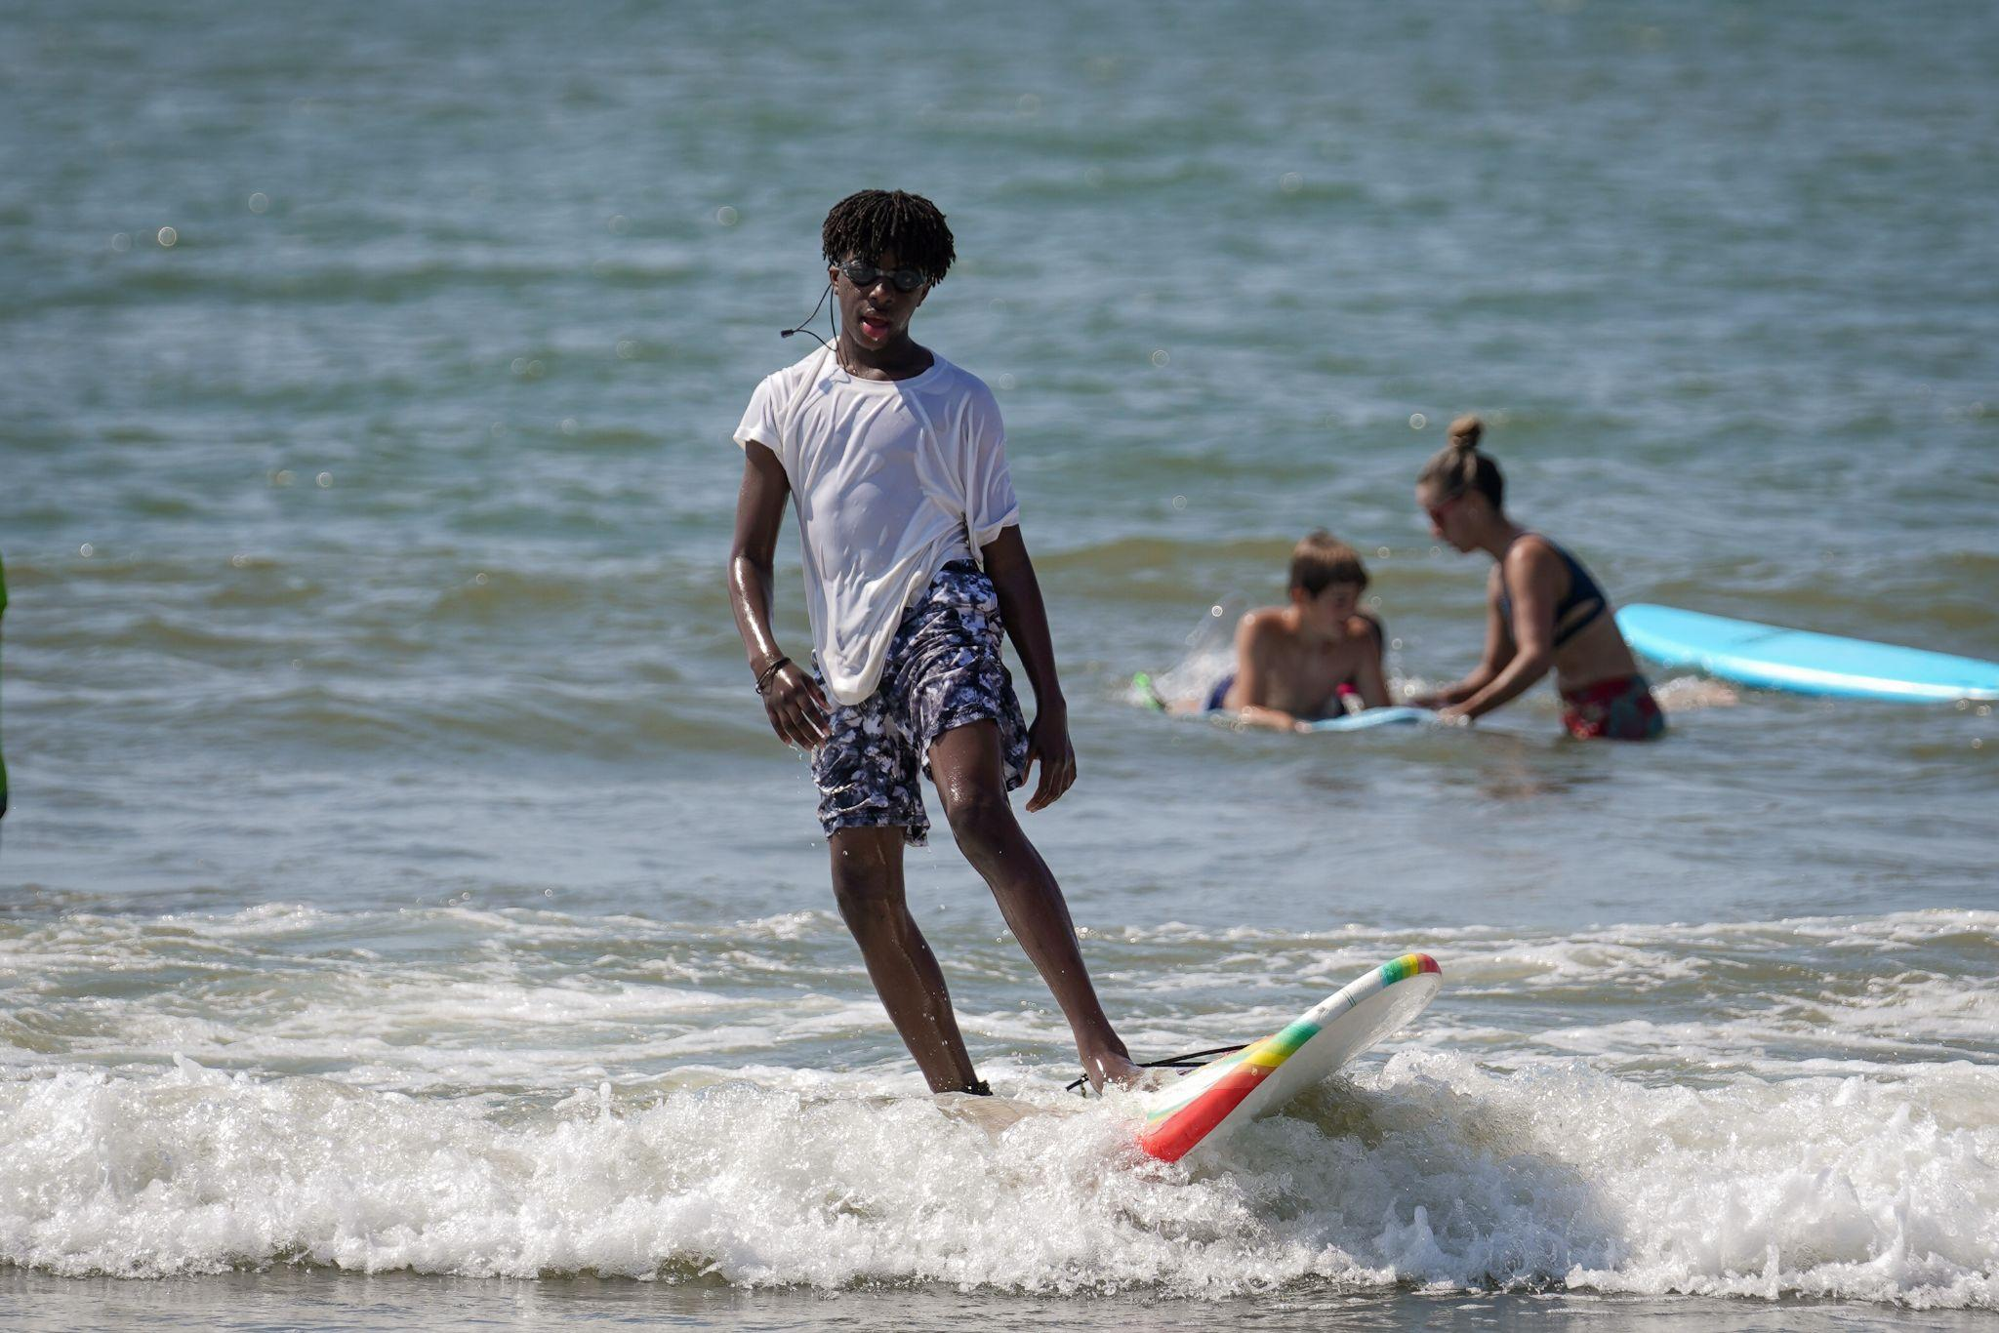
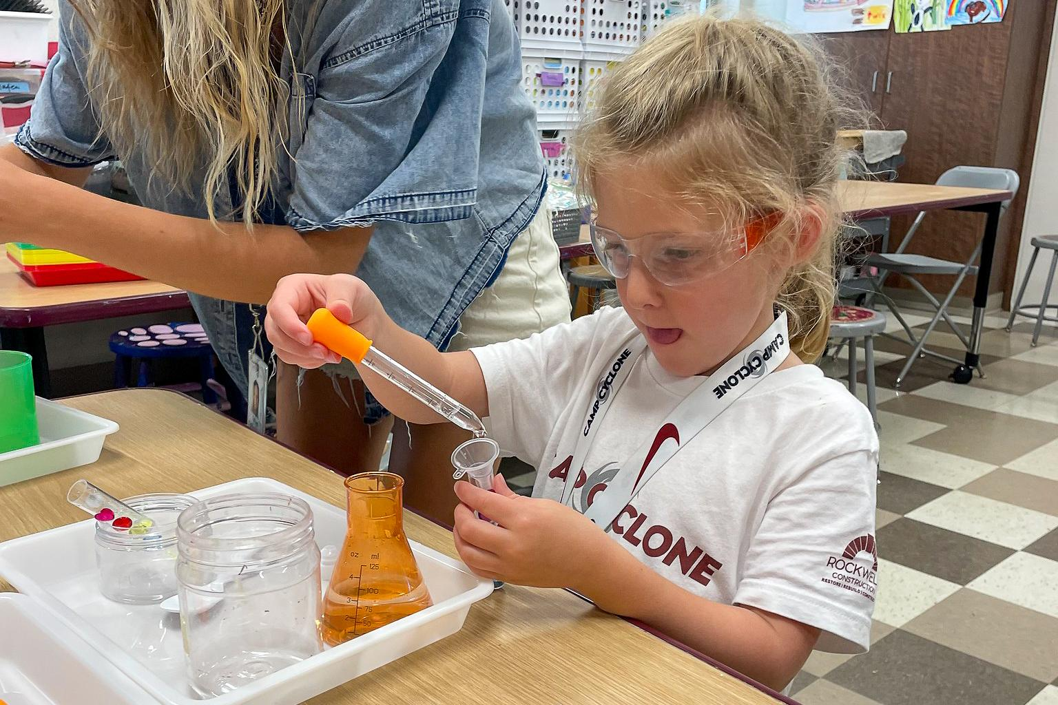
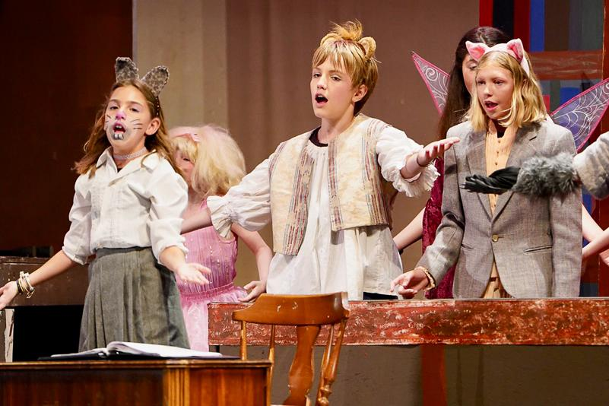
Choose Your Own Adventure

Slide 20
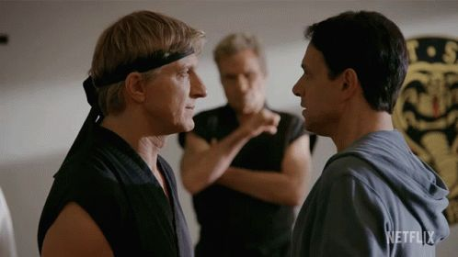
Auxiliary vs Facilities
Acknowledge different viewpoint
Agree to disagree
Look for the win-win (communication)

Slide 21
Auxiliary vs Facilities
Facilities use organization
Be creative
Who owns what?

Slide 22
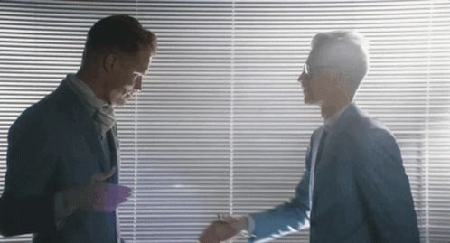
Establish Meaningful Relationships

Slide 23
Use Your Resources
Professional development
SPARC
Create a local network
On campus resources
Update registration platform
Social media

Slide 24
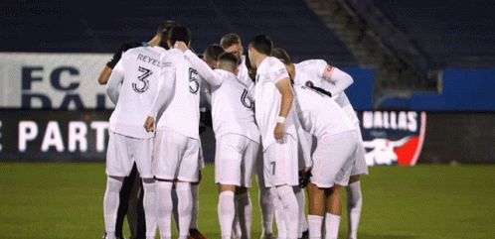
Remember, We’re All 1 team

