Slide 1
Managing Up
by Organizing and Analyzing
Your Auxiliary Data with Spreadsheets:
A Case Study
Marcie Glad
Joe Ali

Slide 2
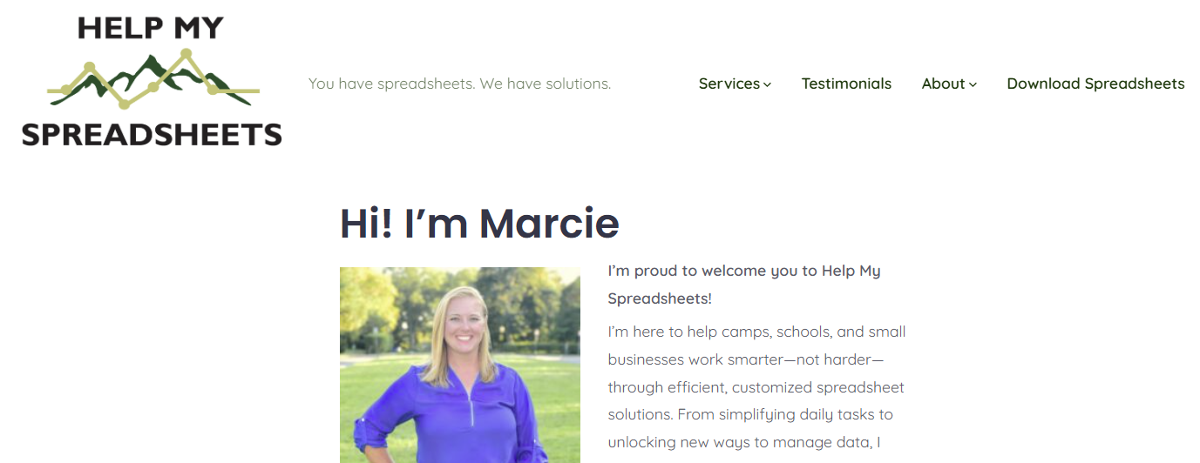
HelpMySpreadsheets.com

Slide 3
A little about us…
Joe Ali Marcie Glad

Slide 4
01
Learning Outcomes & Goals
Key Performance Indicators

Slide 5
1
2
Investment of Time is OK!
Understanding Where to Start
Equipped to Centralize and Organize
Spark Curiosity
3
4

Slide 6
Process
Joe’s Needs
Clean Up
Organize + Explore
Visuals
Presentation To The Board

Slide 7
Product
Joe’s Needs
Naming Conventions
Build for Registration
Continuity with Registration + Reporting
Clear Vision

Slide 8
Help My Spreadsheets + Joe’s Primary Focus
Organize Data
Pivot Tables
Graphs + Slicers
Titles not organized
Efficiency
Quick Toggle

Slide 9
What does your CRM do for you?
How is your data pulled?
Do you build backwards?
Can you work with support team?
What else?

Slide 10
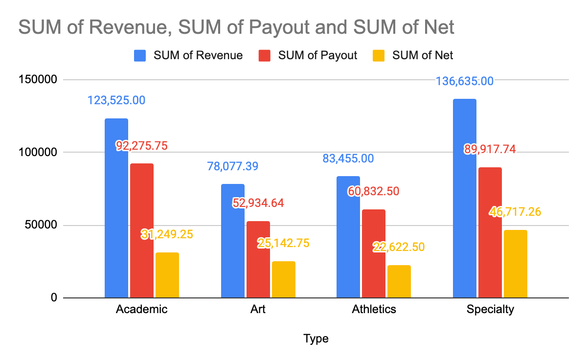
End of Summer General Breakdown
Type | Gross Revenue | Compensation Payout | Net
Academic | $123,525.00 | $92,275.75 | $31,249.25
Art | $78,077.39 | $52,934.64 | $25,142.75
Athletics | $83,455.00 | $60,832.50 | $22,622.50
Specialty | $136,635.00 | $89,917.74 | $46,717.26
Grand Total | $421,692.39 | $295,960.63 | $125,731.76

Slide 11
02
Teaching Time
Open up your spreadsheet you received via email.

Slide 12
HelpMySpreadsheets.com

Slide 13
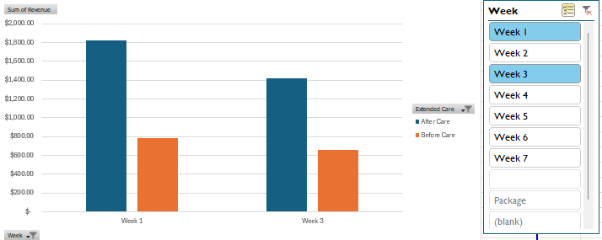
Graphs
Slicers

Slide 14
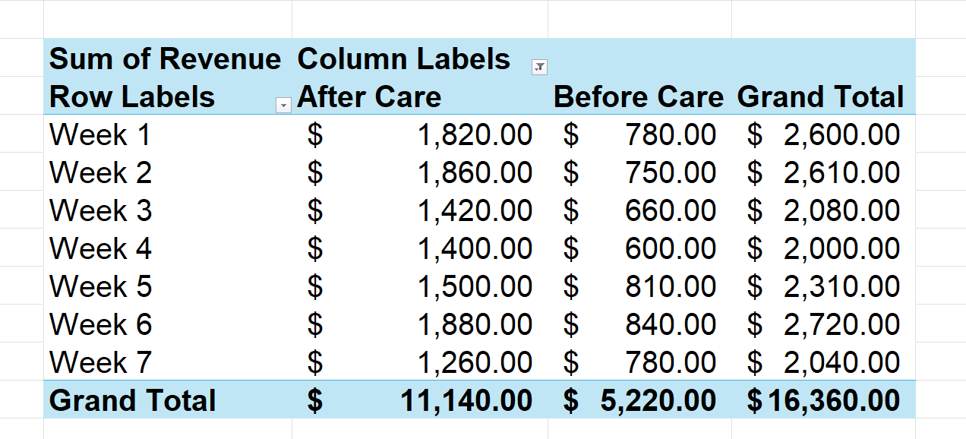
Pivot Tables (1/3)

Slide 15
Pivot Tables (2/3)
Type | Gross Revenue | Compensation Payout | Net
Academic | $123,525.00 | $92,275.75 | $31,249.25
Art | $78,077.39 | $52,934.64 | $25,142.75
Athletics | $83,455.00 | $60,832.50 | $22,622.50
Specialty | $136,635.00 | $89,917.74 | $46,717.26
Grand Total | $421,692.39 | $295,960.63 | $125,731.76

Slide 16
Pivot Tables (3/3)

Slide 17
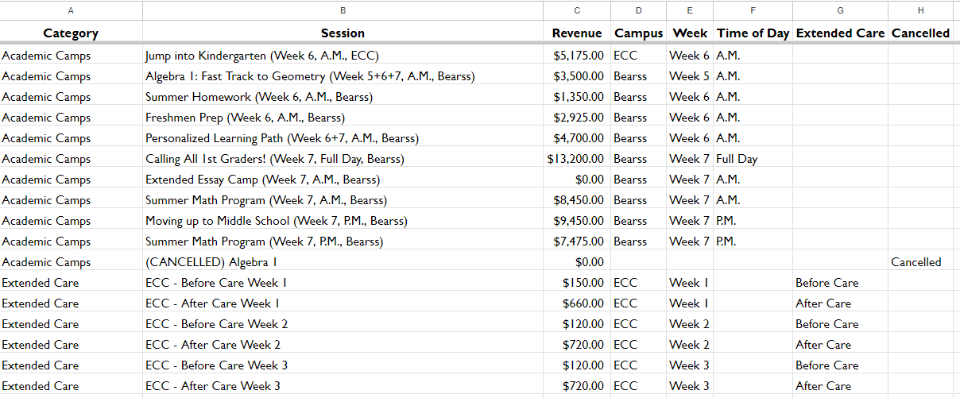
Sortable Spreadsheet = Good

Slide 18
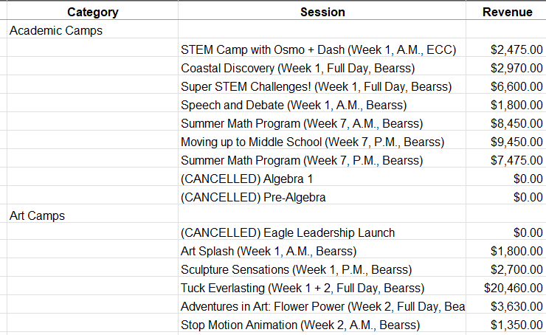
NOT sortable spreadsheet = BAD

Slide 19
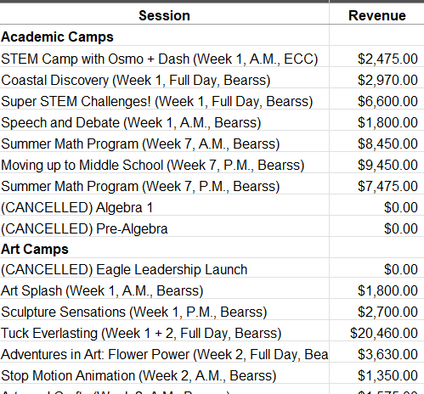
Also bad

Slide 20
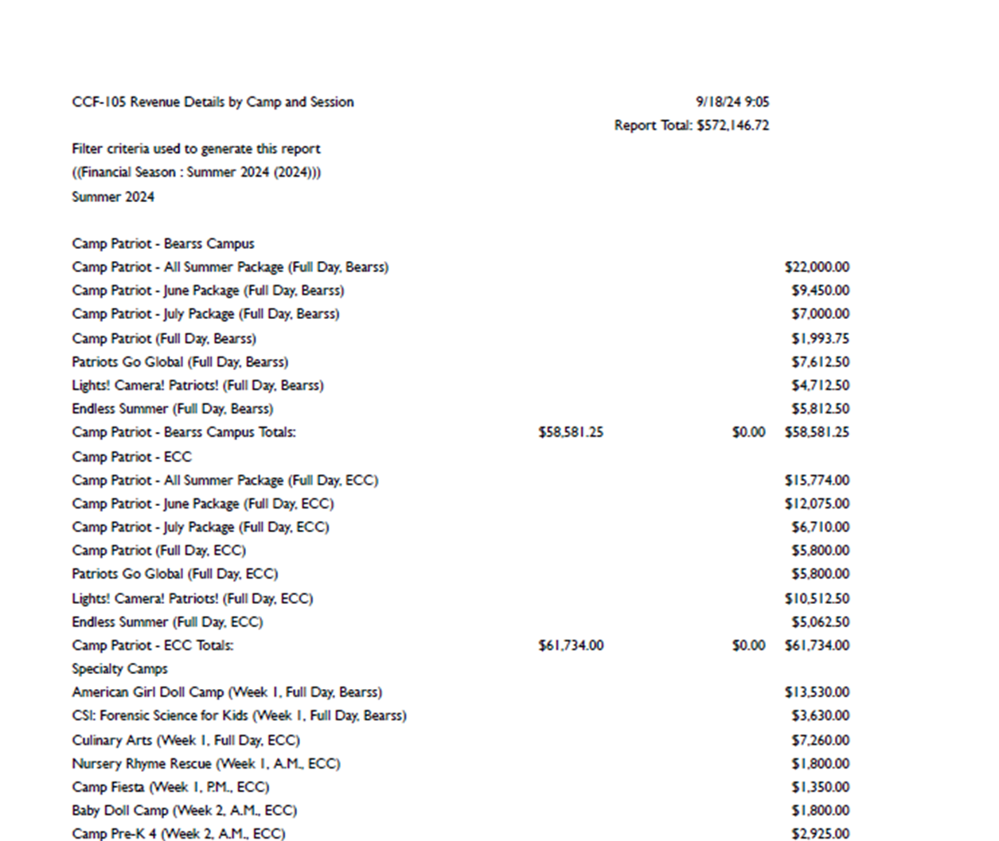
CRM Report
Sortable Sheet

Slide 21
How to make a Good, Sortable Spreadsheet
Move categories to new column

Slide 22
Categories in designated column

Slide 23
Extract Data Points

Slide 24
Extract Data Points
Clean the garage

Slide 25
Clean the Garage (Part 1)

Slide 26
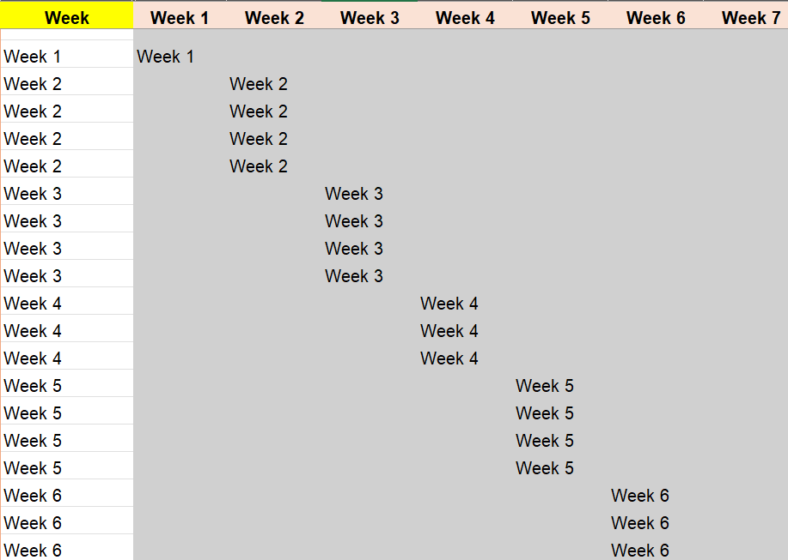
Clean the Garage (Part 2)

Slide 27
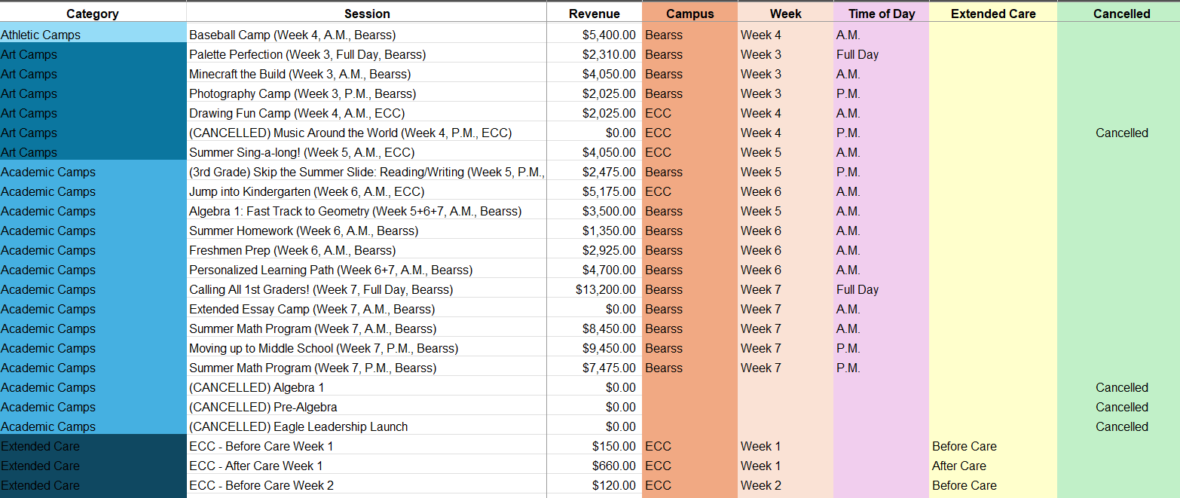
Sortable Spreadsheet with Valuable Information

Slide 28
Start
Finish
This session

Slide 29
Tangible Takeaways:
Determine goal (KPIs)
Centralize data (one workbook, many tabs)
Organize spreadsheet
Recognize formula parts
Pivot table
Charts
Slicers

