Slide 1
Blueprint for Collaboration: The Facilities Manager & Head of School Connection
Mark Charneske, Director of Facilities
Steve Salvo, Head of School
St. Mary’s Episcopal Day School (Tampa, FL)

Slide 2
About Us
Mark Charneske
Fun Fact 1 (or Bio)
Fun Fact 2
Fun Fact 3
Fun Fact 4
Fun Fact 5

Slide 3
Steve Salvo
Independent school educator since 2000; former public accountant
ISM adjunct faculty member and consultant
Boston native and loyal sports fan
University of Richmond alum
Facilities talents = 0/10; still unsure of how to best hang a picture frame. Can’t ever find the studs.
Enjoys good coffee and bourbon (Mark is a great bourbon drinking partner).

Slide 4
Learning Objectives
Participants will understand the strategic role of facilities in school leadership and how the Facilities Director and Head of School can align facilities management with the school’s mission and long-term goals.
Participants will enhance communication and decision-making strategies to foster a productive partnership between facilities and administration, ensuring proactive planning, budgeting, and crisis management.
Participants will develop a framework for effective collaboration, including joint problem-solving, project management, and stakeholder engagement to optimize campus operations and long-term infrastructure planning.

Slide 5
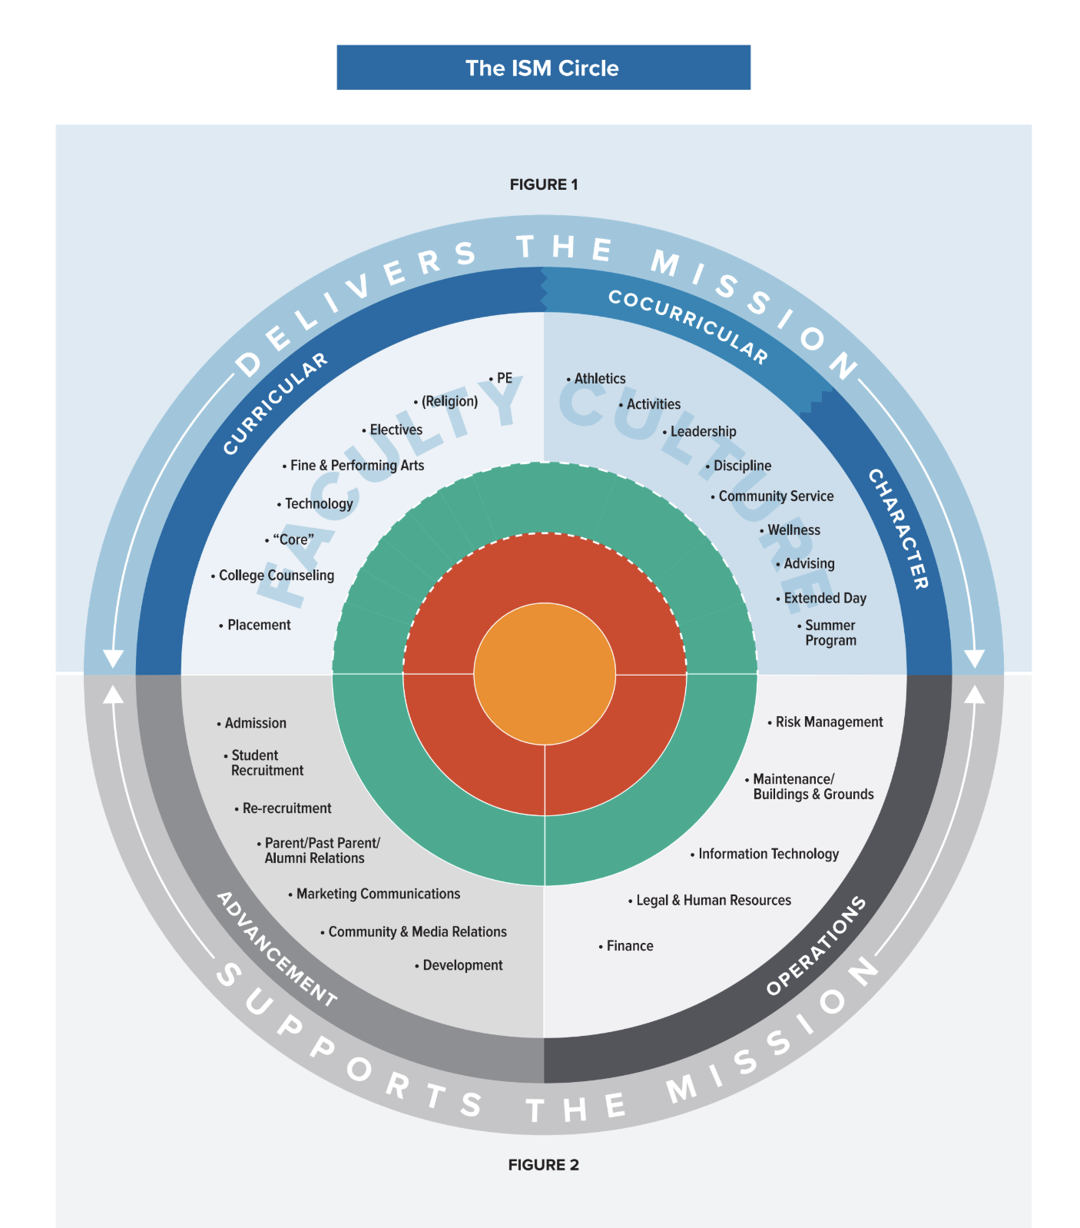
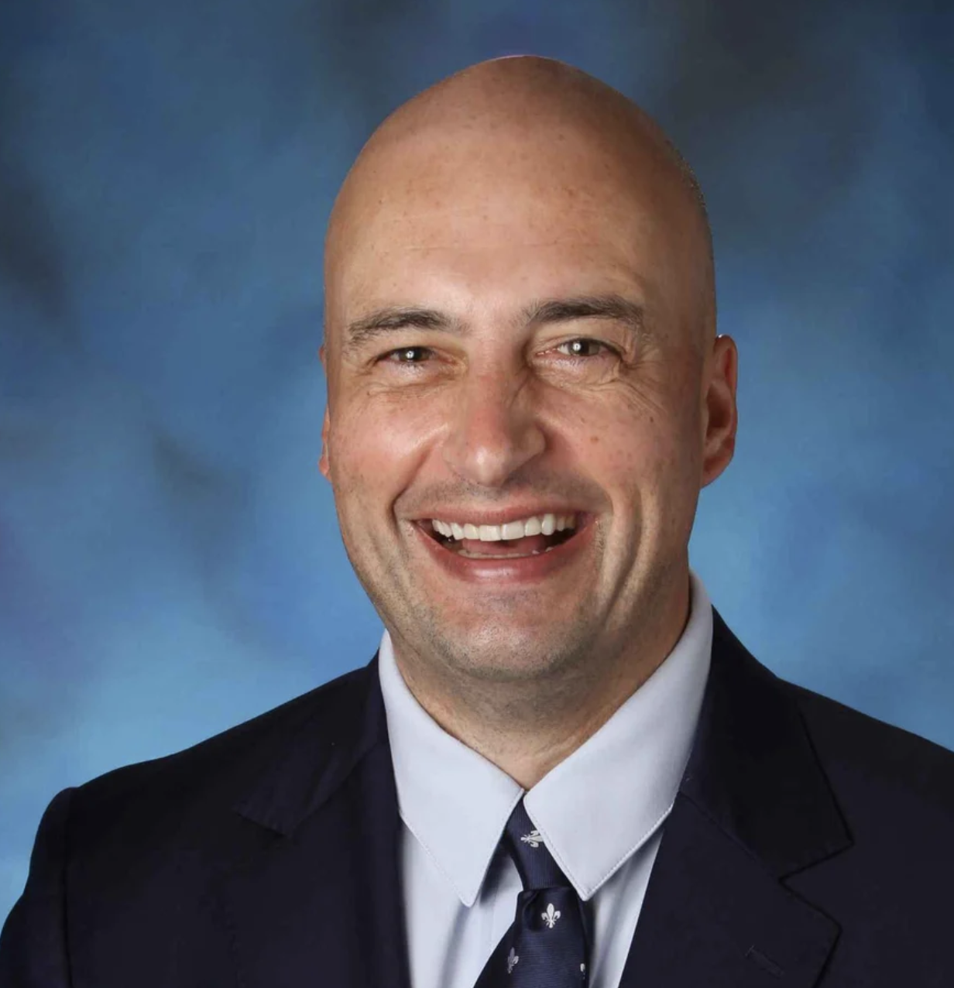

Slide 6
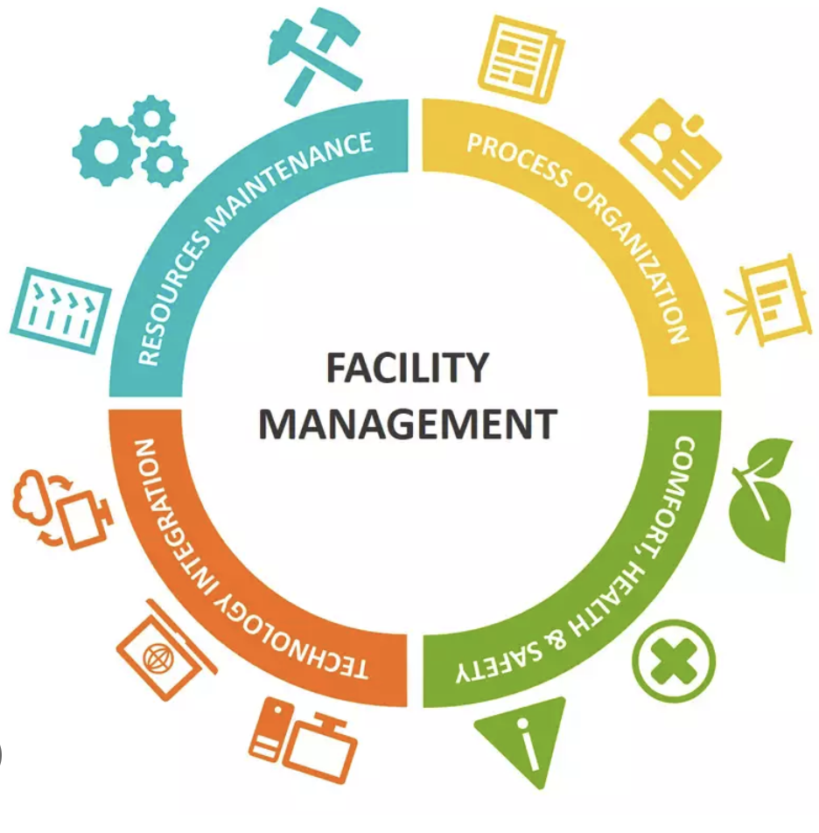

Slide 7
Head of School Learned Lesson #1
The only certain thing is uncertainty!

Slide 8
Facilities Manager Learned Lesson #1
In many instances, anything less than 100% is failure in our line of work.

Slide 9
The Most Important Thing

Slide 10
St. Mary’s Episcopal Day School
Mission:
Inspiring curiosity, kindness, and dignity
in a caring Christian community.

Slide 12
Question: How much do you (the Facilities leader/department) feel like you have a seat at the leadership table at your school?
Sliding Scale (0-10):
0-2: I feel like an outsider. My role is mostly operational, and I am rarely included in leadership discussions.
3-5: I am sometimes consulted, but I do not have a consistent voice in leadership decisions.
6-8: I am regularly involved in leadership discussions and feel my input is valued in strategic planning.
9-10: I am a key member of the leadership team and actively shape school-wide decisions and long-term strategy.

Slide 13
0-2: I feel like an outsider. My role is mostly operational, and I am rarely included in leadership discussions.
3-5: I am sometimes consulted, but I do not have a consistent voice in leadership decisions.
6-8: I am regularly involved in leadership discussions and feel my input is valued in strategic planning.
9-10: I am a key member of the leadership team and actively shape school-wide decisions and long-term strategy.

Slide 14
What’s keeping you from that higher #?
Size and scope of facilities work
Size of team (busy managing operations)
Administrative structure(s)
Personalities involved
Current year priorities or projects
Personal preferences
You have NO IDEA

Slide 15
Sample Administrative Structure - SMEDS
Administrative Team (11):
Head of School Director of Facilities
Assistant Head of School/Director of Admissions and Comm. Director of IT and IT Systems
Primary Division Head
Assoc. Head for Strategic Init./Intermediate Division Head
Middle School Head
Chief Financial and Operations Officer
Director of Human Resources and Controller
Director of Athletics and Auxiliary Programs
Director of Development/Exec. Assistant to Head

Slide 16
Personality Profiles

Slide 17
Personality Profile Impacts
Preferences for giving/receiving feedback
Work styles and approaches
Facing UNCERTAINTY: potential reactions
How to handle the “boss”

Slide 18
Head of School Key Measurables
Governance
Culture/Climate = enrollment and advancement outcomes
Balancing day-to-day operations with long term strategy
Marketplace stance / external factors
Change management and surprises
* The safety, well-being, and satisfaction/enthusiasm of our current stakeholders, especially students!

Slide 19
Facilities Manager Views of the Head of School

Slide 21
Collaboration

Slide 22
HofS Thoughts

Slide 23
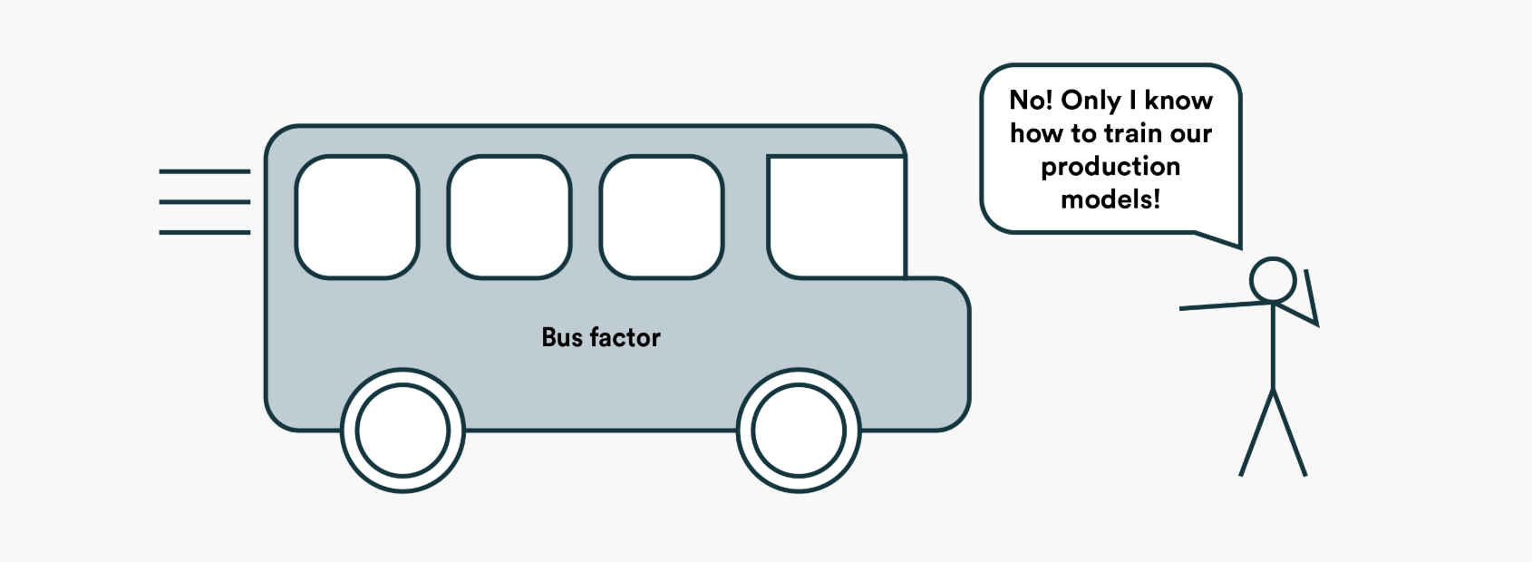

Slide 25
Goals
An appropriate, accessible seat at the table
Trusting communication now and looking ahead
Commitment to collaboration

