Slide 1


Navigating Workplace Law Changes Expected Under a New Administration
MEET YOUR SPEAKER
Bryan Holbrook
Partner
Fisher Phillips, Charlotte
February 4, 2025
© Copyright 2025, Fisher & Phillips LLP. All rights reserved.

Slide 2

The information contained in this presentation or on the Fisher Phillips website is not and does not constitute legal advice.
Please consult directly with your employment counsel to obtain legal advice.
The information does not necessarily represent the position or opinions of the firm or its partners or attorneys collectively

Slide 3
Today’s Goals
“Kudos to you for making it engaging and almost entertaining. 😊 The time flies by and I don’t notice anybody nodding off and considering the subject matter, that is really saying something!”

Slide 4

What’s on Tap
DOL
EEOC
NLRB
Immigration
OSHA/Workplace Safety
Non-Competes
Post-Chevron Implications

Slide 5
What’s on Tap
Parental Empowerment
Non-Profit Status;
Immigration Reform and Impact on Schools
Artificial Intelligence
Title IX
Transgender Students/Employees
DEI Programs

Slide 6
What’s on Tap
Pregnant Workers Fairness Act
School Choice and Vouchers
Joint Employment
Overtime
OSHA/Workplace Safety
Threat Assessments

Slide 7

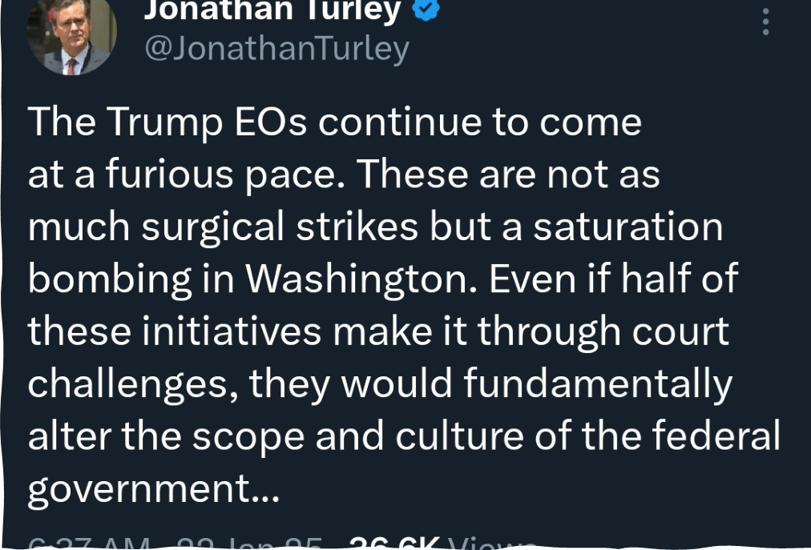

Slide 8

Department of Labor (DOL) Updates

Slide 9
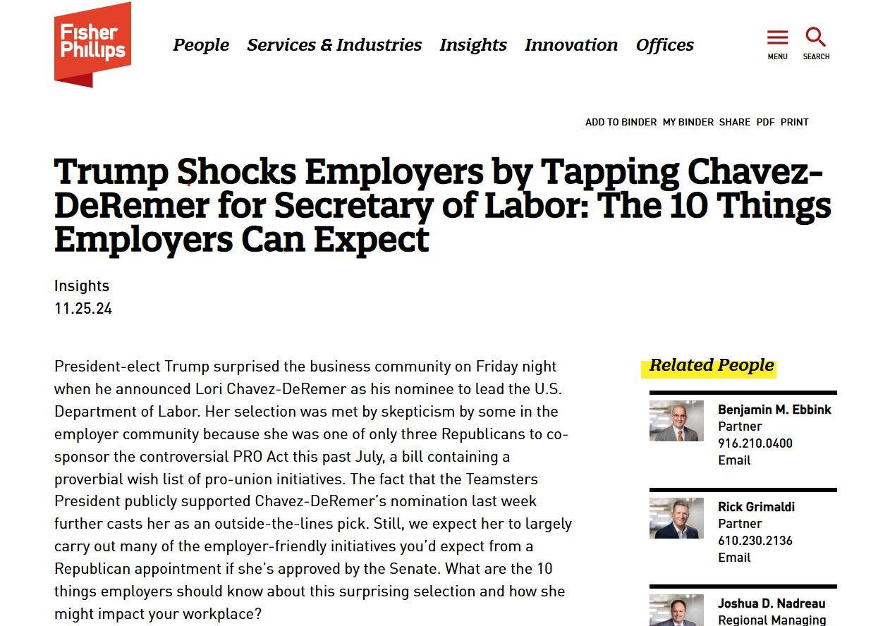
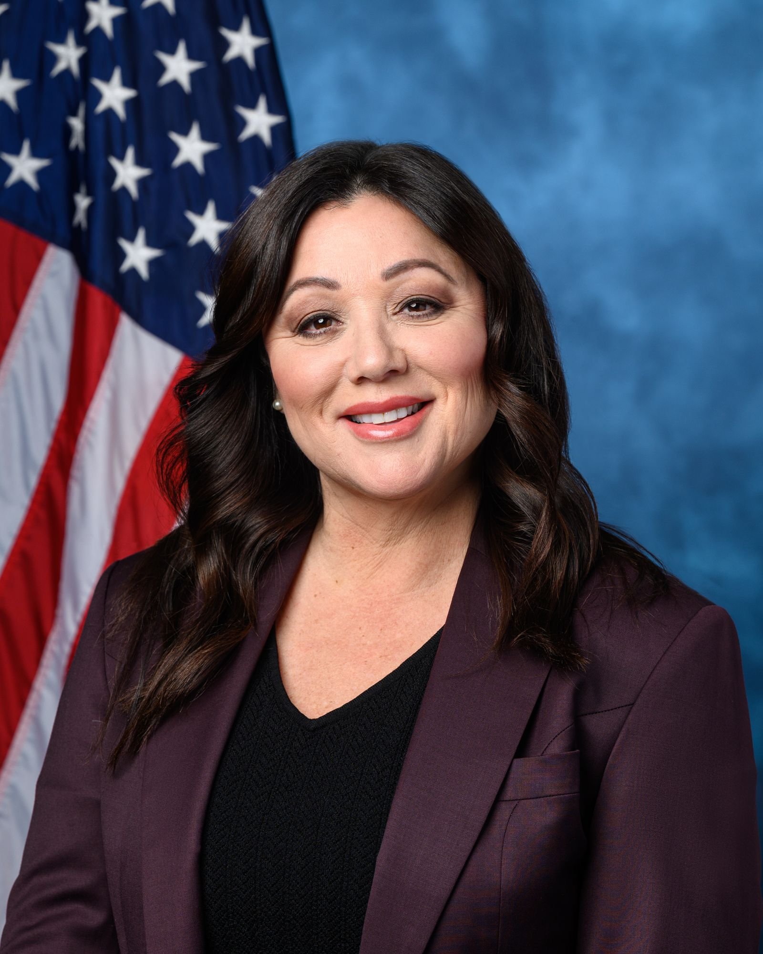

Slide 10
10 Things to Know About Secretary Chavez-DeRemer
Small Business Background
Appeal to Unions as “daughter of a Teamster”
Business Community is “Curious,” but she’s likely to be confirmed (with a few Democrat votes)
PRO Act Will Not Pass
New Overtime Rule, but Not As Dramatic
Minimum Wage Hike a Longshot
Independent Contractor Rule
Joint Employer Test
Impact on Workplace Safety
Likely to Impact Immigration (H-1B Wages)

Slide 11

EEOC Updates
EEOC Updates

Slide 12
EEOC – Who Are They?
Five members appointed by the President and confirmed by the Senate to 5-year staggered terms:
Charlotte A. Burrows, Chair – Democratic appointee (7/28)
Jocelyn Samuels, Vice Chair – Democratic appointee (7/26)
Andrea R. Lucas, Commissioner – Republican appointee (7/26)
Kalpana Kotagal, Commissioner – Democratic appointee (7/27)
Vacant Commissioner
General Counsel appointed by the President and confirmed by the Senate to 4-year term:
  Karla Gilbride (10/27)

Slide 13
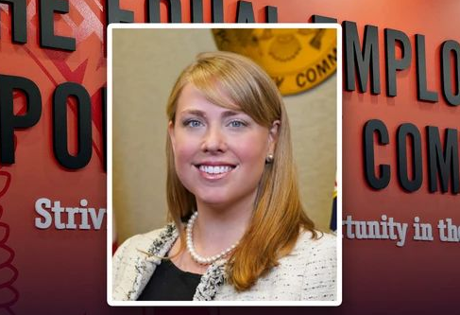
Acting Commissioner Andrea Lucas
President Trump named Andrea Lucas acting chair of the EEOC shortly after his inauguration
Appointed during first Trump administration
Outpaced the agency’s other members in filing commissioner charges
Has previously questioned legality of corporate DEI policies

Slide 14
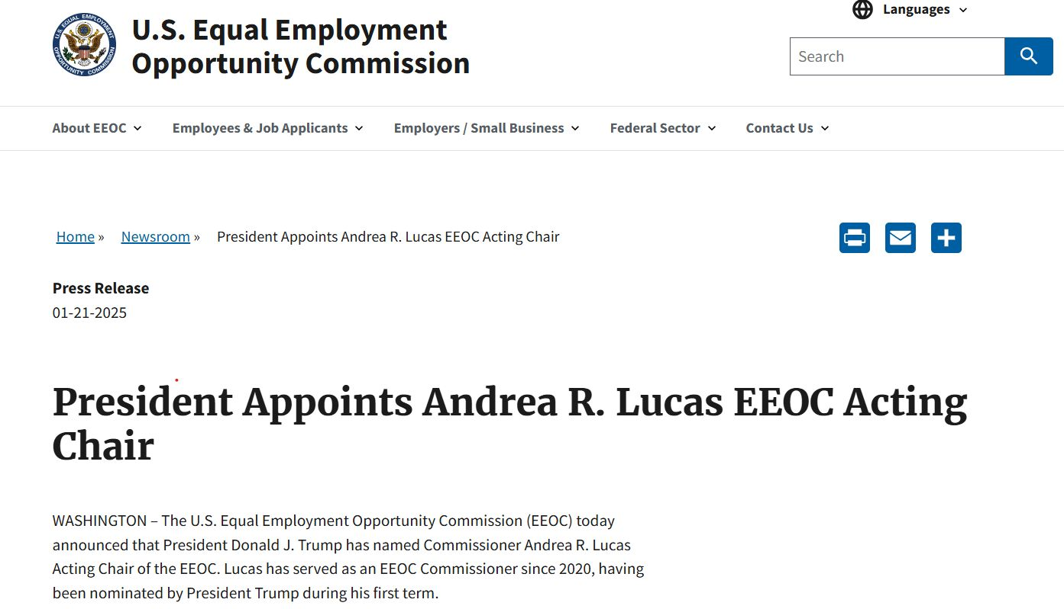

Slide 17

Actions thus far by Commissioner Lucas
Removed the EEOC’s “pronoun app” from Microsoft 365 (i.e. Outlook, Teams, etc.)
Ended the use of “X” or “non-binary” on EEOC intake process form
Removal of “Mx.” from list of prefix options on Charge and related forms
Removal of gender ideology from EEOC’s online materials

Slide 18
EEOC’s 2024-2028 Strategic Enforcement Plan
Eliminating Barriers in Recruitment and Hiring
  Focus on discriminatory impacts of AI, machine learning, and technology
    Trump has been opposed to Biden administration’s regulation of AI as stifling technology
  Protecting Vulnerable Workers and Persons from Underserved Communities from Employment Discrimination
  Focus on LGBTQI+ protections in the EEOC’s April 2024 Guidance on Harassment in the Workplace
    Commissioner Lucas was particularly opposed to provisions on misgendering and restrictions on bathroom access

Slide 19
EEOC’s 2024-2028 Strategic Enforcement Plan
Addressing Selected Emerging and Developing Issues
Pregnant Workers Fairness Act Rules effective June 2024
  Commissioner Lucas was particularly opposed to infertility, menopause, and abortion provisions
  Subject to greater challenge after Loper Bright
  EEOC and DOJ could wind up on opposite sides of the litigation
  Others less likely to be challenged
    Advancing Equal Pay for All Workers
    Preserving Access to the Legal System (waivers, releases, etc.)
    Preventing and Remedying Systemic Harassment

Slide 20
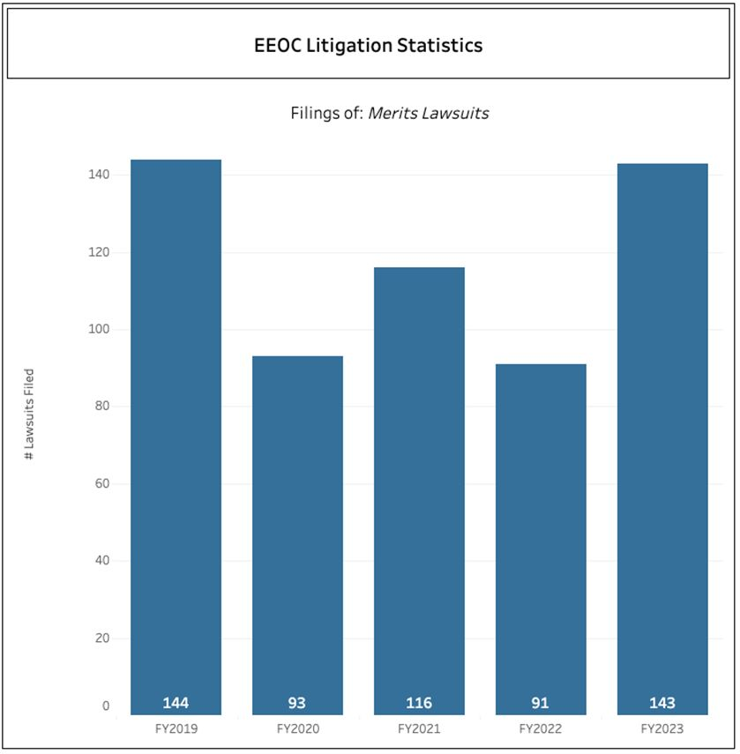
Fiscal Year 2024 - EEOC Litigation Trends
The EEOC filed 110 lawsuits in 2024, including:
  13 systemic cases involving a pattern, practice, or policy of discrimination
  48 cases under the Americans with Disability Act (ADA)
  Over 40 cases alleging retaliation under statutes enforced by the EEOC
  5 cases under the Pregnant Workers Fairness Act (PWFA)
  5 sexual harassment cases on behalf of teenage workers under Title VII
  4 cases under Title VII alleging sex discrimination based on sexual orientation

Slide 21

A Lesser Threat of Employment Litigation?
Non-EEOC employment suits are on the rise in the federal courts
Receiving an EEOC “cause” determination greatly increases your chances of being sued by a current or former employee
This is not the time to let your guard down

Slide 22

Diversity, Equity, and Inclusion Efforts
SCOTUS opinions regarding race in admissions (Harvard and UNC – Chapel Hill)
Except in very limited circumstances, race could not be considered in admissions
Claims targeting DEI programs, preference policies, affinity groups, financial aid/scholarships, fellowships and similar efforts may increase

Slide 23

Diversity, Equity, and Inclusion Efforts
The Supreme Court will decide by June 2025 on lowering the bar for reverse discrimination lawsuits, with the New Administration to likely weigh in.
  Circuit Split: Showing of “background circumstances” to support inference of “unusual employer who discriminates against the majority”
Review your programs, policies and practices
Schools engaged in DEI efforts should consult legal counsel to balance risk and mission alignment amid evolving policies.

Slide 24

Pregnant Workers Fairness Act
Pregnant Workers Fairness Act Rules effective June 2024
  Commissioner Lucas was particularly opposed to infertility, menopause, and abortion provisions
  Subject to greater challenge after Loper Bright
  EEOC and DOJ could wind up on opposite sides of the litigation

Slide 25
Pregnant Workers Fairness Act
Effective June 27, 2023
PWFA Refresher
An act that requires covered employers with 15+ to provide reasonable accommodations for employees with medical conditions related to pregnancy and childbirth.
  Similar to ADA disability requests
Prohibits employers from placing a qualified employee on a leave of absence when a different reasonable accommodation option is available.

Slide 26
Terms Defined
“Limitation” that triggers reasonable accommodation obligation under PWFA “does not require a specific level of severity.”
  Includes: fatigue, need to attend appointments, physical discomfort, etc.
Employees can meet the definition of “qualified,” even if they cannot perform one or more essential functions, provided specific conditions are met:
  The inability to perform the essential function is for a temporary period
  The essential function could be performed in the near future; and
  The inability to perform the essential function can be reasonably accommodated

Slide 27
EEOC Examples of Limitations:
  migraines;
  morning sickness;
  the need to take actions for the worker’s health or the health of their pregnancy such as:
    not being around certain chemicals;
    not working in the heat; or
    limiting or avoiding certain physical tasks, for example lifting, bending, walking, standing, or running, or
    It can be that the employee needs to attend health care appointments for the pregnancy, childbirth, or related medical condition itself.

Slide 28
PREGNANCY, CHILDBIRTH, OR RELATED CONDITION
  EXTREMELY BROAD
Pregnancy and childbirth refer to the pregnancy or childbirth of the specific employee in question and include, but are not limited to, current pregnancy; past pregnancy; potential or intended pregnancy. The foregoing would include infertility and fertility treatment, and use of contraception.
Related medical conditions relate to the pregnancy or childbirth. Examples include:
  termination of pregnancy, via miscarriage, stillbirth, or abortion; ectopic pregnancy; preterm labor;
  lactation and lactation problems; and
  menstruation.

Slide 29

Accommodations Under the PWFA
Job restructuring;
Schedule changes, part-time work, and paid and unpaid leave;
Frequent breaks;
Acquiring or modifying equipment, uniforms, or devices;
Making existing facilities accessible or modifying the work environment;
Allowing sitting or standing (and providing means to do so);

Slide 30
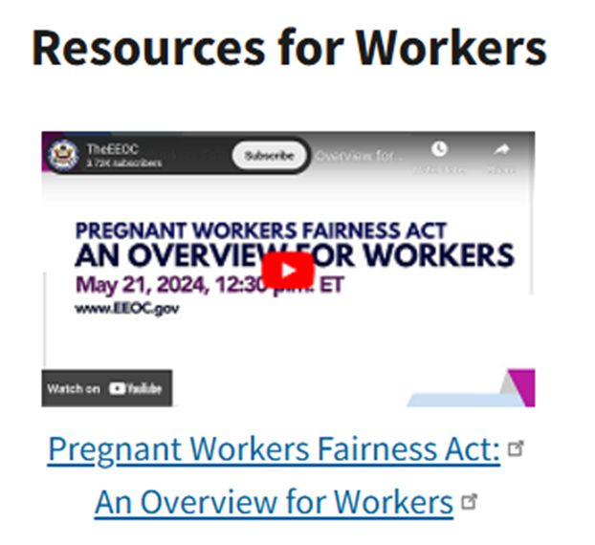
Accommodations Under the PWFA
Light duty;
Telework or remote work;
Providing a reserved parking space;
“Temporarily” suspending one or more essential function; and
Adjusting or modifying workplace policies.

Slide 31
How Should You Prepare?
  Train MGT on PWFA and list of suggested accommodations;
  Make sure the accommodations review process complies with PWFA;
  Know that:
    ADA and FMLA paperwork is likely unnecessary and inappropriate under the “minimum documentation” standard
    Employers can request medical documentation only when it is reasonable and limited;
    Unnecessary delay in accommodation can violate PWFA

Slide 32


EEOC Charges in the News
Chick-Fil-A
  Indiana worker alleges she was punished after she took time off for a threatened miscarriage
  Failed to accommodate when it assigned her absence points in violation of PWFA
Amtrak
  New York engineer alleges she was denied accommodation to express breast milk during her shifts
  Also alleges she received disciplinary notices regarding prenatal appointments
What Happens Next
  EEOC is investigating
  Agency can attempt conciliation, file a complaint in court against employer, or grant charging party a right to sue letter
  Takeaway: more clarification will come from EEOC; PWFA will require training to make sure in compliance

Slide 33
EEOC Brings PWFA Lawsuit
EEOC v. Wabash National Corporation
The employee requested light duty for the duration of her pregnancy. The EEOC is alleging that the company offered only unpaid leave as a pregnancy-based accommodation when light duty was made available to non-pregnant employees, including those with temporary disabilities, who requested similar accommodations under the ADA. Light duty included administrative work, inventory management, workspace housekeeping, and assembly assistance.
According to the EEOC’s complaint, the employee was able to perform administrative tasks like inventory management, order processing, and workspace maintenance supervision. She also could have performed any assembly line tasks that did not require extensive bending or lying on her stomach.

Slide 34

EEOC Brings PWFA Lawsuit
EEOC v. Wabash National Corporation
What does the EEOC claim the employer did wrong?
The employer placed her on leave without engaging in the interactive process, which “constituted a forced accommodation in violation of the PWFA.”

Slide 35

National Labor Relations Board (NLRB) Updates

Slide 36


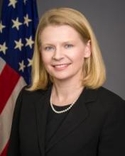



The “Biden Board”
Chair
Vacant Seat
Formerly Occupied by John Ring (R)
Marvin Kaplan (R)
Term Expires 8/25
Lauren McFerran (D)
Term Expired 12/24
David Prouty (D)
Term Expires 9/26
Gwynne Wilcox (D)
Term Expires 8/28

Slide 37

New Labor Board Chair
Trump announced Marvin Kaplan will serve as agency chair for the NLRB
Kaplan will lead the Board’s Republican majority after Trump’s pending nominees for the two open seats receive Senate confirmation

Slide 38
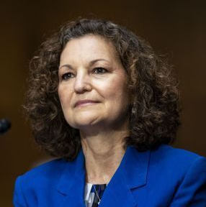
NLRB General Counsel – Jennifer Arbuzzo
Assumed GC office on July 22, 2021.
Immediately outlined a “restructuring” of NLRB law to help unions.
NLRB Regions have been dedicated to implementing this “restructuring.”
The U.S. Chamber of Commerce said she has “a radical agenda hostile to employers” and others have criticized her of a “flagrant disregard of applicable case law.”

Slide 39


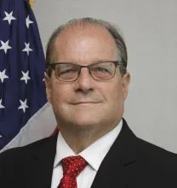
Termination of General Counsel (and General Counsel Memos)
  Following precedent set by President Biden in 2021, President Trump fired General Counsel Jennifer Abruzzo this week
  New General Counsel likely to rescind many General Counsel memos issued by GC Abruzzo over the last few years
  Last night, Trump named William Cowen as acting general counsel. Cowen is known for high-profile prosecution of NLRB cases against Apple and Amazon

Slide 40
So, what does that mean for the NLRB?
General Counsel Memos on the chopping block:
  Seeking “Full” Remedies in Unfair Labor Practices and Settlement Agreements (GC 21-06, 21-07 and 24-04)
  Prohibiting Mandatory Captive Audience Meetings (22-04)
  Prohibiting Most Non-Compete Agreements (23-08)
  Miscellaneous Enforcement Priorities (23-04)
  Crackdown on “Stay or Pay” Provisions (25-01)

Slide 41
What to Expect: NLRB
Decisions of the Board likely overturned:
  Employee Handbook Rules (Stericycle)
  Strict Limitations on Confidentiality and Non-Disparagement in Severance Agreements (McLaren Macomb)
  Independent Contractors vs. Employees (Atlanta Opera)
  Unionization without Elections (Cemex)
  Captive Audience Meetings (November 2024)

Slide 42

Parental Empowerment and Rights
The new administration has publicly supported efforts giving parents more control over what their children learn, read, and do at school each day
Until yesterday, these movements have been largely relegated to politically aligned states with little congressional action…

Slide 43
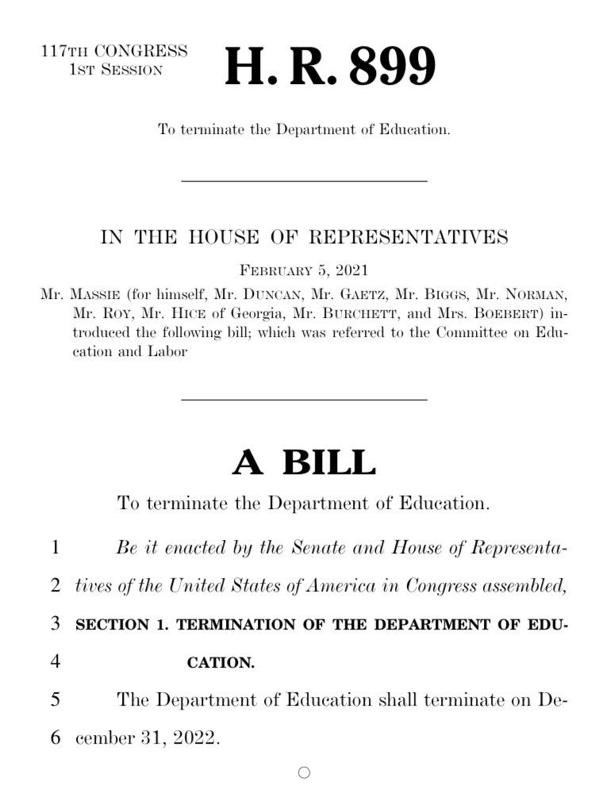
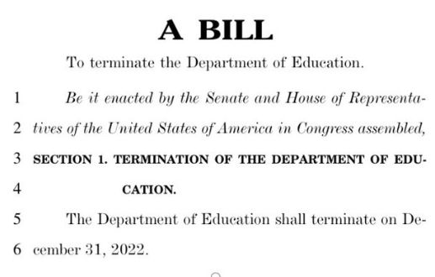
Thomas Massie Reintroduces Bill to Abolish the Department of Education
“The Department of Education shall terminate on December 31, 2026.”

Slide 44

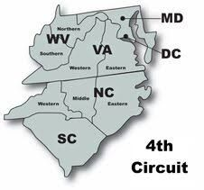
Buttressing of Non-profit Status
Significant angst surrounding rulings from California and Maryland Courts holding that 501(c)(3) status is federal financial assistance
The 4th Circuit and Arizona came through with rulings that 501(c)(3) status is not federal financial assistance

Slide 45


Buttressing of Non-profit Status
Florida Senator Marco Rubio – now Trump’s Secretary of State - introduced Safeguarding Charities Act
Difficulty getting bipartisan support for the Act
While there are still plenty of judges who could rule otherwise, we are hopeful that private schools are safe from this rollercoaster, at least for the next four years….

Slide 46


Slide 47

First Day in Office
Trump issued no less than 10 executive order related to immigration policy following Monday’s inauguration
Reinstated “Remain in Mexico” policy
  Requires asylum seekers to wait in Mexico while their US immigration cases are processed
Terminated asylum-related mobile app
  Ends use of app to schedule asylum appointments. Will further deter asylum seekers and likely reduce number of immigrants
Ended automatic birthright citizenship of children of undocumented immigrants
  Enjoined as running counter to 14th Amendment

Slide 48
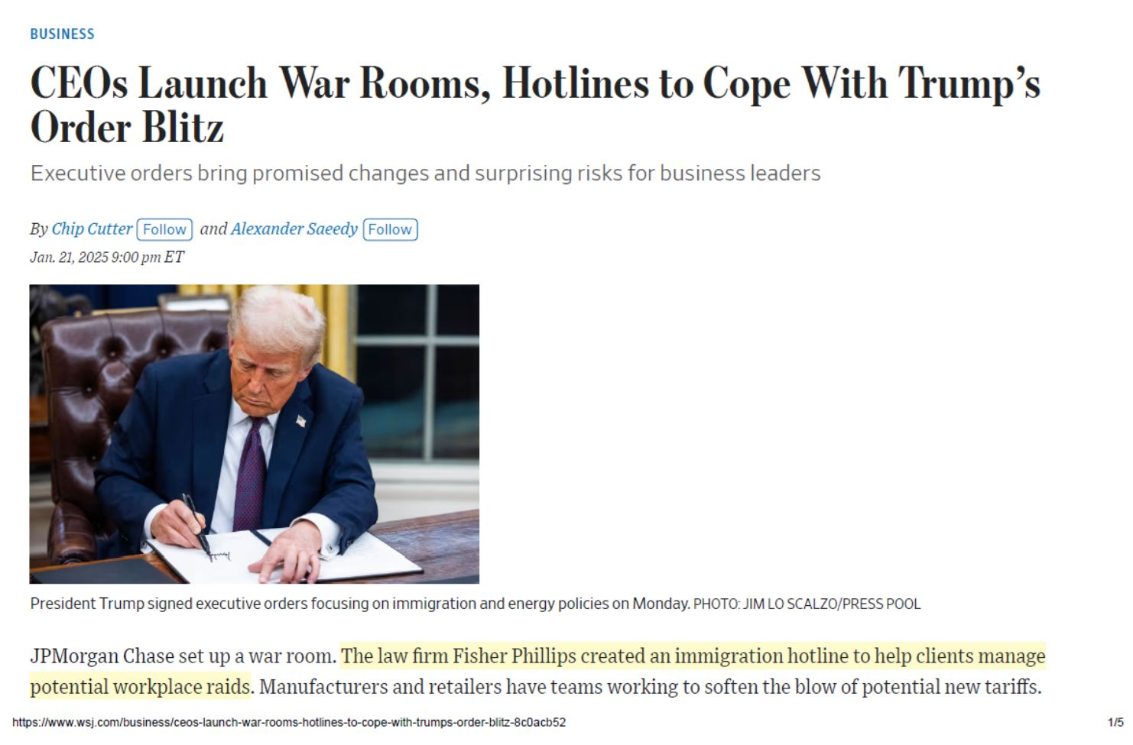
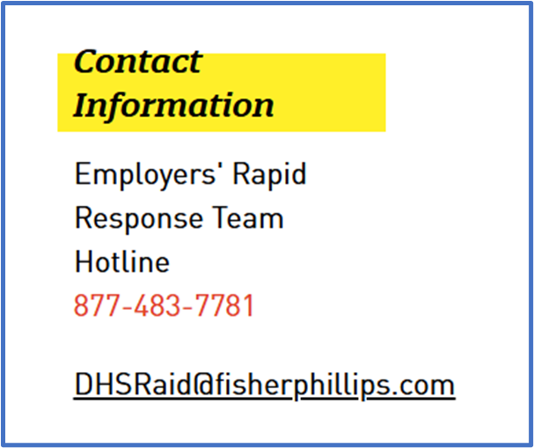

Slide 49
Immigration Compliance ICE Visits
Designate a trained “raid team” to handle ICE visits, including contacting immigration and employment counsel, monitoring compliance with warrants, and tracking actions taken by ICE agents. For more detail on these steps, read our full Insight on the steps you can take if subject to an audit or raid.
If subject to a DHS raid, contact Fisher Phillips’ new Employers' Rapid Response Team at (877) 483-7781 or DHSRaid@fisherphillips.com. While you can (and should) request and examine the warrant, don’t interfere with the raid in any way. You can monitor activities but avoid any activities that could be construed as harboring workers who don’t have proper documentation. Document any seized property or records and manage any public relations fallout.

Slide 50
Immigration Reform and Impact on Schools
The New Administration has pledged:
  Largest deportation operation in U.S. History
  End of Deferred Action for Childhood Arrivals (DACA)
  End of Temporary Protected Status (TPS) for several countries
Significant impact on schools, particularly student body
Currently schools can enroll K-12 students regardless of immigration status – unclear whether that will remain
Will we see movement towards using school enrollment as another “opportunity” to ask immigration status, similar to healthcare requirement in Texas?
Notes:
ALERT: Important Update on Deferred Action for Childhood Arrivals
On Jan. 17, 2025, the U.S. Court of Appeals for the Fifth Circuit issued a decision regarding the DACA Final Rule. Pursuant to the court’s order, USCIS will continue to accept and process DACA renewal requests and accompanying applications for employment authorization under the DACA regulations at 8 CFR 236.22 and 236.23. USCIS will continue to accept initial requests but will not process initial DACA requests at this time. Current grants of DACA and related Employment Authorization Documents remain valid until they expire, unless individually terminated.

Slide 51


AI Free Rein at the Federal Level
Trump revoked Biden’s AI Executive Order 14110 in his first week as part of pledge to embrace innovation
Keep an eye on restrictions and legislation at the state level
AI becoming a significantly more integral part of school curriculum and discipline
Learning together as we encounter things like AI created pornography and deepfakes of administrators and teachers
Review your policies and practices…and then review them again…and one more time because changes are happening constantly

Slide 52

Title IX
Biden Administration’s Title IX changes rescinded on Friday
DOE letter stated it was getting rid of discrimination protection for gender identity/sexual orientation and reverting to rules where “sex” means “objective, immutable characteristic of being born male or female.”
Title IX applies only to private schools if they receive federal financial assistance
Religious exemption under Title IX may be more favorably and broadly interpreted as they were under the New Administration
In the athletic arena – both under Title IX and otherwise – likely to see support for “original birth certificate” gender

Slide 53
Fewer Protections for Transgender Students
No federal protection for private school transgender students under any Presidential administration, other than at those schools subject to Title IX
Not going to happen under the New Administration
Know your state law protections – some apply to private schools
Watch for legislative changes at the state level as there is potential for proactive action
Anecdotally, more transgender students coming to private schools where they feel known and supported, even when they don’t necessarily always get exactly what they want

Slide 54

School Choice and Vouchers
The New Administration plans to push for vouchers
Voucher programs exist in 10 states and D.C.
Federal and state funding often brings non-discrimination obligations
Schools should consult counsel to evaluate legal risks and benefits before accepting vouchers

Slide 55
Joint Employment
The New Administration is expected to reinstate the joint employment test established in 2020, which makes it more challenging for plaintiffs to succeed in joint employment claims
This rule narrows the criteria for when an entity can be considered a joint employer, focusing on whether the employer directly controls the terms and conditions of employment
By rolling back changes made under the previous administration, this shift will likely lead to a more employer-friendly legal landscape in joint employment cases​

Slide 56
Overtime
The Biden administration sought to increase the minimum pay threshold for employees to be considered exempt from overtime laws.
A federal judge blocked that rule in November 2024.
The New Administration has not taken a position on the rule and has instead promised to eliminate federal income tax on overtime wages
It is wise to evaluate current classifications of all employees and assess whether they should be classified as exempt or non-exempt.

Slide 57

Non-Compete Agreements
In August 2024, a Texas federal court prohibited the rule from taking effect, and the FTC has appealed the decision to the Fifth Circuit.
FTC has appealed the decision to the Fifth Circuit.
Absent the FTC's non-compete ban, independent schools that utilize non-compete agreements and other restrictive covenants, such as student and employee non-solicitation agreements and confidentiality agreements, should ensure that they comply with applicable state law requirements.
Notes:
For example, most states impose requirements that such agreements are narrowly tailored to protect the school's legitimate business interests and are reasonable in geographic and temporal scope.

Slide 58

OSHA/Workplace Safety Updates
What Did Trump Do During His First Term?
  Cut inspections to lowest number in OSHA’s history
  Declined to issue COVID-specific protections
  Rescinded key electronic recordkeeping requirements
2025 Predictions – Chavez-DeRemer Influence?
    Scrap union walkaround rule?
    Enforce through OSH Act’s general duty clause?
    Scale back proposed heat safety rule and seek more employer input?
    Revisit electronic recordkeeping?

Slide 59
Relaxed Workplace Safety Measures
Rather than mandating specific standards for different categories of potential workplace danger, you can expect a Trump-led OSHA to enforce safety concerns using the OSH Act’s General Duty clause.
Expect to see the proposed heat safety rule that is slated to take effect as soon as 2025 scaled back dramatically or scrapped altogether.
Notes:
But you’ll still need to ensure compliance with workplace safety laws. Consider reviewing your inspection readiness and strengthening workplace violence prevention measures to make sure you are in the best possible position.

Slide 60

OSHA Updates
August 30, 2024: Proposed rule published in the Federal Register.
  Members of the public can submit comments for 120 days.
Early 2025: OSHA will take the comments into account and publish the rule in final form.
  Unclear what new administration will propose or if the rule will be on hold due to legal challenges.

Slide 61
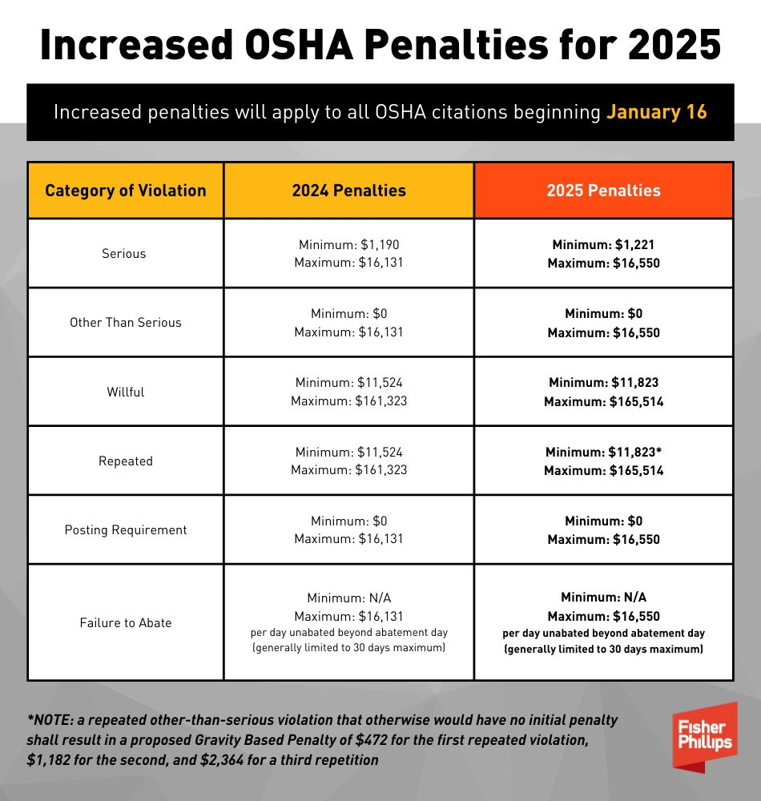
OSHA Updates
Increased OSHA Penalties
Department of Labor’s annual penalty increases went into effect January 16, 2025, including for employers who currently have an open inspection with the agency

Slide 62
Plan and Prepare
  How do these changes impact the way your school lives its mission strategically and practically?
  Strategize about how best to position your school legally
  Does the new Presidential Administration warrant any changes in how your school does its business (recruiting, marketing, framing, positioning)?
  Is there a way to leverage the change in the Administration?
  Set expectations early and often so families, students and employees can make informed decisions and know what to expect when tricky or divisive situations arise
  Educate your community about the school’s expectations of constituents

Slide 63

Self-Aware Reflection
  Review Data
  State, County, City
  Parent and/or Employee Surveys
  Applicant Feedback (student and employee)

Slide 64
We offer a variety of services to private and independent schools nationwide
Board governance and training
Contracts (e.g., employment, executives,
enrollment
and vendors)
Crisis management
Dispute resolution (discrimination charges, litigation, arbitration, mediation)
Employment matters
Governing Documents (bylaws, board policy manuals, and certificates of formation/articles of incorporation)
Handbooks – drafting, implementing and
enforcing policies governing employees and students
Head – Board Relationships
Immigration
Reporting obligations (federal/state, child abuse)
Enforcing guiding religious and/or [secular] tenets
Investigations (sexual misconduct, employee and/or student discipline)
Student discipline advice and training
Student & parent issues
Student affairs
Training and development (faculty and administration, diversity and inclusivity)
Benefits advice and plan creation
Wage Hour Audits/Advice​​​​​​​ … and more

Slide 65
Coming Soon…

Slide 66
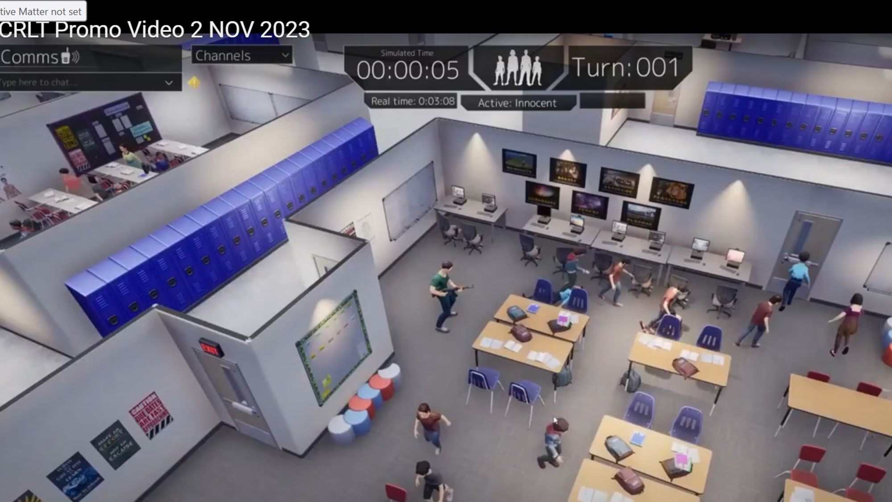

Slide 67
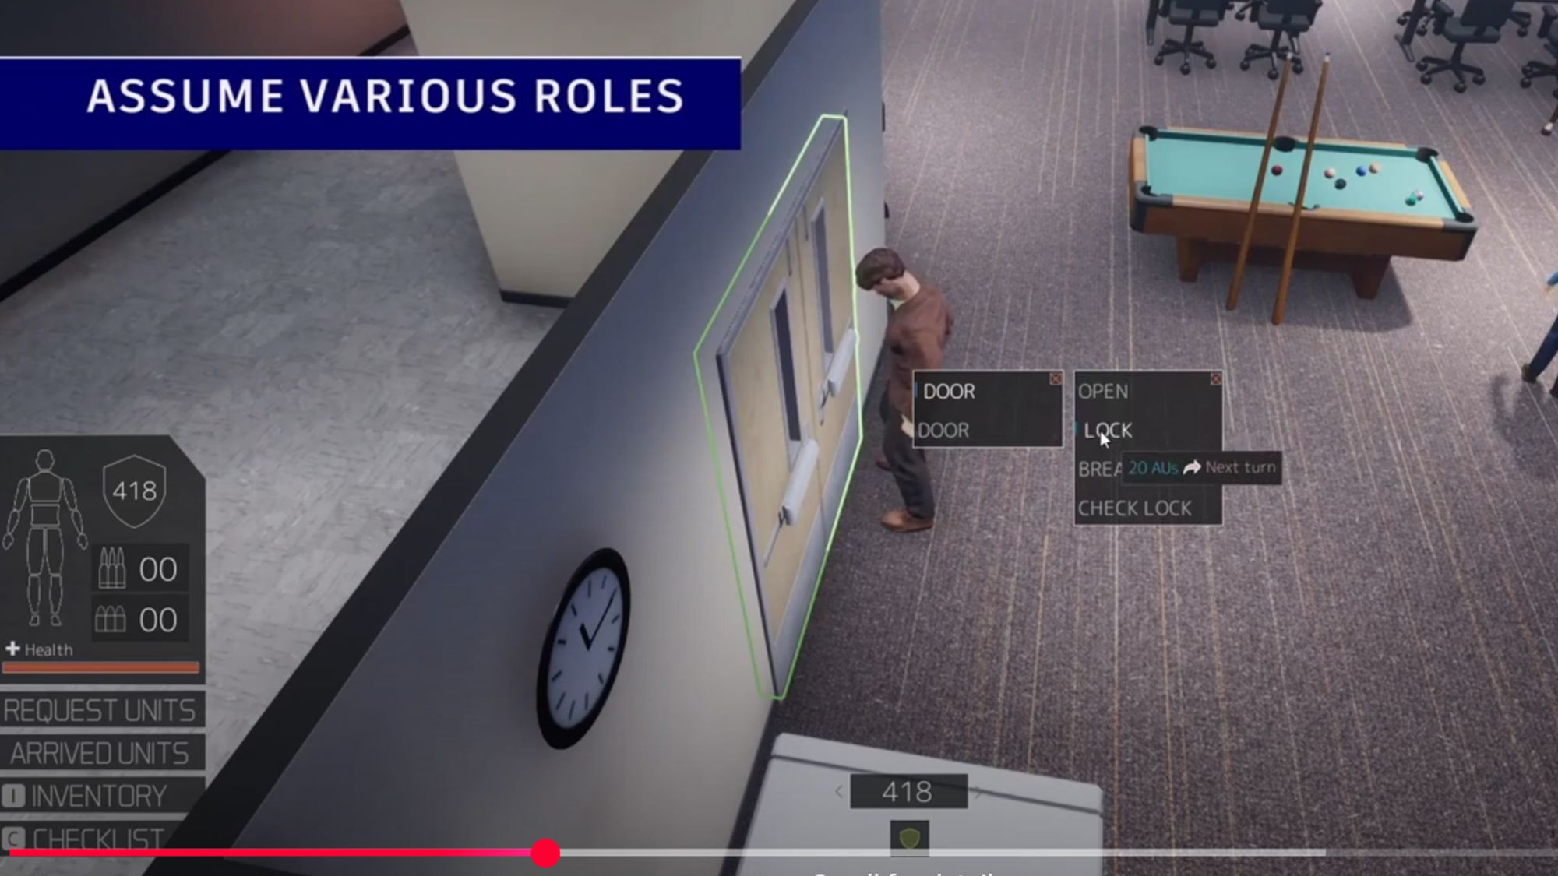

Slide 68
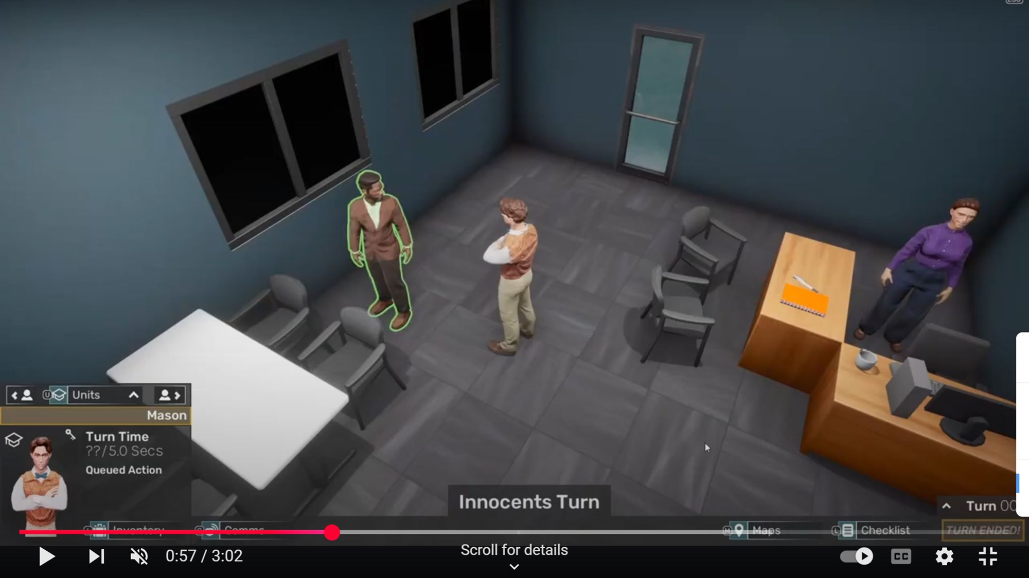

Slide 69
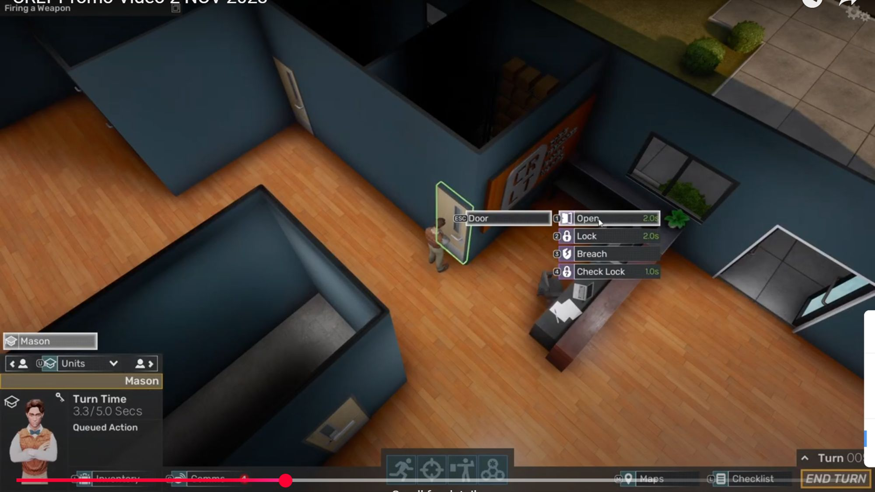

Slide 70
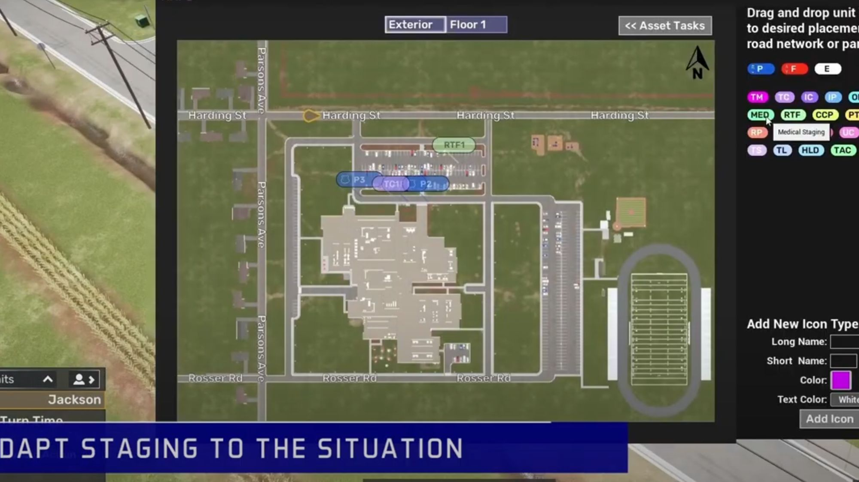

Slide 71
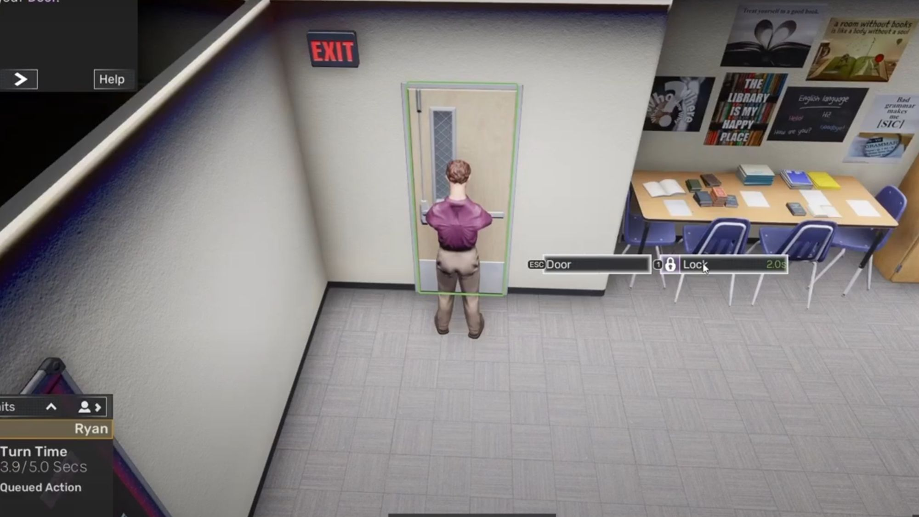

Slide 72
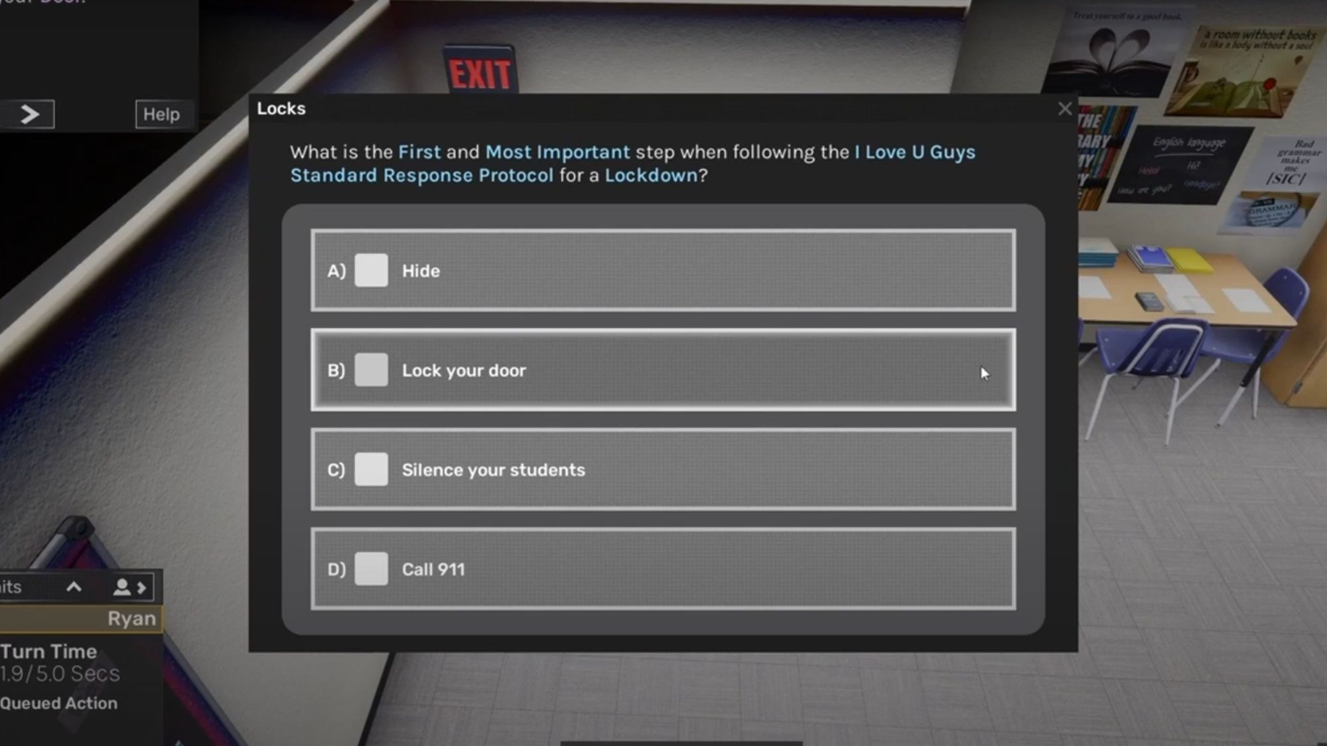

Slide 73
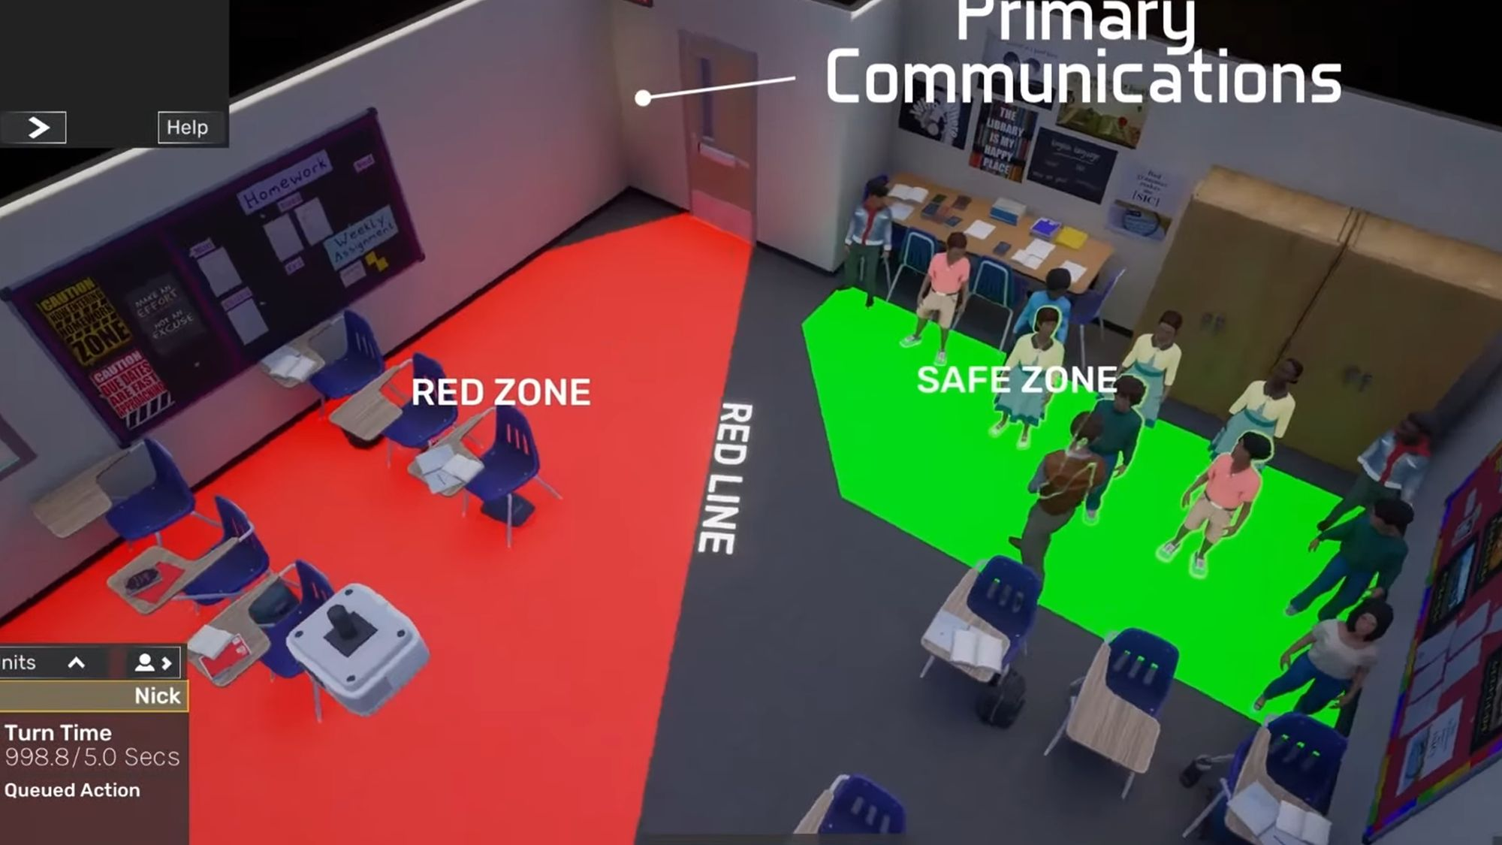

Slide 74
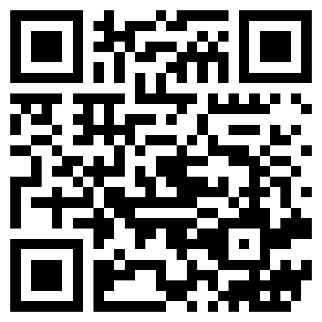

QUESTIONS?
THANK YOU!
SCAN QR Code to sign up for our Insights and events
Bryan Holbrook
bholbrook@fisherphillips.com
704.778.4173
FISHER PHILLIPS EDUCATION PRACTICE

